Slide 1


Slide 2

10- Day FREE Trial
To get started, simply follow these steps:
    1. Open your browser and go to estateview.link.
    2. Create an account.
    3. Select Pro Plus.
    4. Enter code “MARCH16”
    4. Fill in your information.
    5. Enjoy exploring EstateView!
To access our EstateView Video Library, which has instructional videos for each calculator, click here.

Slide 3

Go to estateview.link to use your free trial.

Slide 4

Friday, April 18th
12:00 PM ET
Monday, April 21th
12:00 PM ET
Wednesday, April 23rd
12:00 PM ET
1.0 Florida & New York CLE Credit & 1.0 Florida CPE Credit available

Slide 5
Topic Objectives
Asset Protection Definitions
Estate Planning Definitions
Florida Laws – The Most Generous in the United States
Firewall Protection
Equity Stripping – Reducing Exposed Assets with Preferred Creditors
Charging Order Entities
Foreign Companies and LLCs
Foreign and Delaware Accounts
For Children and Grandchildren
Life Insurance and Annuity Contracts
IRAs and Pensions
Homestead
Tenancy by the Entireties
Separate Community Property to Avoid All Assets Being Subject to the Claims of the Creditors of Either Spouse
Domestic Asset Protection Trusts
Foreign Asset Protection Trusts and Foundations
Charity
What to Do In The Next 30 Days

Slide 6
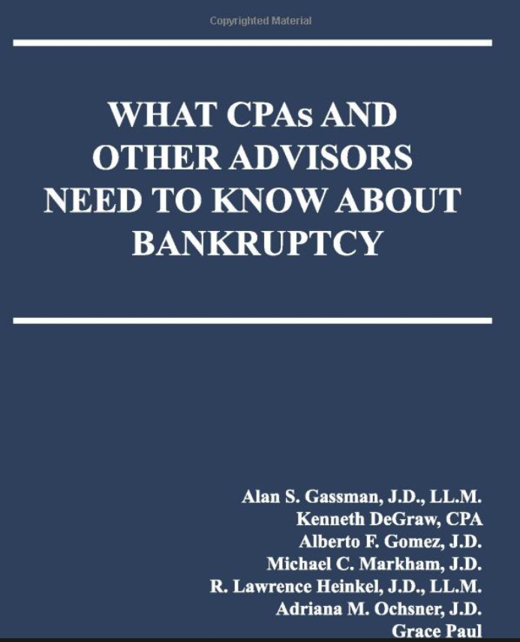
CLICK HERE TO PURCHASE ON AMAZON
WEALTH MANAGEMENT BOOK REVIEW: https://www.wealthmanagement.com/estate-planning/book-review-what-estate-planners-and-others-need-know-about-bankruptcy
Alexander A. Bove Jr. Oct 06, 2020
As a dedicated estate planner for more years than I care to admit, there’s been one subject that kept surfacing in my practice, then subsiding without leaving much information behind—that subject was bankruptcy and all its related issues. Not that the subject wasn’t important enough for me to research it, it’s just that it’s so specialized and arose so sporadically, it didn’t warrant taking a course in it or hitting any of the mass of heavy volumes on the subject. My own personal wish was, if only there was a manageable, authoritative reference I could use to answer some of the questions that advisors, estate planners in particular, typically confront; such as, what are the special fraudulent conveyance rules in bankruptcy? Can a bankruptcy trustee reach the assets clients place in children’s trusts? Are clients’ limited liability company interests protected in a bankruptcy? Are there some assets that are protected if a client later has to file for bankruptcy? Are there some transfers that are protected if a client later files for bankruptcy? What about asset protection trusts that a client establishes in a state like Delaware or South Dakota?
Answers to These Questions
Finally, there is such a work, just recently published, that addresses all of these and the numerous related questions. Attorney Alan Gassman, along with Alberto Gomez, Michael Markham, Adriana Ochsner and Lawrence Heinkel, have accomplished what might appear to be an impossible task: to analyze the numerous issues generated in a bankruptcy proceeding from a tax and estate-planning viewpoint, and they do it in about 150 pages.
Two of the more common issues planners typically face when a client faces or is contemplating a bankruptcy filing are the question of preferential transfers and exposure to fraudulent transfers. A preferential transfer is often distinguished from a fraudulent transfer on the basis that a fraudulent transfer by definition is one in which the client/transferor doesn’t receive fair value for the transfer. Clearly, an outright gift, for example, or the “sale” of a $50,000 asset for $7,500, would be a fraudulent transfer, but when a client pays off a legitimate $50,000 note due to his parents just months before filing bankruptcy, that’s what’s known as a preferential transfer, and as the Gassman group tells us, the bankruptcy court can order the parents to return the payment to the court to be counted with the client’s other assets. Thus, a planner’s advice to a client that he should pay off certain debts before filing would be bad advice and could result in a claim against the planner. But what if the client, who is about to file bankruptcy, owes fees to the planner. May these fees be paid before bankruptcy? According to the Gassman group, “reasonable compensation paid for services rendered will not be considered a preferential transfer, and so should be permitted,” but that rule probably wouldn’t apply, for example, to a previous outstanding debt to the planner.
The list of topics is exhaustive, and there are plenty of cites if one wishes to research the topic as well as a brief discussion of key cases on many issues. The book is truly unique in its practical and informative coverage of so many estate-planning points related to bankruptcy. I recommend it highly as a reference that belongs in every estate planner’s library.

Slide 7
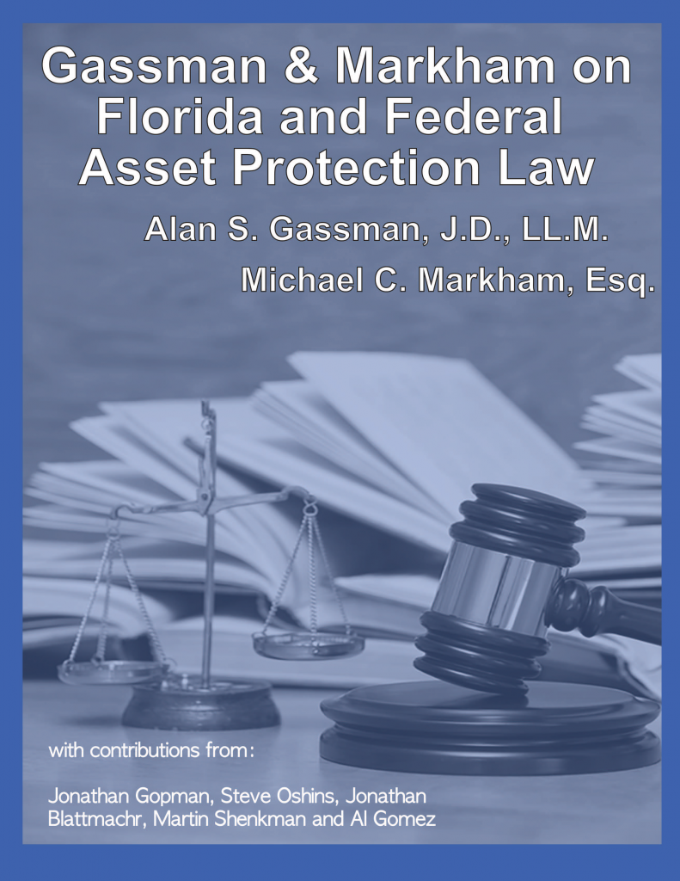
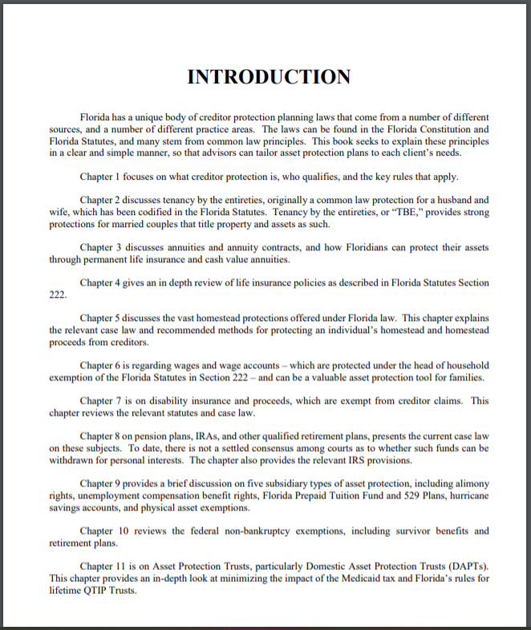


CLICK THIS LINK TO PURCHASE ON AMAZON.COM

Slide 8
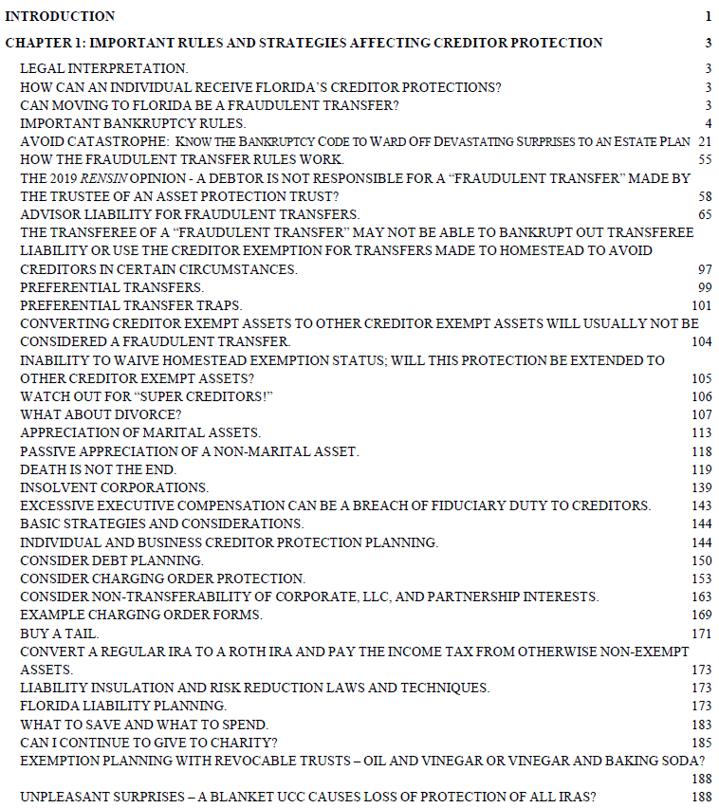
GASSMAN & MARKHAM ON FLORIDA AND FEDERAL ASSET PROTECTION LAW TABLE OF CONTENTS

Slide 9

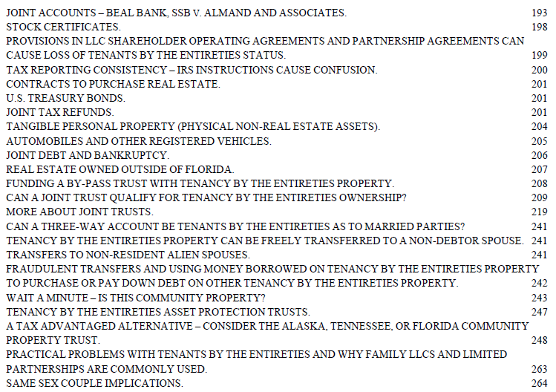
GASSMAN & MARKHAM ON FLORIDA AND FEDERAL ASSET PROTECTION LAW TABLE OF CONTENTS

Slide 10
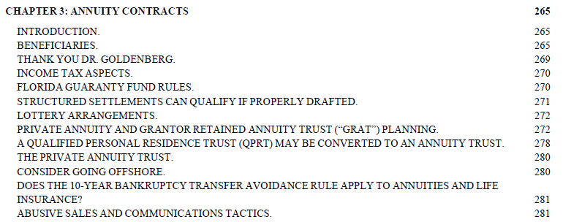

GASSMAN & MARKHAM ON FLORIDA AND FEDERAL ASSET PROTECTION LAW TABLE OF CONTENTS

Slide 11
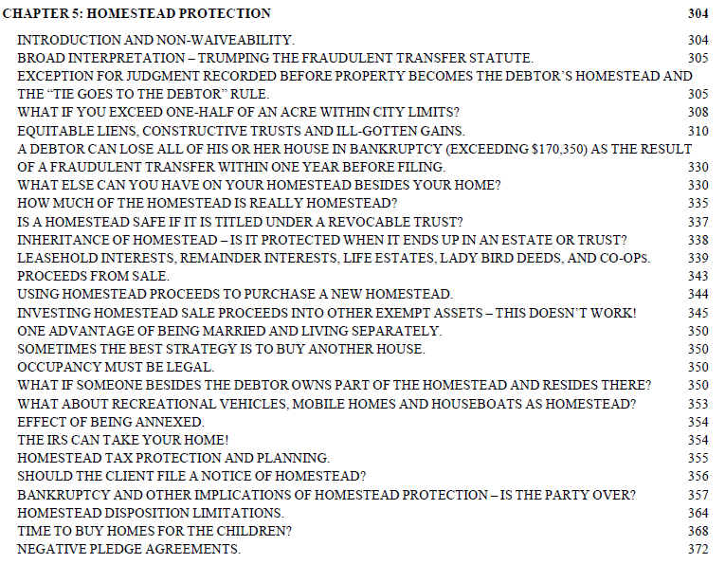
GASSMAN & MARKHAM ON FLORIDA AND FEDERAL ASSET PROTECTION LAW TABLE OF CONTENTS

Slide 12
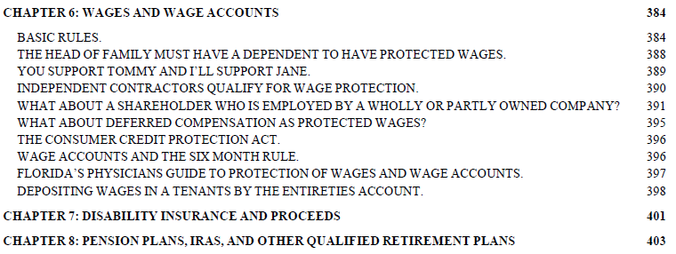
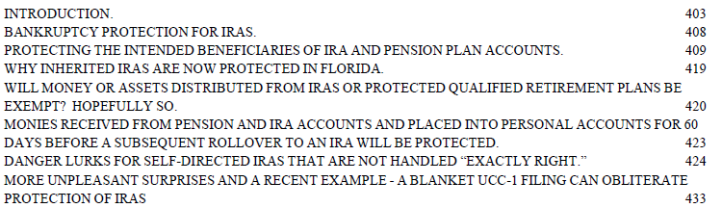
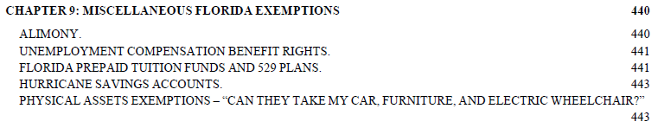
GASSMAN & MARKHAM ON FLORIDA AND FEDERAL ASSET PROTECTION LAW TABLE OF CONTENTS

Slide 13
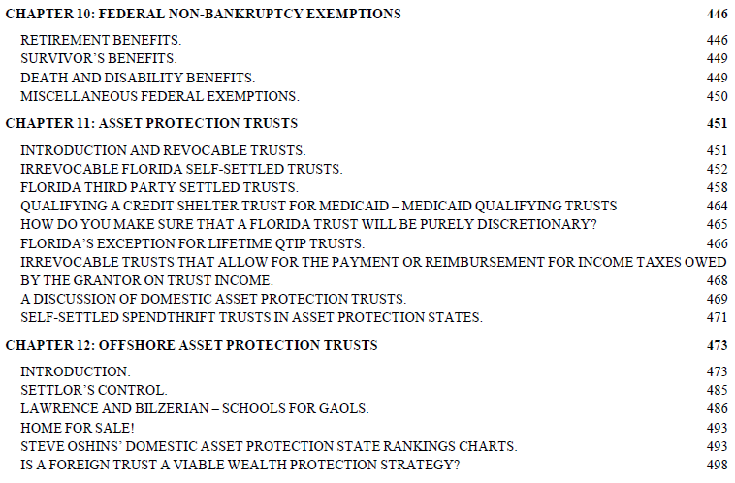

GASSMAN & MARKHAM ON FLORIDA AND FEDERAL ASSET PROTECTION LAW TABLE OF CONTENTS

Slide 14




Slide 15



Slide 16

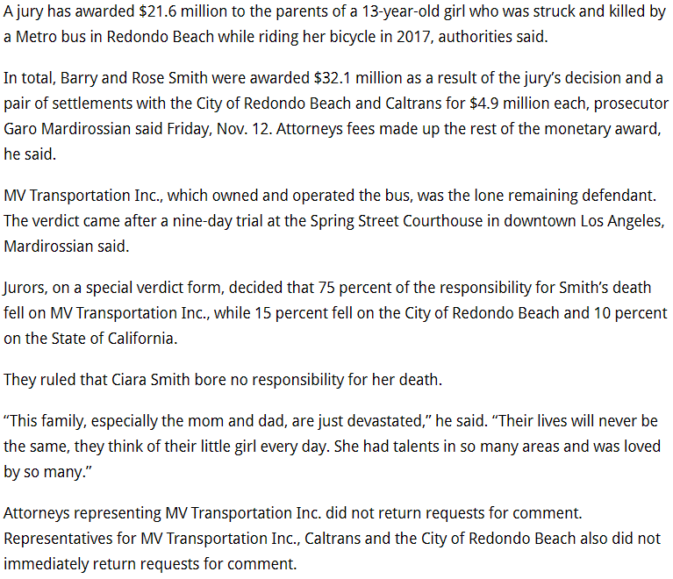
Smith V. MV Transportation

Slide 17


Giacalone v. Medic West Ambulance Inc.

Slide 18



Slide 19



Slide 20

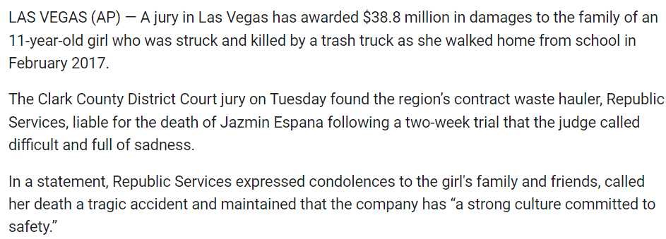

Slide 23
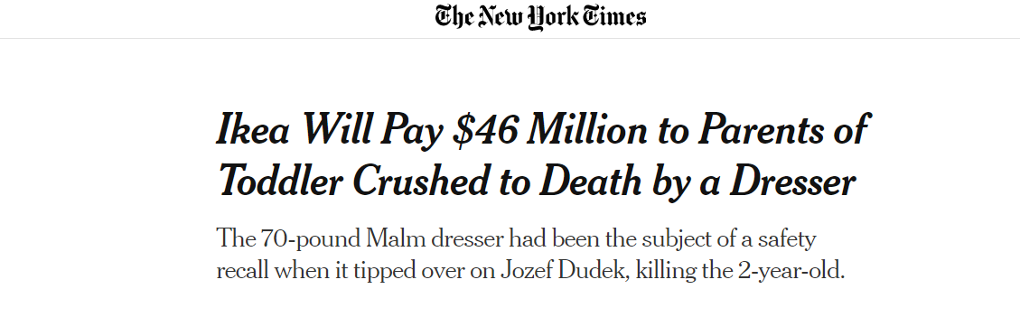

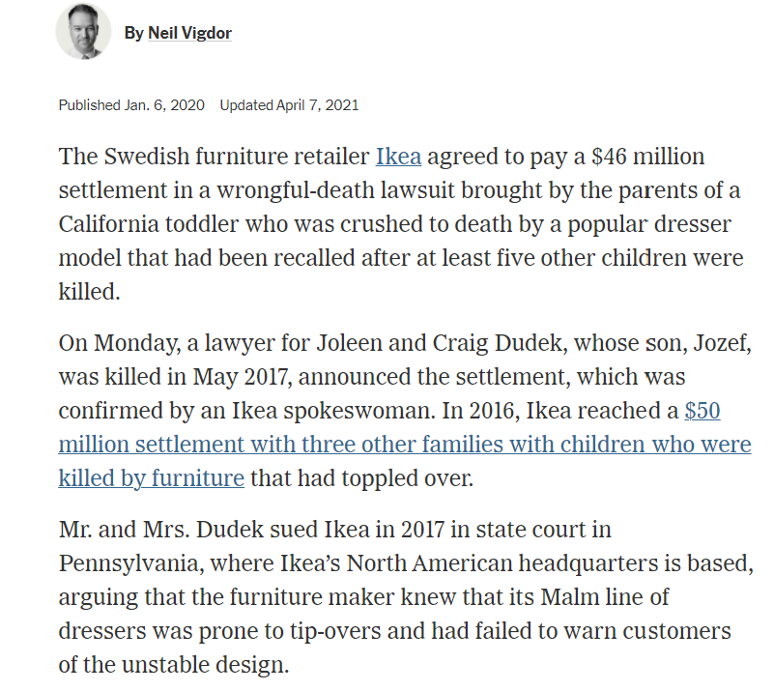

Slide 24


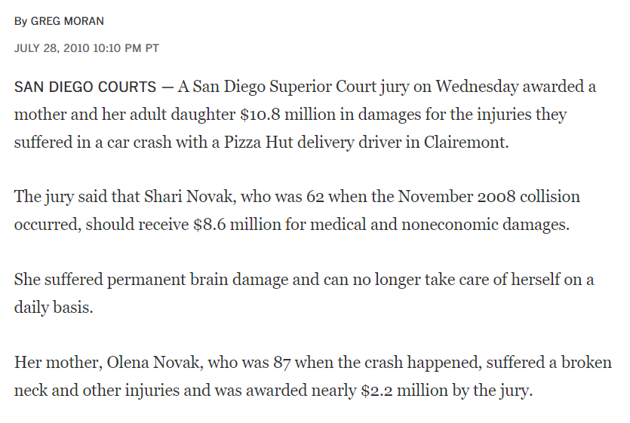

Slide 25
“It Wasn’t Raining When Noah Built The Ark.”

Slide 26
Asset Protection Definitions
To understand the subject of asset protection, you must speak the language. The following vocabulary and definitions will provide you with a basic understanding of the fundamental concepts which make up the “art and science” of Florida creditor protection planning.
Debtor - A party who owes money.
Creditor - A party who is owed money by the debtor.
Judgment - A court order establishing that a debtor owes money to a creditor. The existence of a judgment is almost always necessary before a creditor can seize a debtor’s property.
Plaintiff - A party suing to get a judgment against a defendant.
Defendant - A party being sued by a plaintiff.
Exempt Assets - Assets that are protected from seizure under the creditor laws. A debtor will be able to keep these assets notwithstanding that a creditor may have a judgment against them.
Non-Exempt Assets - Assets of a debtor that are subject to creditor claims.
Fraudulent Transfer - As explained in Chapter 14, this is the name given to a transfer of assets from a creditor available status to a creditor non-available status if a primary purpose was to avoid known creditors. Under federal and state law, such transfers may be set aside if the assets are within the jurisdiction of an applicable court making such a finding. Outside of Bankruptcy Court, Florida has a statute of limitations on the ability of a creditor to set aside a fraudulent transfer, which in many cases runs 4 years after the applicable transfer. This does not apply under Florida law to a transfer of assets to homestead. Under bankruptcy law, however, a discharge of debt can be denied if there has been a fraudulent transfer made within one year of the bankruptcy filing. Also, the homestead exemption may be limited to $136,875, if there has been a “fraudulent transfer” to homestead within 10 years of filing bankruptcy. There is also a 10 year set aside rule for “fraudulent transfers to asset protection trusts and similar arrangements” under the 2005 Bankruptcy Act. Oftentimes, clients will be advised to make transfers in exchange for receiving full value to avoid the fraudulent transfer rules while still making the resulting arrangement more creditor protective than it would have been.

Slide 27
Asset Protection Definitions
Joint and Several Liability - The concept that individuals who participate in a negligent or improper act will be totally liable for all damages imposed to the extent that the other “co-defendants” do not pay their fair share. There are limitations on joint and several liability pursuant to Florida Statute Section 768.81.
Vicarious Liability- The concept that an employer is generally responsible for liabilities incurred by an employee acting within the scope of the employee’s duties. The Greek term for this phenomenon is “respondeat superior.”
Under this concept, parents may be responsible for the driving activities of their nannies or errand runners, and doctors may be responsible for unforeseen actions by employees who might aggressively try to help people using prescription scripts, giving medical advice, and/or driving automobiles.
Secured Interest - The concept whereby a creditor can record a mortgage or lien on assets whereby that creditor would be entitled to repossess the assets and sell them at auction to satisfy a debt owed to the creditor. Real estate is liened by the recording of a proper mortgage, and non-real estate assets may be liened by recording UCC-1 Financing Statements based upon appropriately drafted security and/or pledge agreements. If a friendly debtor has a secured interest in a particular asset, then another debtor would have to pay the friendly secured debtor before they would be able to seize the asset secured. This is why doctors will often give the bank with a mortgage on business real estate a lien against medical practice assets, so that a malpractice claimant would have to pay the bank off or take other steps before seizing medical practice assets.
Marshaling of Assets - Whereby a party having a lien against assets may be forced to sacrifice their position if there are plenty of other assets that it has access to, to satisfy the obligation of the debtor. Over-secured creditor issues may also arise.
Asset Protection Trust - A trust arrangement whereby creditors of the grantor may not have access – which is contrary to Florida and basic common law that if the grantor could receive any benefit whatsoever, then creditors may receive all assets.
Bad Faith – In most states an insurance carrier has an obligation to settle any claim within the limits of coverage of the physician, if reasonably possible. The failure of an insurance carrier to settle within policy limits can result in the carrier being responsible for an “excess verdict.” When this occurs, the plaintiff’s lawyer will often settle with the defendant by receiving an assignment of the defendant’s right to pursue the insurance carrier for the excess amount.

Slide 28
Asset Protection Definitions
If the carrier believes it has a 90% chance of winning at trial and a 10% chance of losing with a verdict well over policy limits, then it may make good economic sense for the carrier to take the chance, but not from the point of view of the physician. If the carrier takes the chance then if it has acted in bad faith it will be responsible for any excess verdict. Private legal counsel is commonly hired to encourage the carrier to settle within policy limits, and a physician should almost never encourage a carrier not to settle or be without private representation when the carrier or its lawyer recommends private representation! Fortunately, most verdicts exceeding coverage limits result in the physician assigning their bad faith claim to the plaintiff in exchange for a total release, particularly where the physician is otherwise judgment proof.
Automobile Liability – The owner of a motor vehicle in Florida is liable for operation of the vehicle by another driver, except that if the other driver has insurance then the owner’s exposure may be limited to $300,000 per incident. If the driver has $500,000 of liability insurance, then the owner may not have liability exposure, unless the owner was negligent in allowing the driver to use the vehicle.
Sovereign Liability - The concept whereby an individual working for a governmental agency and the agency itself has limited liability, presently being $250,000 per incident. This applies to a physician working full time for public hospitals, medical schools, and the Veteran’s Administration.
Successor Liability - When a corporation has a liability and a “successor corporation” has identical or similar ownership, identity, customers, employees and/or general identity, a judge may find the new company responsible for the liabilities of the old company, even if there was a legitimate bankruptcy of the old company before the new company was formed and operational.
Reverse Veil Piercing - When a court unwinds transfers made to entities where the transferor is a debtor that had control over the entity, and used the entity to disguise personal assets to keep them beyond the reach of personal creditors.
Concealment - Under the doctrine of concealment an asset “given away” but actually held for the original transferor will be considered as continually owned by the original transferor, notwithstanding title. Concealing assets puts the debtor at risk for losing a bankruptcy discharge.
How to Stop Worrying and Start Living- A book written by the late Dale Carnegie, which includes phenomenal advice on how to counsel for and live with concerns about what may happen in the future, what can be done about these potential future problems, and how to handle oneself and others in a logical, sequential, and effective manner.

Slide 29
Discussion of attorney client privilege and the anomaly thereto under the crime fraud exception.

Slide 30
Florida Laws – The Most Generous In The United States
CREDITOR EXEMPT ASSETS | ASSETS THAT ARE DIFFICULT FOR A CREDITOR TO OBTAIN | ASSETS EXPOSED TO CREDITORS
Homestead -Up to half acre if within city limits. -May be immune from fraudulent transfer statute. | Limited partnership and similar entity interests. | Individual money and brokerage accounts.
IRA -Includes ROTH, Rollover, and Voluntary IRAs, but possibly not inherited IRAs. | Foreign trusts and companies. | Joint assets where both spouses owe money.
Permanent Life Insurance -Must be owned by insured. | Note – foreign entities are very rarely recommended and must be reported to IRS - | Personal physical assets, including car, except for $4,000 exemption ($1,000 if homestead exemption is claimed in bankruptcy).
401(k) -Maximize these! | Foreign bank accounts. | One-half of any joint assets not TBE where one spouse owes money.
Tenancy by the Entireties (joint where only one spouse is obligated) - Must be properly and specially titled – joint with right of survivorship may not qualify. | Vocabulary: EXEMPT ASSET – An asset that a creditor cannot reach by reason of Florida law – protects Florida residents. CHARGING ORDER PROTECTION – The creditor of a partner in a limited partnership, limited liability limited partnership, or properly drafted LLC can only receive distributions as and when they would be paid to the partner. FRAUDULENT TRANSFER - Defined as a transfer made for the purpose of avoiding a creditor. Florida has a 4 year reach back statute on fraudulent transfers. A fraudulent transfer into the homestead may not be set aside unless the debtor is in bankruptcy. It takes 3 creditors of a debtor who has 12 or more creditors to force a bankruptcy. Upon filing a Chapter 7 Bankruptcy, an individual debtor may be able to cancel all debts owed and keep exempt assets, subject to certain exemptions. Annuities and life insurance policies are not always good investments, and can be subject to sales charges and administrative fees. There is a lot more to know- but this chart may be a good first step.
529 College Savings Plans
Annuity Contracts
Wages of Head-of-Household
Wage Accounts (for 6 months)
Up to $4,000 of personal assets – or possibly less in bankruptcy.

Slide 31
DETERMINING HOW TO BEST ALLOCATE ASSETS AS BETWEEN A MARRIED COUPLE - PART I
General Rules:
Typically want each trust funded with at least $11,200,000 worth of assets on death for estate tax planning.
May be funded from ½ of tenancy by the entireties assets via disclaimer and probate or by life insurance/pension/IRA assets.
Spouse 1
Spouse 2
Trustee other than Spouse 1 or Spouse 2
Spouse 2 could be Trustee if Spouse 1 is sole grantor (or vice versa)
Protected life insurance and annuity contracts “owned by the insured.”
Spouse 1’s Revocable Trust
Spouse 2’s Revocable Trust
Gifting Trust (Irrevocable)
Lifetime By-Pass Trust (Irrevocable)
FLORIDA TBE
(Tenancy by the Entireties)
Assets held directly by revocable trust are subject to Spouse 1’s creditor claims.
Direct ownership of limited partnership or LLC not in TBE may have charging order protection (meaning that if a creditor obtains a lien on the limited partnership or LLC, the Spouse 1 cannot receive monies from the limited partnership or LLC without the creditor being paid).
Only exposed to creditors if both spouses owe the creditor, if one spouse dies and the surviving spouse has a creditor, the spouses divorce, or state law or the state of residence changes.
2. On death of one spouse, surviving spouse may disclaim up to ½ (if no creditor is pursuing the deceased spouse) to fund By-Pass Trust on first death.
Safe from creditors of Spouse 1 but exposed to creditors of Spouse 2 (Maintain large umbrella liability insurance coverage to protect these assets.)
On Spouse 2’s death, can be held under a protective trust, which will continue to be safe from creditors of Spouse 1, subsequent spouses, and “future new family.”
Safe from creditors of both spouses.
If divorce occurs, should not be subject to rules for division of property between spouses.
May be controlled by the “entrepreneurial spouse” by using a Family Limited Partnership.
1. Safe from the creditors of the Grantor’s spouse.
2. If funded by one spouse, may benefit other spouse and children during the lifetime of both spouses.
3. Otherwise can be identical to gifting trust pictured to the left.
SEE NEXT PAGE FOR SECOND TIER PLANNING
A COMMON SOLUTION - to use a limited partnership or similar mechanisms and have no assets directly in the “high risk” spouse’s trust, half to two-thirds of the assets held as tenants by the entireties, and half to two-thirds of the assets directly in the “low risk” spouse’s trust.

Slide 32
DETERMINING HOW TO BEST ALLOCATE ASSETS AS BETWEEN A MARRIED COUPLE - PART II
Subsidiary Entity Techniques:
Limited partnerships and LLCs can be used to facilitate discounts, for estate tax purposes, and for charging order protection.
Limited partnerships and LLCs can also be used to provide “firewall protection” from activities or properties owned.
Spouse 2 could be Trustee if Spouse 1 is sole grantor (or vice versa)
Spouse 1
Spouse 2
Trustee other than Spouse 1 or Spouse 2
Spouse 1’s Revocable Trust
Spouse 2’s Revocable Trust
Gifting Trust (Irrevocable)
Lifetime By-Pass Trust (Irrevocable)
FLORIDA TBE
(Tenancy by the Entireties)
Assets held directly by revocable trust are subject to husband’s creditor claims.
Direct ownership of limited partnership or LLC not in TBE may have charging order protection (meaning that if a creditor obtains a lien on the limited partnership or LLC, the Spouse 1 cannot receive monies from the limited partnership or LLC without the creditor being paid).
Only exposed to creditors if both spouses owe the creditor, if one spouse dies and the surviving spouse has a creditor, the spouses divorce, or state law or the state of residence changes.
2. On death of one spouse, surviving spouse may disclaim up to ½ (if no creditor is pursuing the deceased spouse) to fund By-Pass Trust on first death.
Safe from creditors of Spouse 1 but exposed to creditors of Spouse 2 (Maintain large umbrella liability insurance coverage to protect these assets.)
On Spouse 2’s death, can be held under a protective trust, which will continue to be safe from creditors of Spouse 1, subsequent spouses, and “future new family.”
Safe from creditors of both spouses.
If divorce occurs, should not be subject to rules for division of property between spouses.
May be controlled by the “entrepreneurial spouse” by using a Family Limited Partnership.
1. Safe from the creditors of the Grantor’s spouse.
2. If funded by one spouse, may benefit other spouse and children during the lifetime of both spouses.
3. Otherwise can be identical to gifting trust pictured to the left.
SECOND TIER PLANNING:
97%
3%
1%
96%
3%
Spouse 1, Manager
100%
LLC
LLC
FIREWALL LLC
LLC
Property or activity
Leveraged Investment
A COMMON SOLUTION - to use a limited partnership or similar mechanisms and have no assets directly in the “high risk” spouse’s trust, half to two-thirds of the assets held as tenants by the entireties, and half to two-thirds of the assets directly in the “low risk” spouse’s trust.

Slide 33
Protective Trust Logistical Chart
Life Insurance Trust
(Irrevocable and Owns Life Insurance on First Dying Spouse)
During both spouse’s lifetimes:
First Dying Spouse’s
Revocable Trust
Surviving Spouse’s
Revocable Trust
Upon first death in 2025:
$13,990,000*
Remaining Assets
During surviving spouse’s remaining lifetime:
Held for Surviving Spouse & Children
Family
(By-Pass)
Generation Skipping Trust
(Not taxed in surviving spouse’s estate)
QTIP Non-GST Trust
(Marital Deduction Trust that is not generation skipping)
Surviving Spouse’s Revocable Trust
(Will include assets owned jointly on first death)
Surviving spouse can have the right to redirect how assets are distributed on second death.
$6,500,000?
$15,000,000
Who knows?
Remaining Assets
Upon second death:
May be Generation Skipping to be held as Separate Trusts for Children
Generation Skipping Trusts for Children
Children’s Trust (or distributions)
Generation Skipping Trusts for Children
(Will merge with first dying spouse’s Generation
Skipping Trusts shown on left)
Children’s Trust (or distributions)
After deaths of both spouses:
Benefits children and grandchildren.
Not estate taxable in their estates.
Benefits children.
Taxable in their estates.
Benefits children and grandchildren.
Not estate taxable in their estates.
Benefits children.
Taxable in their estates.
*Assumes first spouse dies in 2025 when the exemption is $13,990,000, and that the surviving spouse dies in a later year when the estate tax exemption has gone up to $6,500,000 (based upon CPI increases). The estate tax exemption is $13,990,000 , less any prior reportable gifts, for those that die in 2025, and increases with the Consumer Price Index in $10,000 increments.
If the first spouse does not use the entire exemption amount, what remains may be added to the surviving spouse’s allowance under the “portability rules” but will not grow with inflation, and will be lost if the surviving spouse remarries and the new spouse dies first, leaving no exemption.

Slide 34
Revised Protective Trust Logistical Chart with Clayton QTIP
During both spouse’s lifetimes:
First Dying Spouse’s
Revocable Trust
Surviving Spouse’s
Revocable Trust
Upon first death in 2025:
$13,990,000*
Remaining Assets
During surviving spouse’s remaining lifetime:
Family
(By-Pass)
Generation Skipping Trust
(Not taxed in surviving spouse’s estate)
QTIP MECHANISM
QTIP Non-GST Trust
(Marital Deduction Trust that is not generation skipping)
Surviving Spouse’s Revocable Trust
(Will include assets owned jointly on first death)
Surviving spouse can have the right to redirect how assets are distributed on second death.
The assets in the Clayton QTIP would be includable in the surviving spouse’s gross estate, but the surviving spouse can use some of his or her DSUEA, and could make a “reverse QTIP election” to utilize any portion of the first dying spouse’s unused GST exemption.
$6,500,000?
$15,000,000?
Who knows?
Remaining Assets
Upon second death:
Generation Skipping Trusts for Children
Children’s Trust (or outright distributions)
Generation Skipping Trusts for Children
(Can merge with first dying spouse’s Generation Skipping Trusts shown on left)
Children’s Trust (or outright distributions)
After deaths of both spouses:
Benefits children and grandchildren.
Not estate taxable in their estates.
Benefits children.
Taxable in their estates.
Benefits children and grandchildren.
Not estate taxable in their estates.
Benefits children.
Taxable in their estates.
*Assumes first spouse dies in 2025 and that the surviving spouse dies in a later year when the estate tax exemption has gone up to $6,500,000,000 (based upon CPI increases). The estate tax exemption is $13,990,000 for those that die in 2021, and increases with inflation in $10,000 increments.
If the first spouse does not use the entire exemption amount, what remains may be added to the surviving spouse’s allowance under the “portability rules” but will not grow with inflation.

Slide 35
PROTECTING THE PROCEEDS FROM THE SALE OF A HOMESTEAD FROM CREDITORS
FROM HOMESTEAD SALE DIRECTLY INTO A NEW REPLACEMENT HOMESTEAD – Florida law will allow the proceeds of a sale of homestead to be held in a specially labeled account, and then invested in a new homestead within a reasonable period of time with continued protection.
FROM HOMESTEAD TO OTHER EXEMPT ASSETS – Unfortunately, homestead is the one exempt asset that cannot be transferred into another type of exempt asset due to an error by the Florida Supreme Court.
However, it is permissible to borrow on a protected homestead and transfer the proceeds to another exempt asset without this being considered to be a fraudulent transfer.
Notes:
35

Slide 36

Marital Asset Preservation System (MAPS)
SPOUSE 2
SPOUSE 1
Thanks for visiting...hope to see you soon!
A required contribution to an asset protection trust by Spouse 2 after death of Spouse 1 is not for the primary purpose of avoiding creditors of Spouse 2.
ASSET PROTECTION TRUST
(In Asset Protection Jurisdiction)
Spouse 1 dies. Spouse 2 is required by written agreement to establish asset protection trust in asset protection jurisdiction with all unprotected assets, and contractual obligation to preserve these for common descendants. A standby unsigned, but trust company approved, Trust Agreement can be approved by both spouses during lifetime of Spouse 1 and/or nominally funded.

Slide 37
Marital Asset Preservation System (MAPS)
One of the primary purposes for utilizing the Marital Asset Preservation System (“MAPS”) is to ensure that married couples keep their marital assets in the family for generations to come. In general, conscientious estate and tax planners will do their very best to meticulously plan and preserve assets for a surviving spouse, while also enabling the surviving spouse to leave assets to common descendants of the decedent, and with the minimal amount of taxes and probate expenses.
However, there is one question that is routinely left out of the discussions between married couples and estate planners during the planning process:
Would you like some assurance that your marital assets will only pass to your common descendants upon the death of the survivor of you?
The answer to this question is usually a resounding “yes”, and as such, requires the surviving spouse to protect the marital assets by not allowing them to be left to a subsequent spouse or some other future significant other.
That answer leaves the estate planner with some rather intricate issues and challenges, not to mention more work and an added layer of complexity to design and implement the various trust systems and strategies to be used.
Once the clients have decided that this is the right strategy for them, the planner must explain that upon the death of one spouse, the surviving spouse may serve as Trustee or Co-Trustee of one or more irrevocable trusts, with the power to change the trusteeship within pre-agreed parameters. These irrevocable trusts may only allow the surviving spouse to have access to assets and monies as needed for the spouse to maintain the standard of living that has been enjoyed during the marriage, and to provide support for common descendants. There are several restrictions that can be placed on a surviving spouse, one of which is to allow them to only make distributions outside of the family based upon an annual allowance that might be used for charity, religious organization dues and donations and gifts to friends based upon guidelines that can be set forth in the documents.
There can also be limitations placed on how much compensation might be paid to third parties for services like housekeeping, nursing, private lessons, personal trainers and otherwise. There can also be limited access for charity, church or synagogue donations, and other defined causes.
An Ability to Provide Limited Benefits and Compensation to a Subsequent Spouse.
While it is commonly assumed that the “next spouse” might threaten to deprive descendants of marital wealth, and might place the surviving spouse in jeopardy of losing assets that would be needed for his or her well-being, there is also the possibility that the subsequent spouse will contribute meaningfully both to the preservation and enhancement of marital assets, and with respect to providing care and support for the surviving spouse. It could be both unfair and counterproductive for the surviving spouse to not be able to allow a subsequent spouse to contribute meaningfully to marital assets, and to be compensated for providing necessary services, whether personal, nursing, or managerial, where this is clearly in the best interests of the surviving spouse, and possibly one or more of the descendants of the original marriage.
For this reason, the authors also provide that the MAPS Agreement or system may be amended by one or more of the adult descendants of the original couple, and/or an independent Trust Protectors or other advisors, to take into account appropriate circumstances and formal requests for changes.
The above normally fits well and naturally under a credit shelter/marital deduction trust arrangement that will typically be established on the death of a first dying spouse where federal estate tax is a possible concern, but quite often a good many assets will be owned outright by the surviving spouse or jointly with right of survivorship, and IRA and qualified retirement plans are typically best left to a surviving spouse to enable postponement of having to take taxable distributions.
The planner must therefore explain that those assets that are not naturally captured under a trust system on the first death of a spouse will need to be either: (1) contributed to a trust system by the surviving spouse, as encouraged or required by planning documents, and possibly a Marital Asset Preservation System (MAPS) Agreement; or (2) have the surviving spouse contractually bound by a MAPS Agreement requiring them to maintain existing marital assets, and any income derived from those assets for the surviving spouses life, and also direct that those assets be left for only common descendants upon the surviving spouse’s death.
The author commonly uses one or both of these alternatives. These techniques are often coupled with carefully drafted trust provisions, as well as an explanation in the trust document to ensure that every possible step is satisfied and that the MAPS objectives are met.
One issue for couples having more than the $22,800,000 exemption level situation, or expectation thereof, is whether limitations placed on inherited assets would cause loss of the federal estate tax marital deduction and consequent income tax to be paid on the first death. Each individual presently only has a $11,400,000 estate and gift tax exemption amount, which must be considered. This issue is especially important when the surviving spouse is contractually bound to preserve and leave the assets for subsequent descendants, as opposed to receiving the assets as the sole owner without any legal entanglements.
Generally, there is no marital deduction allowed for dispositions that do not at least allow the surviving spouse to have all income from marital deduction trust property and to be the sole beneficiary of a trust holding such property for his or her lifetime. A marital deduction may also not be received for assets that are paid outright to a surviving spouse who has significant contractual limitations on what he or she is able to do with the property.

Slide 38
Marital Asset Preservation System (MAPS)
In states that do not recognize community property, most planners will use separate revocable trusts for affluent husbands and wives for estate planning, because of established customs and the complexities associated with using joint trusts. In such situations, it is possible to have the revocable trust of the surviving spouse become irrevocable upon the death of the first surviving spouse. For purposes of federal estate and gift taxes, this event will be considered an incomplete gift because it provides the surviving spouse with the right to veto payments to any person other than the surviving spouse during their remaining lifetime, and the power to appoint trust assets to common descendants of the married couple.
Alternatively, in states that do recognize community property, we find that joint trusts are becoming more prevalent.
An objective for many estate and tax planners, regardless of the state in which they live, is to have the first dying spouse’s death cause a step-up in the income tax basis to a fair market value for any and all family assets. This strategy should be utilized to the extent that the family would benefit from having an increased basis, which would essentially take any property that appreciated during the decedent’s lifetime and provide the surviving spouse with the ability to not recognize any gain on such property when they come into possession.
Many planners in non-community property states are using Joint Exempt Step-Up Trusts (“JEST”), which may enable clients to receive this stepped-up basis on all joint trust assets upon the death of the first dying spouse. When the first spouse dies, assets held by the joint trust are used to fund a credit shelter trust for the benefit of the surviving spouse and descendants. These assets now held by the credit shelter trust will receive a full step-up in basis, and escape tax liability upon the surviving spouse’s death.
Life insurance can also be integrated into the arrangement by having the death benefit payable to an irrevocable trust, which may be a separate trust that owns the policy so as not to be subject to federal estate tax on the death of the first dying spouse.
^{Waiver of Marital Rights.}
Most states have statutes which provide a surviving spouse with a minimal outright disposition, most commonly known as the Elective Share. In addition, some states provide a surviving spouse with homestead inheritance and other rights which may be waived during the estate planning process while both spouses are living.
The estate planner will have to be very careful with respect to disclosing conflict of interest issues and evaluating whether one or both spouses should be required, or at least strongly urged, to seek independent legal counsel before being legally bound to have limited access and control to marital and inherited assets after the death of one spouse. In the event that a conflict of interest does arise, the estate planner should withdraw and require the spouses to retain separate counsel. Furthermore, because the planner represented both spouses, they are prohibited from representing either one of them against the other, even with informed consent.
ABA-Model Rule 1.7 addresses the rules for Current Client Conflicts of Interest. In essence Rule 1.7(a)(1) states that, a lawyer shall not represent a client if representing one client will be directly adverse to another client. However, this Rule is not an absolute bar to representing a client when there is a conflict. Subsection (b) provides that a lawyer may represent a conflicted client if (1) they believe they can provide competent representation; (2) it is not prohibited by law; (3) it does not involve one client asserting a claim against another client, both of whom are represented by the lawyer; and (4) each client gives informed consent. In the context of marital inheritance, subsection (b)(3) will almost always bar the attorney from representing one client over another, even with informed consent.

Slide 39
Example of Spouse 1/Spouse 2
Dynasty Trust Arrangement
SPOUSE 1
SPOUSE 2
Spouse 2 is Trustee
SPOUSE 1
REVOCABLE TRUST
SPOUSE 2 REVOCABLE TRUST
DYNASTY TRUST
Other Assets?
1% GP
99% LP
FAMILY
LIMITED PARTNERSHIP
1. Investments controlled by Spouse 1 as GP of Limited Partnership.
2. Spouse 1 can replace the Trustee of the Dynasty Trust.
3. Dynasty Trust can be used for Spouse 2 and descendants as needed for health, education and maintenance.
4. Dynasty Trust can loan money to family members.
5. Dynasty Trust should be exempt from estate tax, creditor claims, and divorce claims of both spouses and descendants.
**Gift to Dynasty Trust may be based upon 65% of 99% of $5,000,000, after taking discounts into account -
$3,217,500.
Spouse 1 has $8,182,500 of his $11,400,000 exemption remaining.
$5,000,000 in assets

Slide 40
Planning for a Dynasty Trust Where the Spouse of the
Settlor/Contributor is a Beneficiary – Special Considerations
The settlor’s spouse may be a trustee of the trust. As with all irrevocable trusts, administration should be well documented and according to the trust document.
The settlor’s spouse can have the right to receive amounts as reasonably needed for health, education, maintenance, and support. It is best to provide that any such distributions for the spouse will be made only after taking into account the spouse’s other assets and resources.
Otherwise, consider whether the spouse might be considered to be gifting to the trust if he or she had the right to receive distributions and did not take them.
Alternatively, limit distributions to the spouse by requiring an independent fiduciary to approve them.
Marital Deduction Savings Clause - The settlor’s spouse may be the beneficiary of an outright disposition or General Power of Appointment Marital Trust provision to be funded if total contributions to the trust would otherwise cause gift tax responsibility. Do not use a QTIP trust for this because of the harsh regulations requiring a marital deduction election to be filed for a lifetime QTIP trust gift.
Typically the trust will be disregarded for income tax purposes, so that the settlor can pay the income tax attributable to the trust’s income.
In case the settlor may want to “toggle off” defective grantor trust status (such as by reserving the right to replace trust assets with assets of equal value, and then releasing that right) an adverse party (another substantive beneficiary under the trust) must have the right to approve any distributions to the spouse.
Otherwise the trust will be a defective grantor trust under Internal Revenue Code Section 677, and the settlor will not be able to toggle that off (except by getting divorced!).
The settlor’s spouse may choose to “split the gift” on a gift tax return, which is permitted notwithstanding that the spouse is a beneficiary, so long as it is very unlikely that the spouse will need to receive benefits for health, education, maintenance and support when taking into account the spouse’s other assets and resources. See Private Letter Ruling 200345038, William H. Robertson vs. Commissioner, 26 TC 246 (1956), and BNA Portfolios 822-2nd: Estate, Gift and Generation-Skipping Tax Returns and Audits, Section IX.M, and 826-2nd: Life Insurance, Section II.F.
What if the assets used to fund the trust had recently been owned jointly by the settlor and the spouse, or were owned by the spouse and transferred to the settlor, who then transferred them to the trust? Under the Step Transaction Doctrine, the assets and the economic risk associated therewith should be owned and held exclusively by the settlor for a reasonable period of time. In case the IRS argues that the contribution to the trust was really made by the settlor’s spouse (in which event the settlor’s spouse may be subject to federal estate tax under Internal Revenue Code Section 2036(a)(1) - retained life interests), it may be important to have trust language which provides that any trust assets considered as transferred to the trust by the spouse beneficiary will be considered to be held in a separate subtrust of which the spouse will not be a beneficiary.

Slide 41
Planning for a Dynasty Trust Where the Spouse of the Settlor/Contributor is a Beneficiary – Special Considerations
7. Should the surviving spouse be given a limited power of appointment (or general power of appointment) to direct how trust assets will pass? The grantor cannot be given this power if a completed gift to the trust is desired, but the spouse can. However, the power should not be exercisable in favor of her personally, her creditors, her estate, or creditors of her estate.
At what point should the power of appointment exist and/or be terminated?
  (a) Immediately upon inception of the trust until the death of the surviving spouse?; (b) Only after the death of the settlor until the death of the surviving spouse?; (c) Only unless or until the parties are divorced or either party has a child who is not a beneficiary under the trust; or (d) Granted by a committee of independent fiduciaries when deemed appropriate for tax reasons (such as to obtain a step-up in basis upon death)?
What would prevent the beneficiary spouse from exercising his or her power of appointment to fund a trust for the donor spouse to allow the ability to receive amounts as needed for health, education, maintenance, and support – assuming that there is no pre-existing agreement or obligation for this to happen.
8. Should there be a divorce clause?
Typically where the drafting lawyer is representing both spouses this can be discussed and a joint representation letter can be put into place. It is likely that the judge will consider the trust assets to be for the benefit of the beneficiary spouse, but this will vary from state to state and judge to judge.
If the settlor’s spouse is not a client then consider a clause that will provide that, upon divorce, the beneficiary spouse is no longer a beneficiary, trustee or otherwise entitled under the document.
Also consider giving the surviving spouse or another beneficiary of the Trust a general power of appointment, or enabling a committee of Independent Fiduciaries the ability to bestow a general power of appointment upon a beneficiary in order to attain a step-up in basis on the assets held under the Trust.
9. If the trust also provides for health, education, maintenance and support or other payments to descendants, how will the trust be protected from a descendant’s support claims or other items for which state law permits penetration of a trust?
If the trust’s primary beneficiary is your spouse, but your children can reach into it, do you have to worry that one of your children is going to have a nasty divorce and the ex-spouse of a child is going to be able to reach into this trust?
Consider whether there should be a Flee (Cuba) Clause in the trust, or whether the trust should name an independent trust protector or trust protectors with the ability to remove descendant beneficiaries and/or the ability to move the situs of the trust to an appropriately protective jurisdiction.

Slide 42
What is Community Property?
There are two primary types of legal regimes concerning the ownership of property by legally married couples – community property law states and common law states (also known as separate property states).
Under a community property system, all property of the spouses is considered to be either “community” or “separate” property.
All property acquired during the marriage is generally presumed to be community property unless clear and convincing evidence demonstrates that the property is the separate property of one spouse only.
  For example, property received by one spouse as a gift or inheritance as his or her “sole and separate property” generally becomes the sole and separate property of that spouse.

Slide 43
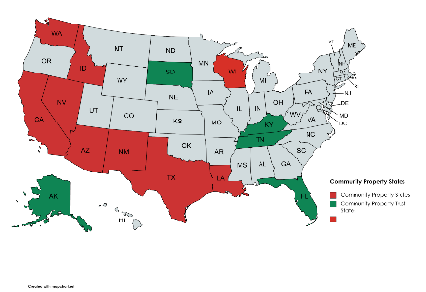
Which States are Community Property States?
In the United States, there have historically been eight community property states and two territories that have applied community property law:
              Arizona
              California
              Idaho
              New Mexico
              Louisiana
              Texas
The laws in these states generally evolved from Spanish law, except that Louisiana’s community property law came from France.
Note that in Louisiana, married couples who have assets characterized as community property can modify or terminate community property characterization only upon joint petition and a finding by a court that this serves their best interests.
In other community property state, married couples can simply enter into marital agreements during marriage (without petitioning a court) that modify or terminate (“transmute”) their community property characterization of assets, and may be required to record such agreements to transmute real estate.
              Nevada
              Washington (state)
              Wisconsin
              Alaska
              Guam
              Puerto Rico

Slide 44
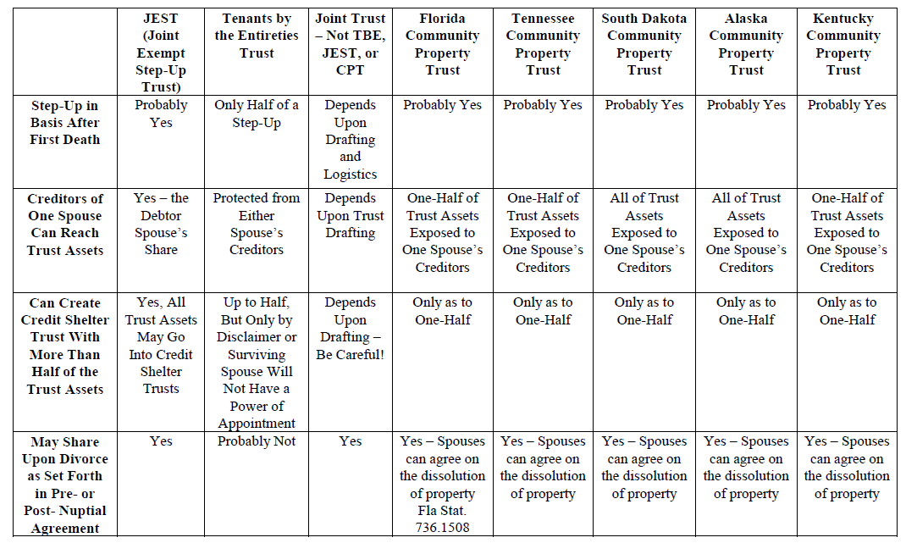
Married Couples Trust Decision Chart
*Chart continued on next slide

Slide 45
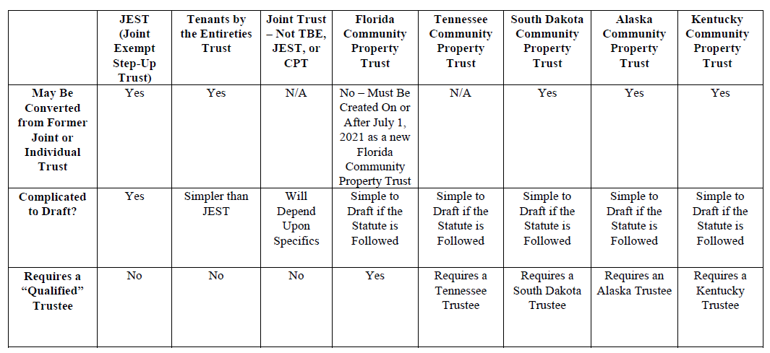
Married Couples Trust Decision Chart, Cont’d

Slide 46
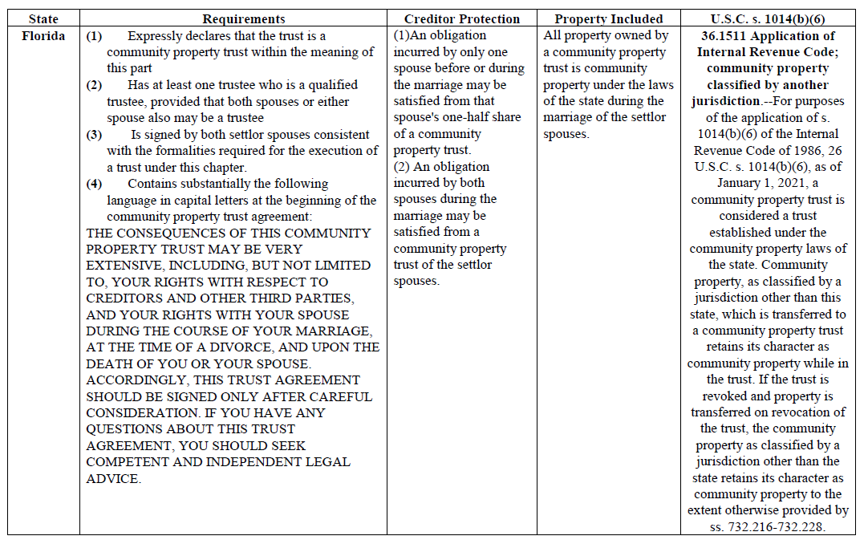
Community Property Trust Features- Florida

Slide 47
The JEST Trust

Slide 48
Traditional Wealthy Floridian
SPOUSE 1
SPOUSE 2
SPOUSE 1
REVOCABLE TRUST
SPOUSE 2 REVOCABLE TRUST
ASSETS
ASSETS
On first death, Trust of first dying spouse becomes irrevocable. Credit Shelter Trust to avoid estate tax and protect assets of first dying spouse.
Assets of surviving spouse - flap in the wind.

Slide 49
JEST Trust
SPOUSE 1
SPOUSE 2
JEST TRUST
SPOUSE 1's ASSETS
JOINT
ASSETS
SPOUSE 2's ASSETS
On first death, up to exemption amount of first dying spouse (as much as $11,400,000), may pass to Credit Shelter Trust or Trusts to benefit surviving spouse and descendants, with a possible full step-up of all assets - excess assets going into QTIP Trusts, which may also qualify for full step-up.

Slide 50
Basic JEST Anatomy
1993 Technical Advice & 2001 and 2002 Private Letter Rulings
SURVIVING SPOUSE
Gift Upon Death of
First Dying Spouse
(Qualifies for marital deduction)
First Dying Spouse
CREDIT SHELTER TRUST
Appoints to Credit
Shelter Trust
(Included in
1STD’s Estate – No
Step up under 1014(e) as arranged
(Avoids Estate Tax on SS’s Death)
Blattmachr Article
Credit Shelter Trust could be found to be funded by surviving spouse under step transaction doctrine so creditor may invade the trust in most states.
Mulligan
If first dying spouse needs approval of surviving spouse to appoint then 2041 may not apply, could be considered as a gift of ½ by the surviving spouse – but 1933 Johnston case held otherwise in a similar situation.
Zaritsky
2015 Heckerling Presentation.
Will the service consider the surviving spouse to have funded the credit shelter trust or trusts by reason of the step transaction doctrine?

Slide 51
Joint Exempt Step-Up Trust (JEST) Chronology - The 4 Steps from Drafting to Implementing
Copyright © 2015 Gassman Law Associates, P.A.
Derived from articles that can be found on Leimberg Information Services (Estate Planning Newsletter #2086)
and Estate Planning Magazine October and November 2013 Editions
Before Funding
Step 2
Step 3
Step 4
Funding of Joint Revocable Trusts; each spouse has the right to revoke his/her share until first death
Division upon First Dying Spouse’s Death
Assume Spouse 1 dies first
Results of JEST Technique
Spouse 1’s Assets
For Spouse 2 & Descendants benefit (limited by ascertainable standard)
Assets will receive a stepped-up basis
Assets are protected from Spouse 2’s creditors
Assets escape estate tax on Spouse 2’s death
Spouse 1’s Share
Spouse 1’s Assets
½ of former
JTWROS Assets
½ of former TBE Assets (or by other percentage)
Credit Shelter Trust A
Funded from Spouse 1’s Share in the amount of Spouse 1’s available Estate Tax Exemption (ETE)
Joint Assets: Joint Tenants w/ Right of Survivorship
Spouse 2 can be beneficiary of income and principal
Assets will receive a stepped-up basis on Spouse 1’s death, and then again on Spouse 2’s death
Assets included in Spouse 2’s taxable estate
Will be protected from Spouse 2’s creditors
½ to each Spouse’s share
Q-TIP Trust A
If Spouse 1’s Share exceeds Spouse 1’s available ETE, the excess will fund this trust
Joint Assets: Tenancy by the Entireties
½ to each Spouse’s share or actuarial value
Assets may receive a stepped-up basis, but this is more likely if Spouse 2 is not a beneficiary
May escape estate tax liability on Spouse 2’s death
For creditor protection and estate tax exclusion purposes, CST B may be moved to an APT jurisdiction
Special Consideration: If Spouse 2 is found to have made a gift of trust assets to Spouse 1 upon Spouse 1’s death, this gift may qualify for the marital deduction
If IRS argues that Spouse 2 has gifted to trust the gift will be incomplete because of Spouse 2’s power of appointment
Spouse 2’s Share
Spouse 2’s Assets
½ of former
JTWROS Assets
½ of former TBE Assets (or by other percentage)
Credit Shelter Trust B
If Spouse 1’s Share is less than his available ETE, Spouse 2’s Share will fund this trust in the amount of Spouse 1’s remaining ETE (But not in excess of Spouse 2’s available ETE)
Spouse 2’s Assets
Q-TIP Trust B
If Spouse 2’s Share has any remaining assets, they will be used to fund this trust
Spouse 2 will be income beneficiary
Assets may receive a stepped-up basis on Spouse 1’s death & again on Spouse 2’s death
Assets included in Spouse 2’s estate
May not be protected from Spouse 2’s creditors unless moved to APT trust jurisdiction
If IRS argues that Spouse 2 has gifted to trust the gift will be incomplete because of Spouse 2’s power of appointment
The IRS could find a gift upon contribution of TBE assets to the joint revocable trust, but this gift will qualify for the marital deduction if recipient spouse can withdraw what is added to Spouse 1 or Spouse 2’s share. Also see PLR 200201021.
Step 3 Note:
CST A and CST B can be merged if there is no concern with estate tax, stepped-up basis, creditor protection, or credit shelter trust effectiveness. Q-TIP Trust A and Q-TIP Trust B can be merged if there is no concern with respect to stepped-up basis or creditor protection effectiveness.

Slide 52
JEST Lite
SPOUSE 1
SPOUSE 2
JEST LITE
Depository language may provide solely for funding of Credit Shelter Trust A, Credit Shelter Trust B, and one possible QTIP or outright marital devise.
SPOUSE 1's ASSETS
JOINT
ASSETS
SPOUSE 2's ASSETS
Same as JEST, but will only break into Credit Shelter Trust A, Credit Shelter Trust B, and at most one QTIP Trust for simpler drafting

Slide 53
JEST Credit Shelter Trust B Planning
Accepted as funded by first dying spouse.
Will not be subject to estate tax at the level of the surviving spouse.
Will not be subject to creditor claims of the surviving spouse.
This is the optimum result.
ALTERNATIVE A
CREDIT SHELTER TRUST B
Considered as funded by surviving spouse.
Might be subject to estate tax at the level of the surviving spouse.
Might be subject to creditor claims of the surviving spouse, unless local law of the Trust provides otherwise.
ALTERNATIVE
B
Formed from assets of the share of the surviving spouse.
Expected to be considered as being transferred to Credit Shelter Trust B by the first dying spouse for federal estate tax purposes pursuant to Private Letter Ruling 200101021 and Private Letter Ruling 200210051.
The IRS could claim that Credit Shelter Trust B was funded by the surviving spouse.
Strategy 1 - Incomplete Gift Treatment
The surviving spouse maintains a Power of Appointment over the Trust assets, which causes the Trust to be considered as an incomplete gift for federal gift tax purposes, and the Trust assets will be considered as owned by the surviving spouse for estate tax purposes on his or her death.
In light of the IRS' position in CCA 201208026, it is best to give the surviving spouse a lifetime Power of Appointment over the assets in Credit Shelter Trust B to assure that an incomplete gift results for federal gift tax purposes.
If there are separate children for each spouse or a concern that the surviving spouse might not appropriately exercise a Power of Appointment, then it could be limited to being exercisable only with a consent of non-adverse parties, or limited to the extent needed to avoid imposition of federal gift tax by funding under a formula clause.
Strategy 2 - Complete Gift Treatment
If the surviving spouse disclaims all Powers of Appointment over the Trust, then the transfer to Credit Shelter Trust B is considered to be a complete gift by the surviving spouse, and the Trust will not be subject to federal estate tax of the surviving spouse's estate.
The value of the assets passing to Credit Shelter Trust B would reduce the surviving spouse's $11,400,000 exemption.
Give the surviving spouse the power to replace Trust assets with assets of equal value, so then it can be considered a Defective Grantor Trust if this occurs.
Note (applicable to both Strategy 1 and Strategy 2): Situs Credit Shelter Trust B in an "asset protection trust jurisdiction" to avoid having creditors be able to reach into the Trust, and also to avoid the Trust being included in the surviving spouse's estate if the surviving spouse was considered as a contributor to the Trust for federal estate and gift tax purposes.

Slide 54
JEST with Some Creditor Protection
SPOUSE 1
SPOUSE 2
Independent Trustee
JEST
(with creditor protection)
IRREVOCABLE TRUST FOR DESCENDANTS
.5% V / 96.5% NV
.5% V / 2.5% NV
LLC
ASSETS

Slide 55
Irrevocable JEST Trust
SPOUSE 1
SPOUSE 2
IRREVOCABLE
JEST TRUST
(in asset protection trust state)
Where a couple has concerns that they may be subject to undue influence, distortion or loss of assets and direction from dementia, or otherwise, why not make the Trust irrevocable, and to also possibly provide that transfers are "incomplete gifts" by having each spouse reserve the right to veto distributions and to appoint the Trust assets (with the Power of Appointment being subject to the consent of a non-adverse party) in addition to having other JEST Trust terms to obtain a stepped-up basis on each spouse’s death.

Slide 56

Irrevocable Multiple JESTs –
Possession is 90% of the Law
And never the twain shall meet.
SPOUSE 1
SPOUSE 2
Spouse 1, Spouse 2, Son
Co-Trustees
(Mark Twain)
Spouse 1, Spouse 2, Daughter
Co-Trustees
IRREVOCABLE
JEST TRUST 1
IRREVOCABLE
JEST TRUST 2
(One-half of assets)
(One-half of assets)
Becomes Generation-Skipping Trust for son and his descendants on death of surviving parent.
Becomes Generation-Skipping Trust for son and his descendants on death of surviving parent.
This trust has been funded for the primary purpose of benefitting the Grantor's during our lifetime, and then having a protective trust or trusts established for our daughter, Molly Hatchett, to the extent of assets then remaining. Our son, Leonard Skin-Us is the Trustee of another trust that will be held for his benefit. Distributions to my said child and his/her descendants shall therefore reduce his/her subsequent inheritance. Either child may require that a licensed trust company serve as additional Co-Trustee of each trust, and both of our children will receive annual accountings prepared by our certified public accountant of each trust. We, as Grantors, may further exercise our power to reappoint trust assets, but only after a four hour neurological examination and verification that we are not known to be subject to undue influence, and have received approval from any two of the following five trusted non-related individuals ...

Slide 57

What Howard Zaritsky Said
About The JEST At The 2015 Heckerling Institute
“With portability, you are not as concerned with the problem of the first spouse not having money. In fact, the best portability comes from an insolvent estate of the first spouse. They got no use of their exemption. The only problem is convincing them to file a return. A little tricky. Somebody has to pay for preparing the return. The problem of 1014(e) was addressed by Alan Gassman and a couple of other lawyers in a series of articles - where they created what they call “The Joint Estate Step Up Trust” (or “JEST”). Okay, I kind of like that acronym. I am not a big fan of acronyms, but at least it is a word. DSUEA is not a word, and I really do not like using it. At least JEST is something.
But the concept here looks a great deal like the tax basis revocable trust, with one very clever distinction, and that is that the assets of the donor surviving spouse that are includible only because of the General Power of Appointment (where the first spouse to die does not have enough assets to fully fund their exemption) to bring the estate up to the exemption amount, which are thus includible only because of 2041, and are attributable to the property that was owned by and contributed by the surviving spouse, will go into a non-marital trust that the surviving spouse is not a beneficiary of, and the rest is for marital deduction funding. That absolutely ought to work in terms of 1014(e).
You still have the question of whether the spousal gift is the moment before or the moment after, and when you are explaining the technique to the client in writing, you need to point out this one little tiny item of uncertainty. You can state that you think it unlikely that this will be a problem - that all the private rulings take favorable positions. All of them. There are none taking an unfavorable position. That’s something. We can cite them, but we can’t rely on them, but it is still something. And if you ever look at any of my recent development outlines, the first footnote involves a long thing about what courts have said - they always say they are not precedent, but we will rely on them anyway. So they have some significance.
Once the client can get past that one little piece of risk, I think the JEST is a great technique for what it is seeking to do. It is a way to minimize the problems of 1014(e). I commented earlier that you can accomplish the same concept if you are dealing with an inter spousal gift within one year of death, you say “fine, the access I was given within one year of death are a little different - non-marital trust. It is a great technique-- - the cases I mentioned about the - whether or not it is really a general power - on page 199-- I had a debate with Mitch Ganns, who said - the rulings don’t really say that, and I went back and read them, and said, yes they do really say in my opinion they really do say that, and while Mitch is one of those people I usually defer to in judgment - I really disagree on this one.
So, the JEST actually is a workable technique to get the basis step-up on the estate of the spouse to die, when they don’t have money or enough money. It is a way around 1014(e) - the tax basis revocable trust - not so much.
The JEST is a material improvement.
I have got to say that in Alaska, and now Tennessee, a Community Property Trust is probably the simplest and best basis play in estate planning, and no one seems to be using it, and I think it is outrageous that it isn’t being proposed more often, but there it is.
We mentioned that community property has a really swell rule that both sides get a basis step-up on the first spouse’s death. (Howard continued to cover the Alaska and Tennessee Community Property Trust discussion, stating that it is the best technique available).”

Slide 58
From Howard Zaritsky – Lester Law January 2017 Heckerling Institute Fundamentals presentation (pgs 1-134 & 1-135):
GETTING A FULL STEP-UP USING POWERS OF APPOINTMENT ON FIRST DEATH – THE JEST TRUST
Consider the JEST Trust to fully fund a Credit Shelter Trust while receiving a stepped up basis for all joint and separate assets.
The Joint Estate Step-Up Trust (JEST)
A recently variation on the tax-basis revocable trust is the joint estate step-up trust, or JEST. See Gassman, ' Denicolo, & Hohnadell, JEST Offers Serious Estate Planning Plus for Spouses - Parts I and 2, 40 Est. Plan. 3, 14 (Oct., Nov. 2013).
  1. Structure of the JEST
    a) Joint Revocable Trust
A JEST is a joint revocable trust created by a married couple who reside in a non­ community property state. The JEST becomes irrevocable when the first spouse dies; both powers to revoke then terminate.
      b) Separate Shares for Each Spouse
Each spouse owns a separate share of the trust.
            c) Each Spouse Can Terminate Trust During Joint Lives
Each spouse has the power to terminate the trust during their joint lives, when each spouse's share will be distributed to him or her individually.

Slide 59
The Joint Estate Step-Up Trust (JEST) – Cont.
            d) First Spouse to Die Can Appoint Entire Trust Fund
The first spouse to die is given a testamentary power to appoint the entire trust fund.
e) In Default of Exercise
  (1) Credit Shelter Trust A
  On the death of the first spouse to die, the unappointed assets of his or her share of the trust are divided into a credit shelter trust A, for the benefit of the surviving spouse and descendants.
  (2) QTIP Trust
    If the first spouse's estate exceeds his or her applicable exclusion amount,. the excess is held in a QTIP trust for the surviving spouse.
        (3) Credit Shelter Trust B
          (a) Generally
        If the share of the first spouse to die is less than his or her applicable exclusion amount, then the assets over which he or she holds a general power of appointment are used to fund credit-shelter trust B, for the benefit of other family members and excluding the surviving spouse as a beneficiary.
              (b) Adding the Spouse Later
          It is sometimes suggested that the surviving spouse may be added as a beneficiary by a trust protector at some later date. The step-transaction doctrine could be a serious impediment to this approach, because the spouse could be deemed already to be a beneficiary if it can be shown that there was always an intention that he or she be added to the trust.

Slide 60
The Joint Estate Step-Up Trust (JEST) – Cont.
Note. The step-transaction doctrine is particularly a problem if the estate planner has documented in the planning memoranda that the surviving spouse can be added later.
2. Analysis of the JEST
The JEST has one noteworthy advantage over the tax-basis revocable trust, in that the assets contributed by the surviving spouse do not pass back to the surviving spouse at the first spouse's death. The assets passing subject to the power of appointment will, except to the extent appointed otherwise, pass to a trust for other family members. This should make application of Code § 1014(e) extremely difficult.
  3. Analysis of the JEST
The IRS analysis of the tax-basis revocable trust turned on the application of Section I014(e), which denies a basis adjustment to assets transferred to the decedent within one year of the date of his or her death, that pass to the original transferor upon the decedent's death. The JEST gets around Section 1014(e) by not having the assets transferred to the decedent return to the original transferor, to the extent that the original transferor has unused applicable exclusion amount. Thus, there is no reason why the JEST should not work.
4. Asset Protection and the JEST
The JEST offers only limited asset protection benefits.
          a) Assets Contributed by the First Spouse to Die
            (1) Creditors of the First Spouse to Die
  The assets contributed to the JEST by the first spouse to die should be as available to the first spouse to die as any other assets of that spouse's revocable trust.

Slide 61
The Joint Estate Step-Up Trust (JEST) – Cont.
(2) Creditors of the Surviving Spouse
The surviving spouse should be able to obtain the benefits of the spendthrift clause applicable to the assets contributed by the first spouse to die and then held either as Non-marital Trust A or as a QTIP.
(3) Creditors of the Descendants
The beneficiaries of Non-marital Trust B should be able to do the same
b) Assets Contributed by the Surviving Spouse
The assets contributed by the surviving spouse are also subject to a general testamentary power of appointment held by the first spouse to die. As noted above, these assets may be subjected to the claims of the creditors of the first spouse to die, even though they were originally assets of the surviving spouse.

Slide 62
JEST TRUST ADVANTAGES
1. Potentially a full step-up in income tax basis on first death.
2. Community property couples can achieve the above without having all community property exposed to the creditor claims of either spouse.
3. Can allocate all Trust assets to fund the Credit Shelter Trust or Trusts on the first death, up to the exemption ($13,990,000) amount.
4. Clients in non-community property states can have one Joint Trust instead of attempting to balance assets between separate trusts.

Slide 63
JEST TRUST ADVANTAGES
5. The spouse at higher creditor risk can own a very small percentage (1%) of the JEST, and let 99% be owned by the non-risk spouse, yet 100% of the JEST assets can be used to fund a Credit Shelter Trust or Trusts on the first death.
6. Locking up all JEST assets on the first death is better creditor protection and “next spouse” protection for the surviving spouse and common descendants.
7. The Credit Shelter Trust may be formed in an asset protection jurisdiction immediately after the first death.
8. Close coordination with legal, tax and accounting advisors will be necessary after first death. This can result in the family receiving better advice and having more stability.

Slide 64
JEST TRUST DISADVANTAGES
1. Complexity of drafting and explaining the JEST System.
2. The IRS may not agree with the stepped-up basis on the first death.
3. The IRS may not follow its own PLRs and TAMs with respect to the ability to use a surviving spouse’s assets to fund a Credit Shelter Trust.
4. Complexity and expense of administration after the first death, which should be more than outweighed by income and estate tax savings.
5. Subsequent professionals may not understand the JEST or properly manage it - a degree of sophistication is necessary.

Slide 65
The Stepped Up Basis Conversation
By: Jonathan Blattmachr and Alan S. Gassman
Copyright © 2013
“Step Right Up. Everyone’s a winner, bargains galore.”
- Tom Waits - Step Right Up from the 1976 album Small Change.
The largest tax facing the great majority of American families on death will be the capital gains tax. The increase in this tax from 15% to 20%, with the additional 3.8% Medicare tax for high income earners makes this a very important topic to cover with clients and their families.
The primary estate planning goal of most married couples is to provide as well as possible for the surviving spouse, but most of them do not recognize that 23.8% of the lifetime appreciation of family investments including in many cases on a large residence will have to be paid to the government in order to produce money for the surviving spouse.
For some survivors, this will be a devastating reality that must be faced when the cost of an adult congregate living facility and proper care is compared to the net proceeds that can be derived from the liquidation of assets.
Even a modest investment portfolio owned by a retired married couple can be significantly impacted by these taxes.
Assume that a married couple in their late sixties has $500,000 of investments with a cost basis of $100,000, and their home’s worth is $100,000.
If one spouse dies owning one-half (1/2) of the assets or the assets are jointly owned in a non-community property state and one of them dies, his or her half of the assets will receive an automatic change in income tax basis to its estate tax value (even if no estate tax is due) and the inherent gain in those assets are forgiven. That result is known as the income tax free “step up in basis” at death. But the inherent gain in the survivor’s half of their wealth will not be stepped up. That means then that there is $200,000 worth of untaxed gain that will cost, depending upon several factors including whether the couple lives in a jurisdiction with state and local taxes of, perhaps, over $50,000 in capital gains tax in order to liquidate their wealth to provide cash to support the surviving spouse or to buy into a retirement center unit. And if most of the couple’s wealth was owned by the surviving spouse, then the amount of the remaining gain (and, therefore, tax resulting from liquidation) will be even greater.

Slide 66
The Stepped Up Basis Conversation
By: Jonathan Blattmachr and Alan S. Gassman
Copyright © 2013
Contrast that couple’s situation with one if they live in a community property state, such as Texas or California. For that couple, all of the inherent gain is “forgiven” when the first spouse dies. Therefore, the survivor would face no capital gains tax in liquidating the couple’s wealth.
A couple with $2,000,000 of assets and a $500,000 home with the same ratios of growth face a much larger tax which could be $450,000 or more.
The above assumes that tax rates will not rise and that there will be no state income tax to be paid.
Why do so many planners fail to discuss this with clients, much less put mechanisms in place to assure a complete step-up in basis of all of a couple’s assets on the first death? One reason is that the full impact of the large capital gains tax increase has not yet been felt by many clients. Another is that the complexity of the recent estate tax changes, and especially the attention given to wealthy clients during 2012 to use their large gift and generation-skipping transfer tax exemptions have taken the typical estate planner’s eyes “off the ball” where they should be for many couples.
There are three primary ways that the typical non-community property state couple can attain a full step-up in basis for assets on the first death (understanding that some assets, such as those in pension plans or IRAs never receive a step up when the owner dies):
1. Have the assets owned by the first dying spouse more than one (1) year before he or she dies, or if the one (1) year period cannot be met, have the spouse leave the assets to a trust that may benefit the surviving spouse and not violate the one (1) year rule under Internal Revenue Code Section 1014(e).
Trying to guess who dies first and even having to talk about this can be a difficult and risky proposition.

Slide 67
The Stepped Up Basis Conversation
By: Jonathan Blattmachr and Alan S. Gassman
Copyright © 2013
2. The couple can amend their estate planning documents to either provide that each of them will have a testamentary power of appointment over assets held in one another’s separate revocable trusts or form one joint JEST trust, in which event Private Letter Rulings 200101021, 200210051, and 200403094 and TAM 9308002 support the proposition that assets owned jointly under a JEST Trust or under the revocable trust of a surviving spouse may be considered to have passed through the “taxable estate” of the first dying spouse, although there are Section 1014(e) one (1) year rule and fundamental issues associated with this that are discussed at length in LISI Newsletter No. 2086 and the October and November issues of Estate Planning Magazine that were co-written by Alan S. Gassman, Tom Ellwanger, Christopher J. Denicolo, and Kacie Hohnadell.
This technique has its downsides, as described in the chart below but the JEST Trust itself has no annual cost associated with it unless there are changes in the client’s estate plan. Many clients prefer to have their assets under a single trust, and preexisting separate trusts can be amended and restated to be considered a part of the single JEST Trust so that re-titling of assets is not required. It will take the planner a few hours to draft and thoroughly review their initial trust draft, or a number of JEST Trust versions and client letters and explanations drafted by Gassman Law Associates, PA can be purchased through the website of Phil’s Ultimate Estate Planner.
3. The most reliable way to achieve a full step up on the first death, with very effective incidental asset protection features is to establish a conventional Alaska Community Property Trust with an Alaskan Co-Trustee. The Alaskan community property statute was enacted in 1998 to allow non-Alaskan couples to form trusts there to comply with Internal Revenue Code Section 1014(b)(6), which provides that community property will receive a full step up on the death of one spouse. This technique has been endorsed by not only Jonathan Blattmachr, who originated the concept, but also by Howard Zartisky and a number of other well respected experts. The Alaska Trust Company provides the trust form to professionals who use these, and an Alaskan lawyer is available to review and approve the trust document for only about $1000.
A chart of considerations and factors is as follows:

Slide 68
The Stepped-Up Basis Conversation
 | No Planning | JEST or Special Power of Appointment Trust Arrangements | Community Property Trust
Drafting and Design Time to Implement | None. | Requires sophisticated drafting and implementation. | Can be simple to install.
Creditor Protection Attributes | No effect. | Will typically expose assets to creditors to each owner spouse unless further planning is effectuated. | Alaska creditor protection law applies.
Annual Maintenance Costs | None beyond what client is already paying. | None but best to review assets and allocation within JEST periodically. | $3,000 per year payment to Alaska trust company and requiring that the clients follow appropriate formalities if they want to have creditor protection attributes. (But not necessarily required in Florida!)
Administration After Death of First Spouse | No special provisions needed. | Must meet with qualified planner to decide how to allocate assets between one or two credit shelter trusts and administration issues. | Can simply dissolve trust or maintain trust and step up has occurred.
Degree of Tax Certainty | Nonapplicable. | The Service may challenge the stepped-up basis and funding of a credit shelter trust from the assets of the first dying spouse. | Statutory support and over decades of community property case law eliminates stepped-up basis and full credit shelter trust funding issues.

Slide 69
The Stepped Up Basis Conversation
By: Jonathan Blattmachr and Alan S. Gassman
Copyright © 2013
Dear Lawyer and CPA:
Thanks for all the work you did for Mom and Dad over the years. As the result of Dad’s recent death, we are having to sell their joint investment account assets to pay for Mom’s care. My accountant says that we have to pay a 20% income tax on a lot of the gains as the result of this. Was there any way that this could have been avoided?
On a $400,000 portfolio this is costing over $71,000 in taxes.
Thanks for helping our parents to avoid probate, but what about all these income taxes?
Response from Planner;
Dear Son of Clients Who is a Personal Injury Lawyer:
I am glad to hear that your Mom is getting good care.
We suggested consideration of a JEST trust or an Alaska community property trust, but they decided against this. If you could wait to sell the assets after your mother dies you will not have the income tax. Maybe you could loan the money to your mother and let her hold the appreciated assets.
You and your siblings may consider doing this type of planning for yourselves now. I can see that you are doing very well based upon the Billboards and television advertising. Keep up the great work!!
Conclusion
Planners need to become accustomed to stepped-up basis planning being in the forefront of objectives and structuring. The Alaska community property trust is extremely under-utilized, and the JEST trust or stepped-up basis power of appointment arrangements can be considered for those clients who for whatever reason would not prefer to use an Alaska community property trust.

Slide 70
TBE Revocable Trust
SPOUSE 1
SPOUSE 2
TBE
REVOCABLE TRUST
Carefully drafted Trust provides that all beneficial interests are owned as tenants by the entireties, and solely owned by surviving spouse after first death -
Then acts as a simple Revocable Trust for the surviving spouse.
Surviving spouse must have total control over the Trust after the first death to qualify under tenancy by the entireties.
Question ?
.
Why not have Credit Shelter/QTIP Trust provisions that would be activated to the extent that the surviving spouse disclaims TBE Trust assets? - To be a true TBE Trust, the beneficial interest disclaimed would need to flow through the probate estate of the first dying spouse, but could be poured back into the Trust and then handled by “if a disclaim occurs” provisions, or under Testamentary Trust provisions in Last Will and Testament.

Slide 71
TBE Revocable Trust/ LLC Combo – Hold the Fries!
TBE LLC ownership will pass to Revocable Trust by pay-on-death clause on death of surviving spouse.
SPOUSE 1
SPOUSE 2
TBE
TBE
LLC
TBE
REVOCABLE TRUST

Slide 72
Florida and APT Jurisdiction Trust Varieties
Reciprocal Asset Protection Trusts
INCOMPLETE GIFT TRUST
FLORIDA COMPLETE GIFT TRUST
APT
COMPLETE GIFT TRUST
TRUST 1
TRUST 2
To preserve assets for marriage, management , or otherwise.
Grantor retains power to prevent distributions and testamentary power to appoint how assets pass on death - may be limited to not being exercisable in favor of creditors or creditors of estate, and exercisable only with approval of a non-adverse party not acting as a fiduciary.
Use Crummey Power for annual exclusions, or part of Grantor's exemption amount.
Held for health, education, and maintenance of individuals other than the Grantor.
Complete gift to fund - will not be included in Grantor's estate.
Grantor/Contributor cannot be a beneficiary.
Use Crummey Power for annual exclusions, or part of Grantor's exemption amount.
Held for health, education, and maintenance of individuals other than the Grantor.
Complete gift to fund - will not be included in Grantor's estate.
Under PLR 200944002, Grantor may be a discretionary beneficiary.
Beware the reciprocal trust doctrine, both under estate tax law and creditor protection law - see Gideon Rothschild's article entitled Creditor Protection - - The Reciprocal Issue for Reciprocal Trusts (It's Not Just About Estate Taxes ).
http://www.mosessinger.com/site/files/creditorprotectionreciprocaltrusts.pdf

Slide 73
Estate & Asset Protection Planning for the Single Professional
SINGLE
(NON-MARRIED) INDIVIDUAL
Child or Children
529 Plans
UGMA Accounts (Subject to Creditors of the Child)
Child’s or Children’s Automobiles?
(Who signed for driving privileges?)
IRA Account Automobile
401k/Pension Account
Annuity Contracts
Life Insurance
Can deposit into a wage account.
HOMESTEAD
Offshore Trust Company, as Trustee or Co-Trustee
Nevada Trust Company, as Co-Trustee
Parent, Trustee
LIVING TRUST
GIFTING TRUST
OFFSHORE ASSET PROTECTION TRUST
NEVADA ASSET PROTECTION TRUST
TRUST FORMED BY CHILD WITH EXCESS ASSETS
3%
97%
3%
99%
97%
S Corporation Stock
1%
REAL ESTATE FLP
PROFESSIONAL PRACTICE CORPORATION
PROFESSIONAL BUILDING AND/OR EQUIPMENT LLC
SECURITIES FLP
WAGE ACCOUNT?
Wages
Long
Term
Lease
LLC
LLC
LLC
Furniture, equipment, accounts receivable
Brokerage Accounts
Building 1 Lot 1 Condo 1

Slide 74
    Limited Liability Trust – Asset Protection Trust
Trust Company in proper jurisdiction = Trustee or Co-Trustee
ASSET PROTECTION TRUST
Mother & Father as contributors
Benefits mother, father and children.
May be disregarded for income tax purposes.
No tax filing requirements if a domestic asset protection trust jurisdiction is used.
May need to have subsidiary management trust owned 100% by asset protection trust to hold title, to allow parents to have management powers (preferably one parent who does not have other exposed assets).
Rental Home(s)

Slide 75
Homestead Confidentiality
SPOUSE 1
SPOUSE 2
TBE
Delaware or Wyoming LLC, Trustee
REVOCABLE LAND TRUST
“Statement of Authority” to avoid theft
Use SunBiz.org
Homestead

Slide 76

Confidential Rental House Ownership Strategies
*Rental houses - limiting liability while also qualifying for appropriate insurances.
SPOUSE 1
(or Revocable Trust of Spouse 1)
SPOUSE 1
(or Revocable Trust of Spouse 1)
SPOUSE 1
(or Revocable Trust of Spouse 1)
Separate Manager
Separate Manager
(Judgment proof Uncle or Nephew) - has full management authority.
LLC
(Judgment proof Uncle or Nephew)
LLC
Spouse 1, Trustee
(Trustee has no authority to manage the property, but can only direct the LLC to change title)
(rental house)
LAND TRUST
* Spouse 1 or Revocable Trust
of Spouse 1 owns rental house.
* House can cause creditor
problems.
(rental house)
* Should limit liability but good luck
getting insurance.
(rental house)
* Some insurance carriers
will like this better.

Slide 77
CHILD’S HOMESTEAD IRREVOCABLE TRUST
Can own a home used by a child to benefit the spouse and descendants
Can qualify for the State Homestead Exemption and 3% cap
Can be considered as owned by the Child for income tax purposes under Internal Revenue Code Section 678 to qualify for the $250,000 income tax exemption on sale
Can be controlled by the Trustee and used for the benefit of various family members
Will insulate family members from liabilities associated with ownership of the home
Relative, Advisor or Trust Company = Trustee
Trust assets can be applied for the health, education, maintenance and support of the Trustee-Spouse and children.
One or more children may reside in the house to qualify for the Florida Tax Homestead Exemption.
For income tax purposes, the Trust can be considered as owned by the child who lives in the house so that the house can be sold income tax free to the extent of up to $250,000 in appreciation.
The Trust will not be subject to creditor claims of any family member unless (1) the transfer to the Trust by the Grantor Spouse is a “fraudulent transfer,” or (2) the child has a right to withdraw more than the gift tax exclusion amount in any calendar year.
NOTE – The Trust must be appropriately drafted, funded, and administered to achieve the above results.
CHILD’S HOMESTEAD IRREVOCABLE TRUST
GRANTOR
SPOUSE
Gift
Home and Other Assets
Notes:
77

Slide 78
COMPARISON OF METHODS TO PURCHASE HOMES FOR THE CHILDREN
 | $250,000 Exemption on Sale of Home | $50,000 Homestead Exemption and 3% Per Year Cap on Valuation | Divorce | Control | Notes
Father and Mother loan money to the child. Child purchases and owns home. | Child gets income tax exemption. | Child gets homestead exemption and cap. | Loan will be repaid to parents. Equity may be subject to claim by spouse if this is not waived by Prenuptial Agreement. | Child controls the house. However, we may be able to call the Note to force a sale. | Note: Child gets equity above Note.
Father and Mother own the home and the child lives in the house. | No. | Generally no. However, it may be possible to obtain these with a 99-year lease. | Better protected. | Father and Mother control.
Via Child Funded Homestead Bypass Trust. | Child gets income tax exemption. | Child gets homestead exemption and cap. | Better protected. | Friend, relative, advisor or trust company would be Trustee of the Trust and would retain control. | Note: Creditors may be able to get into the Trust. It may be possible for Trustee to transfer the house to the child’s individual name in the event of a Creditor issue.
Direct Client Funded Homestead Bypass Trust. | No | Child gets homestead exemption and cap. | Better protected. | Mother would be Trustee of the Trust and would retain control. | Note: The $250,000 exemption is lost, but no creditor of the child should be able to get the assets.
One-half purchased by child and one-half owned by Father and Mother. | One-half. | One-half. | One-half, better protected. | Each controls one-half.
Notes:
78

Slide 79
QPRT TRUST PLANNING DEMONSTRATION
Age of Client 68
Initial Value of Home $860,000
Fractional Discount Assumed 15.00%
Discounted Value of ½ of Home $365,500
 | Gift Component (with respect to each QPRT) |  | Value of ½ of Home at End of QPRT Term Assuming 7% Growth | Estate Tax on Value at End of Term Assuming 35% Estate Tax Rate | Estate Tax Savings on ½ of Home at End of QPRT | Estate Tax Savings on Entire Value of Home at End of QPRT | Estate Tax Savings After 16 Years Assuming 7% Growth on ½ of House | Estate Tax Savings After 16 Years Assuming 7% Growth on Entire House
6 Year QPRT | Gift % | 73.220% | $645,314.05 | $225,859.92 | $132,193.23 | $264,386.96 | $350,633.96 | $701,267.92
 | Value of Gift | $267,619.00
8 Year QPRT | Gift % | 64.328% | $738,820.06 | $258,587.02 | $176,295.43 | $352,590.85 | $362,009.05 | $724,018.10
 | Value of Gift | $235,118.84
10 Year QPRT | Gift % | 55.528% | $845,875.08 | $296,056.28 | $225,022.09 | $450,044.17 | $373,266.45 | $746,532.90
 | Value of Gift | $202,954.84
12 Year QPRT | Gift % | 46.916% | $968,442.38 | $338,954.83 | $278,937.54 | $557,875.08 | $384,283.35 | $768,566.70
 | Value of Gift | $171,477.98
14 Year QPRT | Gift % | 38.633% | $1,108,769.68 | $388,069.39 | $338,648.12 | $677,296.25 | $394,879.38 | $789,758.76
 | Value of Gift | $141,203.62
16 Year QPRT | Gift % | 30.840% | $1,269,430.41 | $444,300.64 | $404,848.7 | $809,697.15 | $404,848.57 | $809,697.15
 | Value of Gift | $112,720.20
Probability of Death Before Certain Age
Current Age 68
2 years (70) 4.18% 6 years (74) 14.31% 10 years (78) 27.33% 20 years (88) 68.53%
4 years (72) 8.92% 8 years (76) 20.45% 15 years (83) 47.24%
Notes:
79

Slide 80
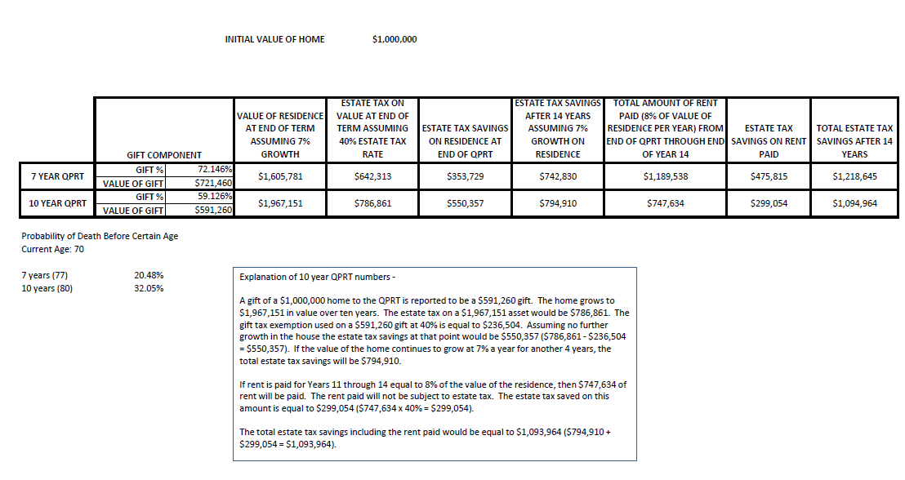
QPRT TRUST PLANNING DEMONSTRATION

Slide 81
#1
Firewall Protection

Slide 82
Firewall Protection
Use Firewall Protection and Multiple Entities Where Possible:
A. Two cabs in each LLC.
B. Rental properties under separate LLC’s managed by your judgment-proof nephew who
needs to earn money.
C. Put the business that may be sued under a company that is separate from a large portion
of the assets and intellectual property associated therewith.
D. Maintain proper corporate formalities.

Slide 83
Using Intermediary Entities to Protect Family Limited Partnership From Potential Liability
FAMILY LIMITED PARTNERSHIP
100%
100%
NEVADA
LLC
LLC 1
LLC 2
Other Persons
Owns mortgages owed by third parties
Owns Hedge Fund Investment
26%
74%
ENTITY
(with Member Obligations)

Slide 84
Possible Family Logistics for a Successful Business and Estate Plan
SPOUSE 2
SPOUSE 1
SON
Has Prenuptial Agreement with Spouse
Low Interest Note owed to Husband from sale
SPOUSE 2’s REVOCABLE TRUST
SPOUSE 1’s REVOCABLE TRUST
TRUST FOR CHILDREN & SPOUSE 2
SON’s REVOCABLE TRUST
30%
50%
49%
70%
40%
10%
30%
50%
30%
41%
REAL ESTATE, LLC
(Taxed as Partnership)
MEDICAL PRACTICE, LLC
(S corporation)
INTELLECTUAL PROPERTY DEVELOPMENT, LLC
(S Corporation)
ABC MANAGEMENT, LLC
(C Corporation)
Lease
Agreement
License
Agreement
Management Agreement

Slide 85
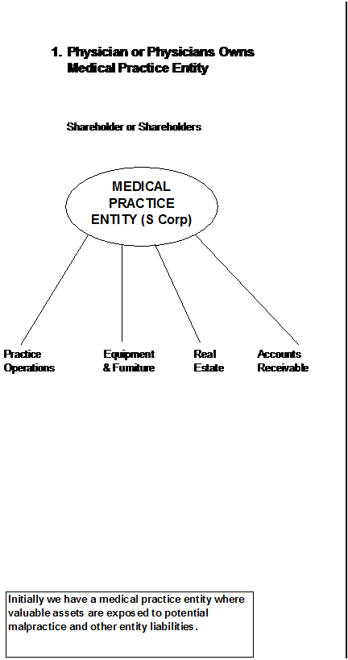
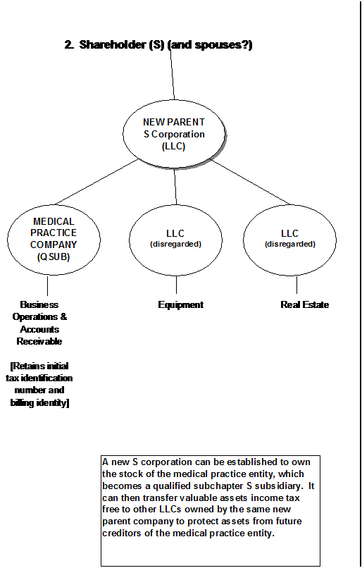
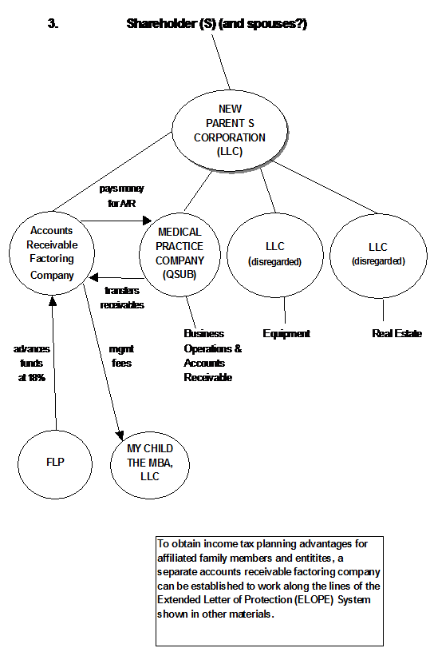
New Parent F Reorganization
Showing Accounts Receivable Factoring Arrangement
IRC Section 368(a) (1)(F) Allows a Regular Corporation to Divide into Separate Corporations Tax-Free by Having a New Common Parent Company Formed

Slide 86
Trustee’s Creditors May Not Invade a Trust
Held for Third Parties
Florida Statute Section 736.0507 codifies the concept that a trustee’s interest in trust assets will not be subject to personal obligations of the trustee, even if the trustee becomes insolvent or bankrupt. This, of course, does not apply to the extent that the trustee is the settlor and the beneficiary.
Under Florida Statute Sections 736.1013 and 736.1015, the trustee of a trust is not personally liable on contracts entered into on behalf of the trust unless the contract so provides or the trustee fails to reveal its fiduciary capacity. Pursuant to Florida Statute Section 736.1013(2), a trustee is personally responsible for torts committed in the course of administration of a trust where the trustee is personally at fault. As provided in Florida Statute Section 736.1015, the trustee has no personal liability for obligations of a general partnership where the general partner interest is held solely in his or her capacity as a trustee, unless the trust is a revocable trust and the trustee is the settlor.

Slide 87
Limited Liability Trust – Asset Protection Trust
Better than an LLC to hold investment property if liability insurance coverage and rates will be beneficial; Such a trust may also qualify under an individual umbrella policy, whereas an LLC may not
Trust Company in proper jurisdiction = Trustee or Co-Trustee
ASSET PROTECTION TRUST
Benefits mother, father and children.
May be disregarded for income tax purposes.
No tax filing requirements if a domestic asset protection trust jurisdiction is used.
May need to have subsidiary management trust owned 100% by asset protection trust to hold title, to allow parents to have management powers (preferably one parent who does not have other exposed assets).
Mother & Father as contributors
Rental Home(s)
Note: An alternative may be to have a revocable land trust owned by an LLC – some carriers will insure property this way, but not under an irrevocable trust or an LLC.

Slide 88
Practice and Business Entities and How They Can be Taxed
REGULAR CORPORATION
OR PROFESSIONAL ASSOCIATION
LLC OR PL
OR LIMITED PARTNERSHIP
OR LLLP
GENERAL PARTNERSHIP
OR LIMITED LIABILITY PARTNERSHIP (LLP)
Taxed as S corporation or C corporation.
S corporations pay no tax unless they used to be a C corporation and certain circumstances exist.
The income and deductions of an S corporation flow through to the shareholders pro rata to ownership.
3. A C corporation is taxed as a separate entity and if it is a professional service company, all net income is taxed at the highest bracket (39.6%).
No charging order protection.
$35 filing fee
$150 annual report fee
Only 1 member- disregarded for federal income tax purposes.
But may have a Taxpayer Identification Number.
If 2 or more members – taxed as a partnership. A partnership is taxed in a manner similar to an S corporation, but with major differences.
Can elect to be taxed as an S corporation or a C corporation for federal income tax purposes.
To have corporate tax treatment a Form 8832 must be filed with the IRS.
$125 LLC filing fee
$138.75 LLC annual report fee
$1,000 LP/LLLP filing fee
$500 LP/LLLP annual report fee
(other state filing fees are much lower for L.L.L.P.’s)
Can be disregarded if considered to have one member (such as if an individual owns 50% and his or her revocable trust owns 50%)
Taxed as a partnership if 2 or more members.
No charging order protection.
No filing required for general partnership.
$50 LLP filing fee
$25 LLP annual report fee

Slide 89
Basic Income Tax Operation of Each Type of Entity
Shareholder
(Dividends are taxed)
Shareholder
(Dividends are not taxed)
Partners
(Individuals, S corporations or otherwise)
(Distributions are not taxed)
C CORP TAXED ENTITY
S CORP
TAXED ENTITY
PARTNERSHIP TAXED ENTITY
PROPRIETORSHIP
Or Disregarded
Corporate level tax – revenues minus deductible expenses.
Dividends are not deductible expenses.
May deduct healthcare and disability insurance expenses under certain circumstances.
In the highest individual tax bracket on the first dollar of income if this is a personal service company.
Income and deductions are computed and then go on income tax returns of owners by K-1 reporting.
There can only be one class of stock, but voting/non-voting is permitted.
Contribution of appreciated assets can trigger tax unless the 80% rule is followed under IRC Section 351
Income is triggered if an appreciated asset or accounts receivable are transferred from the S corporation to shareholders unless it is deductible compensation.
Special rules apply if an S corporation used to be a C corporation. This can cause double tax.
Income and deductions are computed and then go on income tax returns of owners by K-1 reporting – no entity level tax.
Distributions to partners are usually subject to employment taxes
Compensation paid to partners is often called “guaranteed payments” and reduces partnership income
Typically no income tax is triggered when appreciated assets are contributed to the partnership in exchange for a partnership interest
Typically no gain is triggered when the partnership transfers appreciated assets to its partners to redeem their ownership interests.
All income and deductions are shown on individual’s Form 1040 Schedule C – subject to employment taxes of 12.4% on the first $113,700 of income, plus the 2.9% Medicare tax, making for a 15.3% tax thereon, plus the 2.9% Medicare tax on income from $113,700 and an additional 0.9% Medicare tax to the extent of self-employment income that exceeds $200,000 for a single taxpayer and $250,000 for a married taxpayer.

Slide 90
Choices and Factors with Respect to Allocation & Payment of
Medical Practice Income for the Practitioner
PAYEE
CREDITOR PROTECTED IN FLORIDA?
Current Taxes/Expenses
Tax Cuts and Jobs Act
Pension Plans
Yes
Costs for staff and to maintain plan – spouse on payroll to justify additional contribution.
Highest tax - 39.6%. Nonqualified plans subject to 3.8% Medicare tax
Highest tax bracket is 37%.
Owned by Physician or as Tenants by the Entireties
Children on the Payroll
Yes – If goes to Roth IRA in the name of the child.
Child in lower rate (Lowest bracket – 10%) but 15.3% employment taxes apply.
Lowest bracket will be 10%.
Standard Deduction = $12,000 Single or $24,000 MFJ
Wages paid to Doctor
If Head of Household, Florida Statute 222 may apply – deposit directly into protected account.
15.3% employment taxes on first $127,200, and then 2.9% over $127,200 plus .9% tax on wages exceeding $200,000 for single person and $250,000 for married joint filers.
Repeal of additional 0.9% tax not mentioned in new Act
S CORPORATION PRACTICE
ENTITY
Dividends to owner of entity.
Only if owner is protected – such as tenants by the entireties or a family limited partnership owning the entity.
Not subject to payroll taxes – but could be recharacterized by IRS, and not subject to the 3.8% Medicare tax unless distributions represent income from passive sources.
Business Income Deduction of 20% of Qualified Income
Repeal of 3.8% Medicare tax not mentioned in new Act
Spouse on payroll.
Yes, if spouse is safe.
15.3% employment taxes on first $127,200, and then 2.9% over $127,200 plus .9% tax on wages exceeding $200,000 for single person and $250,000 for married joint filers.
Repeal of additional 0.9% tax not mentioned in new Act
Rent
Yes, if renting entity is protected. They protect PA assets if landlord has lien to enforce rent on long-term lease.
6.8% sales tax
Subject to the 3.8% Medicare tax for single taxpayers with MAGI over $200,000 and MFJ taxpayers with MAGI over $250,000.
Repeal of 3.8% Medicare tax not mentioned in new Act
State sales tax is reduced to 5.8% on commercial real property rentals
Interest owed to related parties.
If related party is protected.
Deductible as interest – receiving party pays interest income.
Interest expense not eliminated.

Slide 91
Partnership v. S Corporation- Which is Better to Hold Real Estate?
PARTNERSHIP | S CORPORATION
Advantages and Disadvantages
Partners receive basis for indebtedness incurred by the partnership | Shareholders do not receive basis for indebtedness incurred by the corporate, unless the loan is made by such shareholder.
On the death of a partner, the partnership’s (inside) tax basis of its assets can receive a step-up in income tax basis, if a Section 754 election is in place for the partnership | No similar basis adjustment mechanism applies to S corporations.
When a new partner buys into a partnership corporation, their depreciation write-off and underlying basis in their partnership interest will be based upon the price that they pay. | When a new shareholder buys into an S corporation, their depreciation write-off and underlying basis if and when the real estate is ever sold has to be based upon the historic basis and depreciation taken, versus being based upon the price they pay.
Appreciated real property can generally be distributed from the partnership tax-free to the partners. | Distributions of appreciated real property to the shareholders are treated as if the property was sold at its fair market value to the shareholders.
No restrictions apply as to who can own partnership interests. | S corporations can only be owned by certain individuals and trusts, and cannot be owned by non-resident aliens, corporations or partnerships
Partnerships can have more than one class of stock, and income and distribution preferences can be drafted in virtually any manner, so long as they have substantial economic effect | S corporations cannot have a “second class of stock,” and income allocation and distribution rights must be pro rata to ownership
DOI income insolvency exclusion is determined at each partner’s level. | DOI income insolvency exclusion is determined at the corporate level.

Slide 92
Refresher on Types of Entities That Can Hold S-Corporation Stock
Single Person, owns 100% of LLC
Complex Electing Small Business Trust “ESBT”
(Non-Resident Alien as beneficiary-ok)
Beneficiary Defective Trust (aka BDIT or 678 Trust)
Grantor Trust
Disregarded LLC
(May not be safe with non-community spouse married couples)
501(c)(3) Organization
Qualified Subchapter S Trust “QSST”
Varieties of Grantor Trusts:
1. GRATs
2. Grantor SLATs
3. Grantor CLATs
Can make protective ESBT Election.
ABC COMPANY
(Taxed as S-Corporation
The following entities will not qualify to own S corp stock:
1. Non-Resident Aliens
2. Partnerships
3. Charitable Remainder Trusts (CRATs and CRUTS)
4. IRAs or pensions
5. Off-Shore Trusts
6. Elvis the dog
S-Corporation
(Electing to treat Subsidiary as
Q-SUB)

Slide 93
#2
Equity Stripping –
Reducing Exposed Assets
With Preferred Creditors

Slide 94
Equity Stripping
Definition:
Reducing the amount of value of an asset that a creditor may have available to them by reason of having debt secured by the property that might otherwise be subject to forfeiture or sharing.

Slide 95
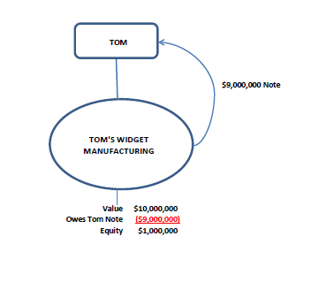
Debt Equity Planning
Tom owns a company that has a $10,000,000 book value and no debt.
It makes widgets and may be sued.
Why not have Tom be owed $9,000,000 on a note secured by a pledge of the assets of the company, so that if something bad happens in the company, Tom can foreclose and receive $9,000,000 worth of assets to be in front of the other creditor or creditors.
Typically, this can be done tax-free.

Slide 96
Equity Stripping – Preferred Debtors:
Recapitalize companies with debt
Cross-collateralize loans and pledge assets
Let a friendly creditor get a judgment
Long term leases with acceleration clauses
The ELOPE System

Slide 97
What Can Be Pledged?
Real estate can be mortgaged.
Furniture, equipment, and other non-real estate physical items can be liened by UCC-1 financing statements and legitimate debt.
Intangible assets such as software, logos, 11 secret herbs and spices, stock certificates, ownership in an LLC, and other assets that are not physical in nature can be pledged and/or liened by UCC-1 filing, depending upon state law.
CDs, brokerage accounts, life insurance policies, and annuities can be liened by contractual arrangements based upon forms that most financial institutions and insurance companies have readily available
Your dog
It is not enough to “say” or provide in a contract that an asset will be “secured” by debt. There has to be “perfection of a security interest” under state law - usually two years before another creditor arrives on the scene.

Slide 98
A landlord is a creditor, in effect:
A long term lease that gives the landlord the ability to collect all future rent upon default, and a lien on the assets of the tenant can be an effective creditor protection arrangement.
Cross-collateralization, and guarantees:
Multiple entities can be protected by having common obligations under multiple loans and collateralization arrangements – but the “friendly creditor” will have a lot of leverage against the assets and entities, if it ever becomes unfriendly.

Slide 99
Is A Line Of Credit With A Secured Interest Against Assets Enough to Protect Against Creditors?
  Not if nothing is owed – only to the extent that monies are owed before the problem occurs
  The creditors will not know how much is owed by looking in the public records – they will just know that the lender has a lien, which can deter litigation.

Slide 100
    Charging Orders and an “Over Easy LLC Parent”
SMITH REVOCABLE TRUST
OTHER INVESTOR
A regular corporation has no charging order protection (except perhaps in Nevada)
Why not update the entity ownership by adding a Parent LLC to facilitate a well written By/Sell Agreement between owners, own life insurance for Buy/Sell Agreements that will not be exposed to creditors of the operating entity, and having the operating entity owe a reasonable amount to the new Holding Company?
66.667%
33.333%
SMITH HOLDINGS, LLC
(WY)
(S. Corp.)
(Promissory Note Owed to Holding Company)
100%
SMITH STORE, INC.
(FL)
(Q-Sub)
Other Possible Subsidiary
(Disregarded)
(Valuable assets may be transferred out of Smith Store, Inc.)

Slide 101
Advantages of Over Easy LLC Arrangement
1. No need to change the name or Tax Identification Number of subsidiary entity.
2. The new parent company LLC entity can loan money to the subsidiary entity, and receive a lien on the assets.
3. The new parent company LLC can own life insurance used for buy/sell purposes that is not exposed to creditors of the subsidiary.
4. The parent company LLC can be formed in another jurisdiction that has better creditor protection and/or tax features without registering to do business where the subsidiary operates.
5. This is a tactful way to eliminate present ownership agreements or arrangements under the subsidiary in an indirect manner.

Slide 102
Disadvantages of Over Easy LLC Arrangement
1. The cost of forming a new LLC, and explaining the arrangement.
2. The cost of maintaining a separate LLC, which does not have to file federal income tax returns.
3. Coordination of transition.

Slide 103
Debt Planning for the Professional Practice
and Practice Real Estate
JOHN
“No Debt”
IRREVOCABLE TRUST FOR FAMILY
(Disregarded)
96.5% Non-Voting
.5% Voting
2.5% Non-Voting
.5% voting
FAMILY LLC
(Disregarded)
94.5% Non-Voting
.5% Voting
4.5% Non-Voting
.5% Voting
Professional Practice
Professional Practice Real Estate
(Triple-Net Lease)
Owns Building
$1,800,000 in Asset Value
$1,200,000 Value

Slide 104
“With Maximum Debt Possible Without Triggering S Corporation Income”
JOHN
IRREVOCABLE TRUST FOR FAMILY
(Disregarded)
96.5% Non-Voting
.5% Voting
2.5% Non-Voting
.5% voting
FAMILY LLC
(Disregarded)
94.5% Non-Voting
.5% Voting
(Owes $900,000)
(Owes $800,000)
4.5% Non-Voting
.5% Voting
Professional Practice
Professional Practice Real Estate
(Triple-Net Lease)
$1,800,000 in Asset Value
($ 800,000) Debt
$ 1,000,000 Equity
$1,200,000 Value
($ 900,000) Debt
$ 300,000 Equity
Owns Building

Slide 105
“Increasing Debt by Establishing New Parent F Company”
JOHN
IRREVOCABLE TRUST FOR FAMILY
(Disregarded)
96.5% Non-Voting
.5% Voting
2.5% Non-Voting
.5% voting
Professional Practice S Corp
FAMILY LLC
(Disregarded)
94.5% Non-Voting
.5% Voting
(Owes $500,000)
(Owes $900,000)
(Owes $800,000)
4.5% Non-Voting
.5% Voting
Professional Practice
Professional Practice Real Estate (Taxed as Partnership)
(Triple-Net Lease)
$1,800,000 in Asset Value
($ 800,000) Debt
($ 500,000) Debt
$ 1,000,000 Equity
$1,200,000 Value
($ 900,000) Debt
$ 300,000 Equity
Owns Building

Slide 106
Extended Letter of Protection Enhancement (ELOPE System)
To enable a Family Limited Partnership and child-owned management entity to derive reasonable
profits for the purchase and administration of letters of protection
Physicians and/or spouse may own entity
Physician & Spouse TBE
CHILDREN (AND/OR TRUSTS FOR THEIR CHILDREN)
Parent S Corporation
5% by TBE
50% by children
S Corporation Mgmt Co.
95% by children
50% by TBE
100%
100%
Investment Assets - $1,000,000
Margin Acct Debt
Mgmt Co pays brokerage firm _% interest
Family Limited Partnership
($500,000)
100%
Pays for Letters of Protection
Management fees
Financial Account
Medical Practice Entity (QSUB)
Acme Factoring, LLC
Brokerage Account
Family Limited Partnership makes loans to Acme Factoring, LLC which repays interest
Transfers Letters of Protection
Funded from sales of Letter of Protection from Acme Factoring, LLC
Owns furniture and unsold accounts receivable
Brokerage Firm loans money to Partnership at 6.8% interest
Account can be pledged for load advanced from brokerage firm

Slide 107

Using LLCs and Trusts to Protect
Otherwise Exposed Assets, Part 1
CLIENT
SPOUSE OF CLIENT
$5,000,000
Client owns $5,000,000 building.
Lender is willing to loan $4,500,000 on building.

Slide 108
Using LLCs and Trusts to Protect Otherwise Exposed Assets, Part 2
Debt Planning for the Solvent Family that Wants to Stay that Way
CLIENT
Irrevocable Trust for Spouse & Descendants
Lender made $4,500,000 loan to client that went into LLC B.
Client contributed $4,500,000 to LLC B.
95%
100%
LLC
A
Client is the manager of LLC B.
5%
Lender
LLC
B
Lender owed Note and mortgage by Client securing the property under LLC A.
Building assets protected by lien or mortgage held by friendly creditor
Guaranteed Note to Lender
Purchased $4,500,000 of investments(pledged to Lender)

Slide 109
Coordination of Buildings and Businesses
Debt on building may protect assets of business equity.
Lease obligation to landlord company provides further protection.
SPOUSE 1
SPOUSE 2
GIFT
TRUST
TBE
95%
5%
95%
5%
BUSINESS ENTITY
BUILDING
ENTITY
(20 year lease)
(Guarantees mortgage and pledges assets as collateral)
UCC Filing
(mortgage)
TBE and charging order protection, along with cross- collateralization to protect a married couple's business and investment assets, and reduce federal estate tax.

Slide 110
Equity Stripping
Example:
.
John has ten rental houses worth $3,000,000 and would like to have $2,600,000 safely set aside in an offshore trust for future creditor protection.
Bank of Offshore sets up a Delaware company called ABC Lenders.
John establishes an offshore trust called DEF Trust for John and his family.
ABC Lenders places $2,600,000 into the DEF trust account, and John can direct the investments into CDs, bonds, and other safe (but permitted) vehicles.
The parties sign agreements so that there is a mortgage of public record owed to the Delaware company and secured by a mortgage on John’s properties.

Slide 111
Equity Stripping
Example, Continued:
.
By separate agreement, the DEF Trust pledges its assets as additional collateral in case the foreign lender cannot receive full payment in the event of a default.
John’s financial statements show $3,000,000 in properties, $2,600,000 in mortgages owed on the properties, and that John is the discretionary beneficiary of an offshore trust with $2,600,000 in assets.
John gets into an unexpected and horrendous creditor situation.
The creditor settles the case for $300,000 after reviewing John’s financial statements.
John and his properties live happily ever after.

Slide 112
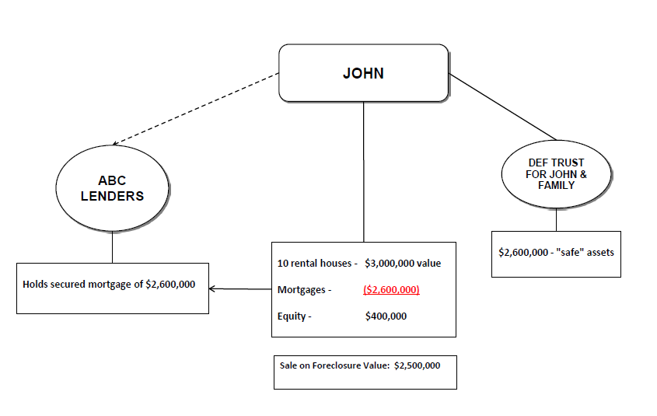

Slide 113
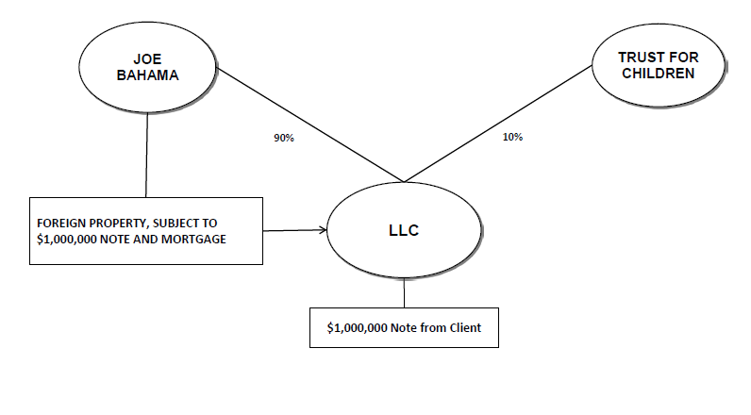
How To Protect A Foreign Property From Being “Easy Pickin’s” Without Transferring The Property

Slide 114
Friendly Judgments
Definition:
Court orders declaring amounts owed by reason of a trial or forfeiture; the judgment “attaches” to all real estate and certain other assets upon filing in the public records by the plaintiff. Once other creditors see a large judgment, they are typically reluctant to spend money to be in “second place.”
20 years is a long time!
When you owe money to two creditors – have a friend buy the position of the first creditor, and record the Judgment to be in front of the second creditor who does not yet have a judgment.

Slide 115
Judgments
If a debtor with a reasonable income and $200,000 of exposed assets has three separate creditors with potential judgments of $800,000 each, a friend of the debtor can approach each creditor and offer to buy the judgment. The creditor willing to sell their rights to pursue a judgment for the least amount (perhaps $125,000) can sell it to a company that the debtor invests in.
The company obtains the judgment, files it of public record against the debtor in the amount of $800,000, and the debtor can pledge the debtor’s assets as additional collateral for a work out that allows the debtor to pay $50,000 a year for four years. Upon default, whatever is left of the $800,000 becomes due and payable.
Are the other two creditors now going to pursue this debtor? Would there be anything for them to get if they do?

Slide 116
#3
Charging Order
Entities

Slide 117
Charging Order Entities:
Limited Liability Companies and Limited Partnerships in jurisdictions that have charging order protection.
Does your home state have charging order protection?
Give voting rights away to facilitate protection.

Slide 118
Wells Fargo Equip. Fin., Inc. v. Retterath
“No. 18-0599
04-12-2019
WELLS FARGO EQUIPMENT FINANCE, INC., Appellee, v. Jason RETTERATH and Analia Retterath, Appellants.” Wells Fargo Equip. Fin., Inc. v. Retterath, 928 N.W.2d 1, (Iowa 2019)
A judgment creditor filed foreign judgments and obtained a charging order to execute these foreign judgments in Iowa district court against the judgment debtor’s membership interests in an Iowa limited liability company (LLC). The judgment debtor and his wife filed a petition to vacate the charging order based on their claim that the creditor could not attach these interests since the debtor and his wife owned them as a tenancy by the entireties in their domicile of Florida. The creditor filed a motion for summary judgment, maintaining Iowa law governs and the legal doctrine of tenancy by the entireties does not exempt the debtor’s membership interest in the Iowa LLC since Iowa does not recognize tenancy by the entireties. The district court granted the creditor’s motion for summary judgment and dismissed the couple’s petition to vacate the charging order.
On appeal, the couple presents multiple claims. First, they argue the district court erred by applying Iowa law instead of Florida law. Second, they contend the district court erred in determining the couple did not own their membership units in a tenancy by the entireties. Third, the couple claims the foreign judgments were not properly registered, nor was the charging order properly issued. Finally, they challenge the district court’s ruling that there were no due process grounds to vacate the charging order. For the reasons set forth below, we affirm the district court judgment.

Slide 119
I. Background Facts and Proceedings.
Jason and Analia Retterath are Florida citizens and residents of Palm Beach County, Florida, who have been married since February 13, 1999. Wells Fargo Equipment Finance, Inc. (WFEFI) is a Minnesota corporation with its principal office in Minneapolis, Minnesota, that is the owner and holder of two Florida judgments against Jason arising from its suit against Jason in Broward County, Florida. The litigation that led to these judgments began in November 2009, and the judgments were entered on August 22, 2011, and January 23, 2012.
On December 22, 2015, WFEFI caused these judgments to be filed in the Iowa District Court for Chickasaw County alongside an affidavit in support of foreign judgment, listing Jason’s name and last known address. The clerk of court did not make a note of the mailing notice of the filing of WFEFI’s foreign judgments to Jason in the docket. On January 6, 2016, WFEFI filed its application for charging order pursuant to Iowa Code section 489.503 in Iowa district court. WFEFI sought to execute the Florida judgments against Jason’s membership interest in Homeland Energy Solutions, LLC, (Homeland), an Iowa limited liability company that has its home offices in Lawler, Iowa. Counsel for WFEFI certified the application, which was mailed to Jason in conjunction with its filing. Jason stated in an affidavit that he did not "receive service of process or otherwise receive notice of the proceedings that resulted in the Charging Order.“
Homeland owns and operates ethanol production and by-product production facilities, and it also markets and processes ethanol and related by-products. Though it is located in Iowa, Homeland began selling membership units in the state of Florida in 2006. Its affairs are governed by its operating agreement, which is entered into between Homeland and "each of the Persons identified as Members on the Company’s Unit holder Register and any other Persons that may from time-to-time be admitted as Members of the Company in accordance with the terms" of the agreement. According to the agreement, "[t]he laws of the State of Iowa shall govern the validity of this Agreement, the construction of its terms, and the interpretation of the rights and duties arising thereunder."

Slide 120
Jason acquired his membership interest in Homeland in his individual capacity on October 29, 2007, when he purchased 2000 units at a price of $1000 per unit. He acquired an additional 250 units in his individual capacity by means of a corporate transfer of assets agreement on May 14, 2010, which was after WFEFI commenced its Florida action against Jason. On December 15, 2010, Jason transferred all of his individual membership units in Homeland to himself and Analia through a unit transfer application. The transfer application required Jason to choose one of the following forms of ownership: individual, joint tenants with right of survivorship, corporation on partnership, trust, or other. Jason marked the "Joint Tenants with Right of Survivorship" box to indicate the form of ownership. The Retteraths file tax returns in Iowa to, among other things, report the income they receive from Homeland. Prior to the charging order, Homeland made distribution payments directly to the Retteraths’ personal joint banking account in Florida.
On January 8, 2016, WFEFI filed an affidavit regarding the amounts due on the Florida judgments, which was served on Jason. Shortly thereafter, the district court entered a charging order on January 12, which stated,
  IT IS, THEREFORE, ORDERED that WFEFI is hereby granted a charging order against the entire membership interest of [Jason] Retterath in Homeland pursuant to Iowa Code section 489.503. Any amount to be distributed to [Jason] Retterath up to and including the amount to fully satisfy WFEFI shall be remitted payable to Wells Fargo Equipment Finance, Inc.... Any amount so received by WFEFI shall be satisfied, and WFEFI shall submit a partial or full satisfaction as appropriate to indicate the status of the Charging Order. In the event of full satisfaction, any surplus shall be paid to Retterath.
The charging order was served on Jason through the mail to his correct address.
On July 13, Jason and Analia Retterath filed a petition to vacate the charging order, claiming they took possession of the Homeland membership units simultaneously as tenants by the entireties under Florida law. The Retteraths maintained Florida law governs their ownership of the Homeland units and Florida law prohibits making property owned as a tenancy by the entireties available to answer for the judgment debts of one of the tenants individually. The petition noted Analia was never served with process or otherwise provided notice of the application for charging and claimed this lack of notice violated Analia’s due process rights under the Federal and Iowa Constitutions. The Retteraths also claimed the statutory scheme of Iowa Code chapter 626A violates their right to procedural due process.
WFEFI filed its answer to the petition to vacate on August 5, asserting Iowa law governs the parties’ dispute and the legal doctrine of tenancy by the entireties does not exempt Jason’s membership interest in Homeland from the judgment. Thus, WFEFI argued as an affirmative defense that the Retteraths failed to state a claim for which relief may be granted. WFEFI and the Retteraths filed motions for summary judgment on March 3, 2017, and the parties filed a resistance to the opposing party’s respective motion for summary judgment on March 24.

Slide 121
On February 8, 2018, the district court granted WFEFI’s motion for summary judgment and denied the Retteraths’ motion for summary judgment. The district court also dismissed the Retteraths’ petition to vacate the charging order. Though the district court found it was unnecessary to determine whether Florida or Iowa law applied, it still addressed the issue and determined Iowa law applied since "Iowa has the most significant contacts with this dispute." Nevertheless, the district court concluded a tenancy by the entireties did not exist even if Florida law applied since they did not receive title from the same conveyance. The district court explained Jason received his membership interest from Homeland, while Analia later received her membership interest from Jason. Finally, the district court addressed WFEFI’s claim from its supplemental brief, which accused Jason of fraudulent conversion for transferring his Homeland membership units to avoid creditors to the underlying lawsuit. The district court concluded additional findings of fact were required and denied summary judgment on the fraudulent conversion issue.
On February 23, the Retteraths filed a motion to enlarge and modify pursuant to Iowa Rule of Civil Procedure 1.904(2), requesting the district court rule upon their claims that the charging order is void because it was issued without jurisdiction over the Retteraths, the statutory scheme of Iowa Code chapter 626A violates their right to procedural due process, and the charging order violated Analia’s right to due process. The district court entered an addendum to its ruling on the motions for summary judgment on March 7. The district court denied the Retteraths’ request to set aside the charging order on due process grounds because Analia was not entitled to notice since she was not a judgment debtor of WFEFI and the order did not direct any collection against her interest. The Retteraths filed their notice of appeal on April 2. We subsequently granted and retained the appeal.

Slide 122
III. Analysis.
On appeal, the Retteraths present a number of challenges to the district court’s ruling. First, they challenge the district court’s conclusion that Iowa law applied to the dispute instead of Florida law. Second, the Retteraths claim the district court erred in determining they failed to show the necessary "unity of time" element of a tenancy by the entireties under Florida law when Jason transferred ownership of his Homeland units to Jason and Analia. Third, they contend the district court erred in concluding the foreign judgments were properly registered and the charging order was properly issued in order for the district court to obtain jurisdiction over the Retteraths. Finally, the Retteraths argue the district court erred in denying their due process challenge.
Choice of Law. The Retteraths challenge the district court’s conclusion that Iowa law applies to their dispute with WFEFI. The district court reached this decision based on its application of the Restatement (Second) of Conflict of Laws sections 222 and 6, which the Retteraths maintain was inappropriate because Iowa has not applied general choice of law principles in the past. Instead of general choice of law principles, the Retteraths argue Iowa law governing personal property applies to their membership interests in Homeland. Thus, the Retteraths claim the situs of their Homeland membership units is the Retteraths’ domicile, which is Florida. The Retteraths also contend the district court erred in relying on the choice-of-law clause in Homeland’s operating agreement.
Courts are divided in determining where the intangible property interest in an LLC lies, and this is an issue of first impression in Iowa. See JPMorgan Chase Bank, N.A. v. McClure , 393 P.3d 955, 958–59 (Colo. 2017) (en banc). We have previously held the situs of similar forms of intangible personal property, such as corporate stock, "is governed by the law of [the owner’s] domicile, and not by the law of the corporate domicile." Judy v. Beckwith , 137 Iowa 24, 30, 114 N.W. 565, 567 (1908) ; see, e.g. , City of Dubuque v. Ill. Cent. R.R. , 39 Iowa 56, 84, (1874) ("As a rule of law, the situs of [railroad rolling stock] is determined by the domicile of the owner. This is true as to questions affecting the sale, distribution, and right of possession thereof."). However, an individual’s interest in an LLC is unlike other forms of intangible personal property since the typical levying procedures available to creditors for similar forms of intangible personal property are unavailable to creditors seeking to levy an individual’s interest in an LLC. Iowa and Florida both have adopted forms of the Revised Uniform Limited Liability Company Act (RULLCA). See Iowa Code § 489.101 (2017); Fla. Stat. Ann. § 605.0101 (West, Westlaw through 2019 1st Reg. Sess. through Mar. 18, 2019). Under the RULLCA in Iowa, a charging order is "the exclusive remedy by which a person seeking to enforce a judgment against a member or transferee may, in the capacity of judgment creditor, satisfy the judgment from the judgment debtor’s transferable interest." Iowa Code § 489.503(7). Likewise, in Florida,

Slide 123
a charging order is the sole and exclusive remedy by which a judgment creditor of a member or member’s transferee may satisfy a judgment from the judgment debtor’s interest in a limited liability company or rights to distributions from the limited liability company
unless the limited liability has only one member. Fla. Stat. Ann. § 605.0503(3).
Charging orders provide a judgment creditor with the ability to satisfy a judgment from the judgment debtor’s transferable interest in an LLC while simultaneously allowing the LLC to protect its other members’ interests and continue operating. 51 Am. Jur. 2d Limited Liability Companies § 23, at 858–59 (2011). A charging order allows a judgment creditor to obtain "a lien on a judgment debtor’s transferable interest and requires the limited liability company to pay over to the person to which the charging order was issued any distribution that would otherwise be paid to the judgment debtor." Iowa Code § 489.503(1) ; see also Fla. Stat. Ann. §
605.0503(1) ("[A] charging order constitutes a lien upon a judgment debtor’s transferable interest and requires the limited liability company to pay over to the judgment creditor a distribution that would otherwise be paid to the judgment debtor."). This remedy is unique to an interest in an LLC, as it is premised upon the distinct ability to separate the individual’s economic interest in an LLC from the LLC’s operations and the interests of its other members. See 51 Am. Jur. 2d Limited Liability Companies § 23, at 858–59.
Charging orders are not available for other forms of intangible personal property. Moreover, both Iowa and Florida law concerning a "transferable interest" in an LLC characterizes the LLC as the core of the interest. Specifically, Iowa law defines a "transferable interest" in an LLC as
the right, as originally associated with a person’s capacity as a member, to receive distributions from a limited liability company in accordance with the operating agreement, whether or not the person remains a member or continues to own any part of the right .
Iowa Code § 489.102(24) (emphasis added). Florida similarly defines a "transferable interest" as
the right, as initially owned by a person in the person’s capacity as a member, to receive distributions from a limited liability in accordance with the operating agreement, whether the person remains a member or continues to own a part of the right.
Fla. Stat. Ann. § 605.0102(66). The individual LLC member, and thus the location of the member, is secondary to the member’s transferable interest in the LLC. See Iowa Code § 489.102(24) ; see also Fla. Stat. Ann. § 605.0102(66). Consequently, while the Retteraths are correct to note their Homeland interests are personal property under the law, there are unique attributes of a membership interest in an LLC that render our traditional debtor-domicile analysis applied to other forms of intangible personal property inadequate with regard to the situs of a membership interest in an LLC.

Slide 124
For the purposes of determining the enforceability of a charging order, we hold that a member’s membership interest is located where the LLC was formed. Our holding aligns with the anomalous characteristics of a membership interest in an LLC, particularly because a charging order is directed to the LLC rather than the individual member since it requires the LLC to redirect the debtor-member’s distributions to the creditor. See Iowa Code § 489.503(1) ; see also Fla. Stat. Ann. § 605.0503(1). Additionally, Iowa law governs an LLC’s "internal affairs" and "[t]he liability of a member as member and a manager as manager for the debts, obligations, or other liabilities" of the LLC. Iowa Code § 489.106. Locating the membership interest in the state in which the LLC was formed recognizes this authority and promotes uniformity. "To conclude otherwise (i.e., that the interest lies wherever the debtor happens to be domiciled) could result in substantial uncertainty and confusion," as an LLC could become subject to various and competing charging orders from differing foreign jurisdictions. JPMorgan Chase Bank, N.A. , 393 P.3d at 959. Likewise, our holding creates certainty for creditors because it provides them with a fixed jurisdiction to pursue charging orders.
In this case, the Retteraths’ interests in Homeland exist under Iowa law, and their creditor’s remedies are also limited by Iowa law. Accordingly, we hold membership interests in an LLC are located in the state where the LLC is formed. The district court correctly concluded Iowa law applies to this case. Further, the district court correctly dismissed the Retteraths’ petition to vacate the charging order since Iowa law does not recognize the ownership of property by a married couple as tenants in the entireties. See Fay v. Smiley , 201 Iowa 1290, 1294, 207 N.W. 369, 371 (Iowa 1926) ("Assuming for the purpose of this division of this opinion, that this deed, in the eyes of the common-law rule, would create an estate in entirety, we have to say that such a construction has never been recognized under the Iowa practice; and, when attempts have been made to induce the court to make such construction, it has refused to do so."). Given this lack of recognition of the doctrine of tenants in the entireties, the district court also correctly found the foreign judgments were properly registered and the charging order was properly issued. Similarly, we need not address Analia’s due process claim since Iowa does not recognize her right to own Homeland interests jointly with her husband as a tenancy by the entireties. She was not entitled to notice since she is not a judgment debtor of WFEFI.
B. Registration of Foreign Judgments. The Retteraths contend the district court erred in concluding the foreign judgments were properly registered and the charging order was properly issued. When a judgment creditor files a foreign judgment, "the judgment creditor or the creditor’s lawyer shall make and file with the clerk of court an affidavit setting forth the name and last known post office address of the judgment debtor, and the judgment creditor." Iowa Code § 626A.3(1). Additionally,
  [p]romptly upon the filing of the foreign judgment and the affidavit as provided in subsection 1, the clerk shall mail notice of the filing of the foreign judgment to the judgment debtor at the address given and shall make a note of the mailing in the docket. The notice shall include the name and post office address of the judgment creditor and the judgment creditor’s lawyer, if any, in this state.

Slide 125
Other Porcupines:
Property with hazardous waste
Other assets that a creditor does not want to touch
The debtor may invest in highly leveraged or environmentally sensitive property that a lender or other creditor would not want involvement with.
Get an orphanage involved…The story of an island on a river!

Slide 126
8 Common LLC Planning Errors
Limited Liability companies are quite often the entity of choice for investment and business holdings. Problems can arise, however, where structuring does not take important risks and federal and state law requirements into account. Some of the most common problems we encounter in reviewing LLC arrangements for clients are:
1.) Tenancy by the Entireties Designation that Will Not Qualify as TBE
Many married couples in states that protect tenancy by the entireties assets from the creditor of one spouse or the other have their LLC interests titled jointly as tenants by the entireties, but they don’t realize that there are provisions in the operative documents which are inconsistent and would, thus, annul tenancy by the entireties characterization and protection. Common examples of this are:
(a) By the rules of tenancy by the entireties, the joint interest must pass outright solely by the surviving spouse in the event of the death of the surviving spouse. Oftentimes, an operational document will provide that, on the death of a member, the interest of that member must be sold. Agreements are commonly not drafted to explicitly provide that on the death of a spouse, the other spouse will be the owner of the joint interests, without any inconsistent member agreement provisions.
(b) Similarly, provisions under an operative document which restrict transfers may actually be read to prevent one spouse from owning the entire member interest on the death of another spouse.
(c) While the certificate of ownership may be issued to both spouses as tenants by the entireties, oftentimes, the Operating Agreements or Articles of Organization will provide for only one spouse or the other to be an owner.

Slide 127
8 Common LLC Planning Errors
2.) Entity Documents Can Disqualify S Election
Limited liability companies may be treated as S Corporations under the federal income tax law if certain very strict requirements are met and an S election is made. If the S election is made but the S Corporation requirements are not met, then the company will be taxed as a “C Corporation,” therefore exposing properties and income to double tax.
Common causes of this catastrophic treatment are as follows:
(a) An operating agreement does not provide for all income to be distributed pro rata to ownership. Commonly, “partnership style” clauses assure members that they will recapture their original investment or have some sort of an income sharing that would reflect a “second class of stock,” which is not permitted under the S Corporation Rules.
(b) Although state law permits a limited liability company to have non-citizens, corporations, and other entities own LLC interests, these and certain other entities are not permitted owners of S Corporation stock and will, thus, cause disqualification.
(c) Too high of a debt equity ration could cause disqualification from S Corporation status.

Slide 128
8 Common LLC Planning Errors
3.) Failure to Plan for Cash or Other Distributions/Failure to Use an Intermediary Entity
Oftentimes, a client will invest in a multiple member LLC, expecting to have charging order creditor protection, but not thinking through that positive cash flow that other members will want to assure is distributed will become accessible to a judgment creditor who has a charging order against the LLC. Many clients are well advised to establish a “Family Holding LLC” or a family limited partnership to hold the multiple member LLC interests so that positive cash flow would pass to the family LLC to be held and reinvested in a protected manner.
Clients who take ownerships in a multiple member LLC as tenants by the entireties may wish to do so under a limited liability company or limited partnership owned by the spouses and another family member in order to assure that upon the death of one spouse tenancy by the entireties status would continue, and positive cash flow from the multiple member LLC will, thus, be protected.
4.) Forced Sale Provisions
Often, well-drafted Operating Agreements will have provisions that would allow any member to force a sale of their member interests at any time or under certain circumstances, such as where another member is selling their interest (“tag along rights”). One advantage of a limited liability company under the laws of most states is that the sole remedy of a judgment creditor is a charging order – meaning that the credit cannot actually force the sale of the limited liability company interest, become a forced owner, or reach into the limited liability company. A bankruptcy or state court judge may override charging order protection where a debtor member would have the right to simply “cash out” at the time when the judgment creditor has a charging order against the debtor.

Slide 129
8 Common LLC Planning Errors
5.) We “Formed it Ourselves” or “My Accountant Took Care of This.”
While it is possible for any third grader to file a charter to establish the existence of an LLC with state authorities, in the author’s experience, the vast majority of LLCs that have been established by non-lawyer personnel have been implemented incorrectly. In most states, it’s the unauthorized practice of law for a non-lawyer to establish and implement a limited liability company for another party. Therefore, the types of non-legal firms that are willing to establish and implement limited liability companies tend to be unconcerned and ignorant, willfully or inadvertently, of the formalities, paperwork, and coordination needed to properly establish, document, implement, and operate a limited liability company. Clients who buy $99 “Total Service Incorporation Kits” run the same risks. The slogan “Pay us now or pay us later” comes to mind, but along with that comes “Pay us later and watch your assets looted by creditors and/or the Internal Revenue Service.”
6.) Assuming that Limited Liability Companies are as Well Protected as Limited Partnerships in All States
Some states provide charging order protection for limited partnerships but not limited liability companies. Clients who have or will have children or other members residing in a state or jurisdiction that may not protect them may want to consider using limited partnerships or other entities in lieu of limited liability companies.

Slide 130
8 Common LLC Planning Errors
7.) Failure to Properly Respect Formalities and the Existence of the LLC
It is generally very difficult to “break the corporate veil,” but a debtor relying upon a limited liability company arrangement needs to be able to show that the company was the actual owner and operator of the property/business, that a charter was properly filed and maintained consistent with operational documents, accounting and tax treatment, and that the arrangement was not in reality a general partnership, a joint venture, or a proprietorship.
8.) Personal Activities May Not be Insulated by Use of an LLC
Some clients believe that they can carry on consulting, management, or related activities under the name of their LLC and not have potential personal liability.
Under general tort law, the officer of a company and the manager of an LLC will be responsible to third parties for personal negligence. Many clients are well advised to keep a low profile with respect to LLC activities and to hire third parties to handle management decision making and day-to-day activities.

Slide 131
#4
Insurance and Checklists

Slide 132
ASSET PROTECTION CHECKLIST – Page 1

Slide 133
ASSET PROTECTION CHECKLIST – Page 2
Notes:
Separate activities and exposures.
3
Impact on an estate plan.
Leasing arrangements with landlord rent right secured by UCC-1 on tenant’s property.
4
Federal and state criminal law.
Car use.
5
Exposure of the advisor.
Car ownership.
6
Exemptions that apply on death – do not make life insurance or annuities payable to an estate or to a trust that provides that estate obligations must be paid.
Delegate to offshore employees.
7
Client guarantee.
Employee causes of action – make sure they have Workers’ Compensation.
8
Confidentiality – use an anonymously owned LLC from Wyoming, Delaware or Colorado to serve as manager of operational LLC’s and Trustee of Homestead Land Trust, and file Certificates of Authority in each county where real estate is located.
Separate intellectual property rights.
9
Equity Stripping – debt secured by a mortgage or lien on valuable assets at risk may be payable to arm’s-length lenders or related party lenders under a number of various arrangements.
Alcohol at events.
10
Make your children self-supporting.
Using independent contractors.
11
Get divorced soon, or not at all.
Client/Patient/Supplier Arbitration Agreements.
Consider New Parent F Reorganization to separate assets within a company without triggering capital gains.
Consider factoring accounts receivable to a related company that may be held for descendants.
Trusteed or Partnership/LLC based Buy/Sell Life Insurance Arrangement.
Consider leasing use of equipment on a triple net basis – be sure all activities are insured.
Pension contributions.

Slide 134
ASSET PROTECTION CHECKLIST – Page 3
Notes:
Separate activities and exposures.
3
Impact on an estate plan.
Leasing arrangements with landlord rent right secured by UCC-1 on tenant’s property.
4
Federal and state criminal law.
Car use.
5
Exposure of the advisor.
Car ownership.
6
Exemptions that apply on death – do not make life insurance or annuities payable to an estate or to a trust that provides that estate obligations must be paid.
Delegate to offshore employees.
7
Client guarantee.
Employee causes of action – make sure they have Workers’ Compensation.
8
Confidentiality – use an anonymously owned LLC from Wyoming, Delaware or Colorado to serve as manager of operational LLC’s and Trustee of Homestead Land Trust, and file Certificates of Authority in each county where real estate is located.
Separate intellectual property rights.
9
Equity Stripping – debt secured by a mortgage or lien on valuable assets at risk may be payable to arm’s-length lenders or related party lenders under a number of various arrangements.
Alcohol at events.
10
Make your children self-supporting.
Using independent contractors.
11
Get divorced soon, or not at all.
Client/Patient/Supplier Arbitration Agreements.
Consider New Parent F Reorganization to separate assets within a company without triggering capital gains.
Consider factoring accounts receivable to a related company that may be held for descendants.
Trusteed or Partnership/LLC based Buy/Sell Life Insurance Arrangement.
Consider leasing use of equipment on a triple net basis – be sure all activities are insured.
Pension contributions.

Slide 135
ASSET PROTECTION CHECKLIST – Page 4
Notes:
Separate activities and exposures.
3
Impact on an estate plan.
Leasing arrangements with landlord rent right secured by UCC-1 on tenant’s property.
4
Federal and state criminal law.
Car use.
5
Exposure of the advisor.
Car ownership.
6
Exemptions that apply on death – do not make life insurance or annuities payable to an estate or to a trust that provides that estate obligations must be paid.
Delegate to offshore employees.
7
Client guarantee.
Employee causes of action – make sure they have Workers’ Compensation.
8
Confidentiality – use an anonymously owned LLC from Wyoming, Delaware or Colorado to serve as manager of operational LLC’s and Trustee of Homestead Land Trust, and file Certificates of Authority in each county where real estate is located.
Separate intellectual property rights.
9
Equity Stripping – debt secured by a mortgage or lien on valuable assets at risk may be payable to arm’s-length lenders or related party lenders under a number of various arrangements.
Alcohol at events.
10
Make your children self-supporting.
Using independent contractors.
11
Get divorced soon, or not at all.
Client/Patient/Supplier Arbitration Agreements.
Consider New Parent F Reorganization to separate assets within a company without triggering capital gains.
Consider factoring accounts receivable to a related company that may be held for descendants.
Trusteed or Partnership/LLC based Buy/Sell Life Insurance Arrangement.
Consider leasing use of equipment on a triple net basis – be sure all activities are insured.
Pension contributions.

Slide 136
THE CPA’S CHECKLIST FOR FLORIDA CREDITOR
PROTECTION PLANNING AND MAINTENANCE
1. Do the clients know about tenancy by the entireties protection?
Are the clients’ assets held as tenants by the entireties? Were the right boxes checked when they opened an account? Do they have out of state real estate that needs to be placed under a Florida LLC? c. How will the client’s fund a bypass trust on the 1st death if everything is owned jointly? – Disclaimer planning. d. Are K-1’s being issued to both spouses or to the correct spouse or entity? If a husband and wife own S-Corporation stock or a partnership interest as tenants by the entireties is it proper to be issuing separate K-1’s to them for 50% each of the interest? Often the CPA’s file is the only place to find documentation on how stock and LLC interests are owned. e. How do stock certificates read? f. What names are on contracts? g. Is property held in a state that allows for tenancy by the entireties? Have the clients considered a TBE owned LLC or family limited partnership. Do their LLC’s have proper operative language?
Is the homestead more than ½ an acre within the city limits or more than 160 acres in the county? Homestead is owned as tenants by the entireties as well?
4. Do they understand that the cash value of a life insurance policy is only protected when it is owned by the insured individual?
5. Is life insurance payable to protective trusts that can benefit the surviving spouse and descendants without being subject to their creditor claims? Does the client own life insurance policies on any other person - if so, it will not be creditor protected.
6. Is there an inherited IRA - inherited IRAs are not protected from creditors under recent Florida case law.

Slide 137
THE CPA’S CHECKLIST FOR FLORIDA CREDITOR
PROTECTION PLANNING AND MAINTENANCE
Who is responsible for making sure that LLCs are properly established and maintained? An improperly drafted LLC will not provide a Florida client with charging order protection or tenancy by the entireties status, even if intended to do so. Many lawyer do not know how to do this properly, so how can accountants and clients themselves even attempt this? Single member LLC’s do not have charging order protection. WARNING - It violates the unauthorized practice of law rules to set up LLC’s and to provide legal documents for LLC’s. This puts the CPA firm at risk for malpractice and licensing purposes.
Do the clients own assets that may cause liability, such as investment real estate, a business or even a charitable activity? Should these be placed in separate LLCs for liability insurance insulation purposes? Some clients think that a flow-through tax entity allows creditor claims to flow through, which is not of the case. Many clients think that revocable trusts will shield them from creditor claims. There is a big difference between avoiding probate and avoiding creditors. Who is the manager? Exposure of the manager? Do insurance carriers on agencies know how assets are owned?
Are proper formalities being followed so that one company or person is not considered an alter ego of the other for liability insurance insulation purposes. Are financial statements being prepared? For example, many CPA firms prepare a form 1065 for an entity taxes as disregarded simply to help confirm appropriate fiscal conduct and accountability.
10. Is the client being realistic about what their risks and exposures are with respect to potential upside down loan situations, guaranties, and real estate debt that may not be renewed. Why do some clients wait until it is too late? A nudge here and there can save significant problems.
11. How much should the CPA know? Will communications with the CPA and other parties become discoverable? Understand CPA client Florida litigation privilege – copies of letters or information given to third parties will be discoverable.

Slide 138
THE CPA’S CHECKLIST FOR FLORIDA CREDITOR
PROTECTION PLANNING AND MAINTENANCE
13. Is the client being accurate and truthful on financial statements provided to lending institutions? How specific do these statements need to be on issues such as joint assets and changes thereto. Proper footnoting is crucial.
14. Are insurance agencies and carriers aware of exactly what is being insured? Is the client telling the insurance carrier that the car is personal and not for business, while telling the IRS that the car is 90% business and is owned by a company? Can someone working for the CPA firm call the applicable insurance agencies to make sure that everything is coordinated? Make sure client understands exclusions, such as animals, pools, civic activities, church or synagogue activities, etc.
15. What is the client’s cash-burn rate? Are they waiting for the economy to turn around, and what if it does not and when do they run out of cash?
16. Schedule an annual review?
17. Consider new entities and trusts, including protective trust systems and limited liability entities. Segregate voting from non-voting under entities.
18. Annual input from and participation with qualified lawyer.
19. Debt at the Debtor’s Best Friend a. Is there one creditor who should be ahead of the others? Are all loans documented by promissory notes and secured by mortgages and/or security agreements? Review various debt-associated strategies, such as cross-collateralization and sale lease backs.

Slide 139
HAVE PLENTY OF INSURANCE COVERAGES –
1. LIABILITY AND CASUALTY INSURANCES.
2. Unowned vehicle insurance.
*(No motor vehicles owned by valuable business or asset holding entities.)
3. Business interruption insurance.
4. Employee practices insurance.
5. Cyber leaks and privacy invasion coverage.
6. Product liability insurance
  Have your insurance carrier come and see your situation from an OSHA and safety point of view.

Slide 140
    FLORIDA LIABILITY PLANNING- VEHICLE LIABILITY
Owner of the vehicle is responsible.
Possible exception if driver has $500,000 of liability coverage and owner is an individual who did not negligently entrust use of the car to the driver.
Parent must take minor to obtain driver’s license and sign an unconditional guarantee that will apply until age 18.
Use Uber instead!

Slide 141

    FLORIDA LIABILITY PLANNING- BOAT LIABILITY
Hello boat, goodbye money!
BOAT = Bring Out Another Thousand
Under Florida law the owner of the boat is responsible if on the boat at the time of the accident, whether piloting or not. In other jurisdictions ownership alone is sufficient to cause liability. Put the boat in an LLC and give the LLC to someone you don’t like. They deserve it.

Slide 142
    Florida Liability Planning
    Landlord Insulation From Potential Liability
A landlord is generally responsible for injuries on leased property if the landlord maintains a possessory interest or control over the property that contains a defect resulting in injury.
Giving a tenant authority to make changes to property can be dangerous from a contractual standpoint, but also necessary to insulate the landlord from premises liability.
However, do not let your clients give total control to a tenant who may cause significant financial liability as a result of this type of authority.
A provision to limit landlord liability may be helpful and is found in the full materials.
Clients might consider other ways of protecting real estate from potential liability, including having plenty of insurance, checking regularly to make sure the tenant is maintaining required liability insurance, keeping the property leveraged with debt, and owning it in a limited liability entity.

Slide 143

Understanding Your Liability Insurance Coverage
The vast majority of carriers will only issue a $250,000 policy on your home, a $250,000 policy on your driving, and a $250,000 policy on your vacation home. A separate “umbrella carrier” or “carriers” will then issue separate policies for above $250,000, as shown in the example below. Sometimes one carrier will write two or more of the below described policies, but often there will be 3 or more carriers involved and coordination can be a challenge:
$5,000,000 $251,000 | Umbrella Policy #1 Covers claims for home at $300,000 and for cars at $250,000. Must be “drop-down” umbrella if home policy is issued by Citizens or a comparable state agency that does not cover liabilities from pools, pets, or other notable exceptions. |  | $5,000,000 $301,000 | Umbrella Policy #2 May need a separate umbrella for out-of-state vacation home, large boats or other items.
$250,000 $0 | Policy #1 – Homeowners | Policy #2 – Vacation Home | $300,000 $0 | Policy #3 – Car Driver and Owner Policy | Policy #4 - Big Boat at Vacation Home

Slide 144
Asset Protection Ownership Choices
  In my own name.
  In my spouse’s name.
  In my mother’s name. Is it really hers?
  Tenancy by the entireties between spouses in a TBE state.
  In investments that are protected from creditors.
  (But not the IRS, the FTC, the SEC and future government categories).
  In LLC’s and Family Limited Partnerships.
  An offshore LLC or Family Limited Partnership.
  An offshore trust or foundation.
  In our children’s name(s).
      UTMA?
      529 Plans?
      Prepaid college savings plans?

Slide 145
Asset Protection Ownership Choices Continued
    In a trust for our children.
    In a trust for our children that we can be added to as beneficiaries if it falls apart.
        The above in a traditional law state.
        The above in an APT state.
        The above for estate tax planning purposes.
    In a foreign bank account or a Delaware bank account.
    In an LLC owned 95% by an offshore trust.
    In a company owned for my children or in a trust described above that earns monies for services rendered from my primary company for services offshore that are actually rendered and tax advantaged.
    In a trust formed by my parents for me that has invested wisely, and limits what I take out to what is needed for health, education and maintenance.
    In my assets, but subject to debt owed to others that liens or mortgages my assets.
    In a private charity.

Slide 146
#5
Foreign Companies and LLCs

Slide 147
Excerpt from a Thursday Report Article:
The Barber of Seville Replaces No Time for Sargeant
by Travis Arango and Alan Gassman
It is shocking that the difference between a Limited Liability Company’s membership interest and stock in a corporation could cause such a different result. In Sargeant v. Al-Saleh, the stock in a foreign corporation could not be reached by the court while Well Fargo Bank v. Barber sent the creditor offshore to get a foreign court to allow seizure. In Barber, sole ownership of a Nevis LLC was considered to be like any other intangible personal property that a Florida judgment could be applied against.
Fans of Gomer Pyle, U.S.M.C. might remember Andy Griffith’s movie No Time for Sergeants, where he starred as Private Will Stockdale. The Sargeant case caught the attention of a great many planners last year when the Fourth District Court of Appeal determined that stock held in a foreign country could only be seized by a creditor when permitted by a court sitting in that foreign country.
One would think that ownership in a limited liability company would be equivalent to owning stock in a foreign corporation, and that may be the case (not to be confused with a case of beer, which is what many planners are going to drink this weekend as they think about this case) because Judge Paul G. Byron, who sits at the United States District Court for the Middle District of Florida, determined that because an LLC membership interest is not “certificated,” it is “intangible personal property” that attaches to the debtor.

Slide 148
In No Time for Sergeants, the character played by Andy Griffith could never get his arms around the situation. Wells Fargo (which has been around since 1852, long before anyone had heard of Andy Griffith,) thought they were going to get their arms around stock but failed. The Barber of Seville was an opera that was written by Gioachino Rossini and Cesare Sterbini and first performed in 1861 at the Teatro Argentina in Rome, Italy. When someone gets a cut out of Will Stockdale, it is a heir-cut as opposed to a judicial haircut, which is what Ms. Barber got from Wells Fargo, when she expected that her Nevis LLC interest would not be seizeable[17] without getting a judgment in Nevis. Nevis does not recognize foreign judgments, let alone question the judgment of foreign countries.
The issue of this case will definitely be appealed by Ms. Barber or some subsequent debtor or creditor as this issue is litigated in the future.
Lawyers who have encouraged clients to use out-of-state and/or offshore limited partnerships, LLCs, or other entities need to realize that judges have the ability to apply Florida law in these situations under the Conflict of Law Rules, and that charging order protection will not be available for many Florida based situations where the debtor is the 100% owner of a foreign LLC, thus calling into question whether planners need to get back to clients and suggest additional members.
Another question is whether LLCs should be certificated (required to have stock certificates issued) and whether that would have changed the result for Ms. Barber, who will now have to trade her Rolls Royce in for a Cadillac Seville.
*****************************************************
[1]2015 WL 470589 [9] Barber, 2015 WL 470589. [17] “Seizeable” is not a word, but what the heck?
[2] Id. [10] Id.
[3] Barber, 2015 WL 470589. [11] Barber, 2015 WL 470589.
[4] Id. [12] Barber, 2015 WL 470589.
[5] Id. [13] Id.
[6] Id. [14] Id.
[7] 137 So.3d432 (Fla. Dist. Ct. App.2014). [15] Id.
[8] Id. At 433. [16] Id.

Slide 149
#6
Foreign and Delaware Accounts –
(May be immune from garnishment – but will not be protected in bankruptcy or if a U.S. court uses a contempt of court order)

Slide 150
#7
For Children and
Grandchildren

Slide 151
Do Good Estate Tax Planning So That Assets Are Beyond Your Ownership But Not Your Control:
    A. Trusts for others that you can borrow from.
    B. 529 plans.
    C. Uniform Transfers to Minors Act
    D. Managed LLCs
    E. Limited Partnerships and LLCs controlled by the parent, but owned for the
    children and descendants and/or spouse
    F. Asset protection trust jurisdiction mechanisms that allow you to be added as a
    beneficiary.

Slide 152
Example of a Spouse 1/Spouse 2
Dynasty Trust Arrangement
SPOUSE 1
SPOUSE 2
Spouse 2 is Trustee
SPOUSE 1
REVOCABLE TRUST
SPOUSE 2 REVOCABLE TRUST
DYNASTY TRUST
Other Assets?
1% GP
99% LP
FAMILY
LIMITED PARTNERSHIP
1. Investments controlled by Spouse 1 as GP of Limited Partnership.
2. Spouse 1 can replace the Trustee of the Dynasty Trust.
3. Dynasty Trust can be used for Spouse 2 and descendants as needed for health, education and maintenance.
4. Dynasty Trust can loan money to family members.
5. Dynasty Trust should be exempt from estate tax, creditor claims, and divorce claims of both spouses and descendants.
**Gift to Dynasty Trust may be based upon 65% of 99% of $5,000,000, after taking discounts into account -
$3,217,500.
Spouse 1 has $8,482,500 of his $11,700,000 exemption remaining.
$5,000,000 in assets

Slide 153
Special Clauses for Trust Agreements
Not all trusts are created equal.
While the trust agreements that we typically prepare for clients have a number of clauses that give instructions to trustees on how and when to determine what income, support, and principal payments should be made to beneficiaries, different clients have different views and preferences. Here is a list of questions and approaches that can be considered in trust design and implementation.
1. Whether to let the beneficiary of a particular trust have a voice as co-trustee or the ability to replace any acting trustee with a licensed trust company or other trustworthy trustee or advisor.
2. Whether to require that the beneficiary would have a prenuptial agreement or a post-nuptial agreement before being able to inherit from a trust or to receive any significant benefits or to have control.
3. Whether there should be a monthly or annual distribution amount guideline that would be presumed to be the maximum that a person should receive, the minimum that a person should receive, or a provision that gives a minimum and a maximum that can be changed with the Consumer Price Index.
4. Whether young beneficiaries should be required to finish a four year degree, a post-undergraduate degree, work full time, have a profession, or be a full time homemaker with children before being able to receive any significant benefits.

Slide 154
Special Clauses for Trust Agreements
Not all trusts are created equal.
5. Whether a beneficiary should have an “incentive clause” where the trust would pay minimal benefits except to match W-2 or other professional or entrepreneurial earnings or pay an hourly rate based upon actual hours worked by the beneficiary in any notable endeavor.
6. Whether individuals who may have tendencies towards alcoholism, drug abuse, gambling problems, or other addictions should have separate guidelines and standards.
7. Whether any spouse or a long time spouse should have the ability to be:
(a) Added as a beneficiary after a certain number of years of consecutive marriage;
(b) To serve as a trustee for the benefit of descendants if that spouse will not be a beneficiary (or if he or she will).
8. Whether the beneficiary should have the power to appoint some portion of the assets upon death to a class of persons, or entities, which can include your descendants, or certain qualified charitable organizations.

Slide 155
#8
Life Insurance and
Annuity Contracts

Slide 156
Use Life Insurance Properly
A. Death benefit to a trust that can support a surviving spouse and
descendants.
B. Tax-free growth?
C. Consider variable annuities and fixed annuities as well.

Slide 157
 | Term Life | Whole Life | Universal Life | Variable Universal Life | Guaranteed Universal Life | Equity Index Life Distinguishing Feature
Distinguishing Feature | Provides protection for a specific period | Lifetime protection for as long as premiums are paid | Guaranteed minimum interest rate on investments accumulated in the accounts – interest rates are based on bonds only and can be higher than the minimum guaranteed | Combines premium and death benefit flexibility of universal life with investment choice of variable life | Death benefit is guaranteed if specified premiums are made timely for a given period of years | No loss of cash value in negative stock market years – rate of return will be a portion of index performance
Premium | Fixed, but will increase at each renewal | Fixed | Flexible since they are set by the policyholder | Flexible, like universal life | Fixed | Flexible, like universal life
Cash Value | None | Guaranteed | Account value minus the surrender charges | Not guaranteed; depends on performance of stocks | Can generate significant cash value (albeit at a higher premium) | See above
Death Benefit | Face amount of policy if death occurs within the term | Face amount of policy if in force when death occurs | Option A: maintain level death benefit Option B: face amount increases as cash value grows Option C: death benefit increases to facilitate a return of all premiums on death | Same options as universal life | Guaranteed if premiums paid timely; accelerated death benefit rider for chronic and terminal illness | Same options as universal life
Can Borrow Against Cash Value | N/A | Yes | Yes | 50%; Subject to Regulation U | May lose “no-lapse” guarantee | Depends upon policy
Cash Value at Risk if Carrier Fails | N/A | Yes | Yes | No | Yes | Yes
Can be Sold without Series 6 License | Yes | Maybe | Yes | No | Yes | Yes
Life Settlement | Yes | Maybe | Yes | Maybe | Yes | Yes
Regulated By | State | State | State | FINRA and State | State | State

Slide 158
What a Difference a 1% Rate of Return Makes “The most powerful force in the universe is compound interest.”
– Albert Einstein
July 2015 – Mavi – Biggest Mistakes

Slide 159
Tax Talk
Insured's Age | Percentage
40 or less | 250%
45 | 215%
50 | 185%
55 | 150%
60 | 130%
65 | 120%
70 | 115%
75 | 105%
80 | 105%
85 | 105%
90 | 105%
95 or more | 100%

Slide 160
Determining Basis (“Investment in the Contract”) for Life Insurance Policies
Investment in the contract or basis is:
        (1) the aggregate amount of premiums or other consideration paid for the contract LESS
        (2) the aggregate amount received or credited under the contract that is excludable from gross income
Payments not included in calculating the amount paid for the contract:
        Premium payments for (1) disability income, (2) double indemnity provisions, and (3) disability waiver provisions.
        Interest payments on policy loans
What else reduces basis?
        Policy Dividends received in cash
        Dividends used to purchase policy riders not integral to the insurance policy (e.g. disability income, disability waiver provisions, accidental death insurance, term insurance riders)
        Dividends used to pay policy premiums
        Dividends used to pay interest on policy loans

Slide 161
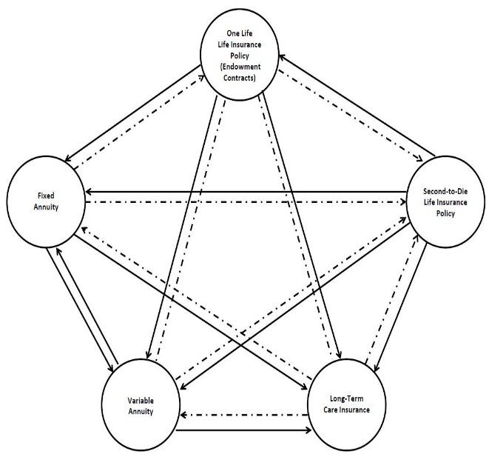
1035 Exchanges
The chart pictured provides a graphic representation of which financial products can be exchanged on a tax-free or tax-deferred basis under Section 1035. As indicated by the chart, Section 1035 allows for a life insurance contract to be exchanged into any of the other listed contracts (i.e. other life insurance policies, endowment contracts, annuity contracts, or long-term care insurance contracts). However, a life insurance policy on one life cannot be exchanged for a life insurance policy that pays on the death of the survivor of two individuals (a second-to-die life insurance policy). Furthermore, endowment contracts may only be exchanged for other endowment contracts, annuities, or long-term care insurance contracts. Long-term care contracts are the most restricted, in that they can only be exchanged for other long-term care contracts. Some variable annuity products provide that minimum annual payments may be doubled if the annuitant would qualify for long-term care benefits. These annuities presumably can be exchanged for other annuities under Section 1035, and the benefit is very limited if all payments under the contract reduce the actual cash value of the contract.
The straight lines in the chart indicate that tax-free exchange treatment under Section 1035 is permitted, while the dotted lines indicate that tax-free exchanges are not available under Section 1035.
Treasury Regulation 1.1035-1 provides that Section 1035 will not apply in situations where the contract or policies that are exchanged do not involve the same insured or obligee. However, Section 1035 allows for the exchange of multiple contracts, meaning that two life insurance policies may be exchanged for one annuity contract, or one annuity contract may be exchanged for two annuity contracts.
Finally, the IRS released Rev. Proc. 2011-38, which provided that, so long as withdrawals are not received from either contract for 180 days following a partial exchange, then the partial exchange will qualify as a tax free 1035 exchange. It reduced the 12-month period that was espoused by the IRS in Rev. Proc. 2008-24 to 180 days, and eliminated the requirement that an exception under Section 72(q)(2) must be met to obtain Section 1035 tax-free treatment. The Rev. Proc. established that a partial exchange of annuity contracts will be tax-free under Section 1035 or “the Service will apply general tax principles to determine the substance of the transfer and, therefore, its tax treatment.” Further, the original contract and the new contract are not aggregated after the 180 day period, notwithstanding whether they are issued by the same carrier.

Slide 162
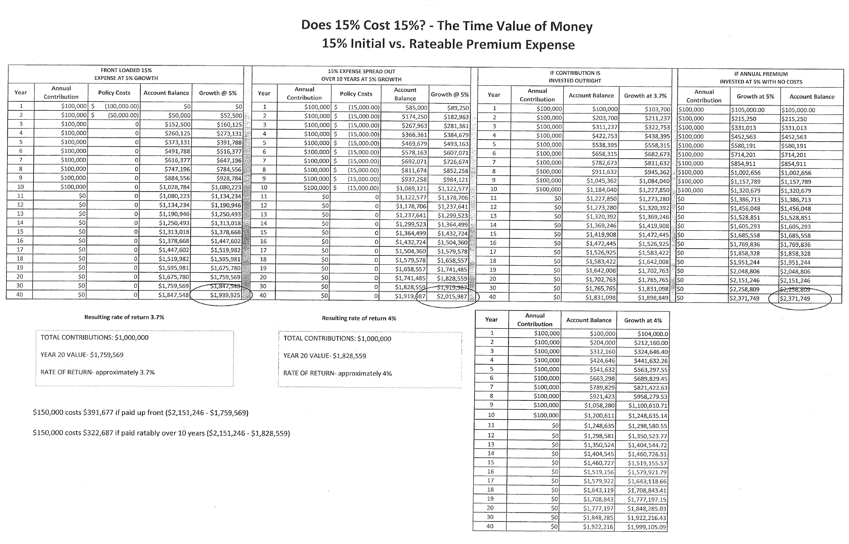
DOES 15% COST 15% - THE TIME VALUE OF MONEY
15% INITIAL VS RATABLE PREMIUM EXPENSE
FRONT LOADED 15%
EXPENSE AT 5% GROWTH
15% EXPENSE SPREAD OUT
OVER 10 YEARS AT 5% GROWTH
IF CONTRIBUTION IS
INVESTED OUTRIGHT
IF ANNUAL PREMIUM
INVESTED AT 5% WITH NO COSTS
Resulting rate of return 3.7%
Resulting rate of return 4%

Slide 163
Existing Life Insurance Review
1. Request inforce ledgers, premium history, and copies of existing policies for permanent coverage.
2. Term insurance policies and a carrier printout confirming ownership and beneficiary designation will also be valuable.
3. Prior policies will have application information attached, which includes full application and medical history information that can be used and updated for subsequent applications.
4. Controversial - have inforce ledger numbers placed on spreadsheets to show historical and expected rate of returns.
a. At same time consider requesting the following for permanent policies:
i. Inforce Ledger showing reduction of death benefit to minimum corridor amount, and separately to MEC amount for permanent policies, and alternatively showing maximizing death benefit if increase is possible.
ii. Confirmation of any payment requirements that must be maintained to keep guarantees or other policy features in place.
iii. Are there existing riders that can be added or switched off and costs thereof.
iv. Veralytic, Inc. or other report on the carrier and product.

Slide 164
Question to Consider
Should spreadsheets be run based upon premium history and inforce illustrations to help predict how the policy has performed and how it is expected to perform?
        Consider reducing the death benefit to (1) death benefits now needed, (2) minimum corridor amount or (3) modified endowment contract level. Surrender charges may apply when reduced.
        Examine financial condition of carrier.
Quantify risk of insolvency of the carrier and note that reinsurance is used by the carrier to pay for death benefit.

Slide 165
Premium Financing as Simple as it Looks
CLIENT
Gift
ILIT
Premiums
CARRIER
Commission
AGENT
Guarantee
Additional
Collateral?
Loan
POLICY
LENDER
Collateral Assignment
The policy may be cashed in with amounts of value exceeding the loan owned by the ILIT or will pay loan and provide remaining death benefit to ILIT on death of client.

Slide 166
#9
IRAs and
Pensions

Slide 167
The Florida Kearney case-11th circuit Court Of Appeal-“a blanket UCC-1 statement may lien and therefore disqualify the debtor’s IRAs”

Slide 168
Optimize Qualified Plan Contributions –
Confer with a Good Actuary
Quite often clients are underserved with respect to retirement planning. This is often the result of product or general brokerage houses and banks that sponsor simple retirement plans without extensively trained planned design and maintenance personnel.
One example is the possible use of a 401(k) plan that uses the 3% safe harbor. Such a plan can be set up so that the 3% contribution is not required. The client can decide before the end of each year whether the safe harbor contribution will be made for the year, and must give notice to all participants by the end of November stating whether or not the 3% contribution will be made. This is often known as the “flexible safe harbor” or “maybe safe harbor” or “wait and see safe harbor plan.” Many physician groups should be checking with their pension advisors to see if their plan has the flexible safe harbor feature. A plan with a required safe harbor match cannot be managed on a flexible basis.
Appropriate pension planning can also include cross-testing and defined benefit planning.

Slide 169
Optimize Qualified Plan Contributions –
Confer with a Good Actuary – Employee Census

Slide 170
Three Choices for Retirement Plan Benefits
May be Best to Have This Spread Among Two of the Choices – Client Age 75, Oldest Child Age 50
CHOICE #1 | CHOICE #2 | CHOICE #3
Mrs. Client as Beneficiary Advantages: 1) Ability to roll over Dr. Client’s retirement plan accounts income tax-free into her own retirement plan account and to take required minimum distributions based upon her life expectancy, recalculated annually, based upon the below percentages of the retirement plan account for the next ten years. The above referenced distribution percentages are less than what would occur if the retirement plan account was payable to Dr. Client’s Revocable Trust. 2) Mrs. Client has the ability to direct the disposition of the retirement plan funds upon her death, and after Mrs. Client’s death, the required minimum distributions from the retirement plan funds would be based upon the life expectancies of her chosen beneficiaries. The retirement plan funds would be protected from the creditors of these beneficiaries if the funds are paid to trusts for the benefit of such beneficiaries after Mrs. Client’s death. Disadvantages: 1) The future value of the retirement plan would be includable in Mrs. Client’s estate for federal estate tax purposes upon her death. 2) The above referenced distribution percentages are greater than what would occur if the retirement plan accounts were disclaimed so that they are payable to the Clients Irrevocable Trust. | Restated and Amended Trust Agreement of Deceased Client’s Revocable Trust Advantages: 1) The retirement plan accounts can benefit Mrs. Client without being subject to federal estate tax in her estate. 2) Mrs. Client cannot access the retirement plan accounts above the annual required minimum distribution without the consent of the other Co-Trustees, which protects Mrs. Client from any undue influence. 3) The retirement plan benefits would be protected from the creditors of Mrs. Client’s children after her death, except to the extent of any distributions actually made from the Trust to the children. Disadvantages: 1) Annual required minimum distributions would be based upon Mrs. Client’s life expectancy and a special distribution table that is not recalculated annually, which would be as described below for the next ten years. The below referenced distribution percentages are greater than what would occur if either of the two other alternatives were chosen. Thus, by using Mrs. Client’s life expectancy to determine the annual required minimum distributions, the retirement plan benefit distributions cannot be “stretched” out over life expectancies of Mrs. Client’s children after her death. 2) Mrs. Client will have to forfeit her ability to direct the disposition of the retirement plan funds after her death. The retirement plan funds will instead pass in separate trusts for the benefit of Mrs. Client’s children upon her death. | Irrevocable Trust for Children Only Advantages: 1) The value of the retirement plan accounts would not be includable in Mrs. Client’s estate for federal estate tax purposes upon her death. 2) Annual required minimum distributions of retirement plan benefits would be based upon the life expectancy of the oldest of Mrs. Client’s children and a special distribution table that is not recalculated annually, which would be as described below for the next ten years. The above referenced distribution percentages are optimal from an income tax planning standpoint, as they are more favorable than the other alternatives because they result is the lowest annual required minimum distributions. 3) The retirement plan benefits would be protected from the creditors of Mrs. Client’s children after her death, except to the extent of any distributions actually made from the Trust to the children. Disadvantages: 1) Mrs. Client cannot benefit from the retirement plan accounts. 2) Mrs. Client cannot control the disposition of the retirement plan funds upon her death. The retirement plan funds will continue to be held pursuant to the terms of the Trust.
2014: 4.5455% 2015: 4.7170% 2016: 4.9261% 2017: 5.1282% 2018: 5.3476% 2019: 5.5866% 2020: 5.8480% 2021: 6.1350% 2022: 6.4516% | 2014: 8.0645% 2015: 8.7719% 2016: 9.6154% 2017: 10.6383% 2018: 11.9048% 2019: 13.5135% 2020: 15.6250% 2021: 18.5185% 2022: 22.7273% | 2014: 3.0120% 2015: 3.1056% 2016: 3.2051% 2017: 3.3113% 2018: 3.4247% 2019: 3.5461% 2020: 3.6765% 2021: 3.8168% 2022: 3.9683%

Slide 171
The Mathematics of Pension and IRA Minimum Distribution Rules
IRA
CHILD 1
LOSE IN A DIVORCE
CHILD 2
LOSE TO CREDITORS
CHILD 3
GAMBLED AWAY OR SPENT ON DRUGS
CHILD 4
GIVEN TO A CULT
IRA
CHILD 1 TRUST
If the trusts for the children are Conduit or Accumulation Trusts, then payments will come out over the life expectancy of each child.
CHILD 2 TRUST
CHILD 3 TRUST

Slide 172
#10
Homestead

Slide 173
What Else Can You Have On Your Creditor Protected Florida Homestead Besides Your Home?
Outside City Limits:
  Property located outside of the city limits can qualify for homestead exemption even where the property (up to 160 acres) for residency of the debtor is used for substantial and independent business activities. This was confirmed in the case of Davis v. Davis, 864 So.2d 458 (Fla. 1st Dist. App. 2003), where the homestead property included the home and an independently operated mobile home park.
  In In re Earnest, the Middle District of Florida held that 4.82 acres in unincorporated Marion County was exempt homestead property. There was a warehouse that the debtors used in their business on the property, and a building rented to a third party.
  In In re Oullette, 2009, WL 1936896 (Bankr. M.D. Fla. 2009), the Middle District of Florida held that property located outside a municipality with two mobile home located on it was exempt homestead property even though the debtors rented to second mobile home to a third party. But not all cases have had this result.
Inside City Limits:
  The law is not as flexible for debtors with dual purpose homestead properties that are within city limits, and can be very fact specific.
  A 2007 Bankruptcy Court opinion issued by Judge Isicoff found that while the constitution protects homestead, it limits the protection to the “residence of the owner or his family” and this protection would only apply to structures in which a member of the family resides.
Notes:
173

Slide 174
Buying The Florida House Or Condo Next Door?
An adjoining vacant lot may not be considered homestead where it has not been used or considered by logistics and fencing, etc., to be part of the homestead estate. This was the result in In re: Estate of Ritter, 407, So. 2d 386 (Fla. Dist. Ct. App. 3d Dist. 1981) where the property in question was never jointly fenced with the residents and was merely a separate, empty lot which served, at best, as an excess side yard to the residence.
When clients buy adjoining homes, they will be well-advised to make sure that there are no fences between the homes and to build pathways, integrated use, and coordinated appearance from the road and otherwise to promote the concept that the two separate houses are a single homestead. The second house may be referred to as a storage/exercise/guest house.
Notes:
174

Slide 175



Florida Homestead Planning
Creditors Lost In Mountains
Excess Property
Driveway Easement
1/2 Acre Waterfront Home

Slide 176
LAND TRUSTS
HOMESTEAD
CLIENT
SPOUSE 1
SPOUSE 2
CLIENT
FLORIDA LLC
100%
TBE
Client, Trustee
LAND TRUST
Colorado LLC, Trustee
Colorado LLC, Trustee
LAND TRUST
LAND TRUST
Property
Homestead
Property

Slide 177
Qualified Personal Residence Trust
The home is transferred to a trust that allows the grantor to make use of the home for a term of years, following which the trust is held for the spouse and descendants, and the grantor must pay rent at fair market value for use.
Not very appetizing for a creditor, and creditor protection provisions may be included in the QPRT document.

Slide 178
QPRT Trust Planning Demonstration
Age of Client 68
Initial Value of Home $860,000
Fractional Discount Assumed 15.00%
Discounted Value of ½ of Home $365,500
 | Gift Component (with respect to each QPRT) |  | Value of ½ of Home at End of QPRT Term Assuming 7% Growth | Estate Tax on Value at End of Term Assuming 35% Estate Tax Rate | Estate Tax Savings on ½ of Home at End of QPRT | Estate Tax Savings on Entire Value of Home at End of QPRT | Estate Tax Savings After 16 Years Assuming 7% Growth on ½ of House | Estate Tax Savings After 16 Years Assuming 7% Growth on Entire House
6 Year QPRT | Gift % | 73.220% | $645,314.05 | $225,859.92 | $132,193.23 | $264,386.96 | $350,633.96 | $701,267.92
 | Value of Gift | $267,619.00
8 Year QPRT | Gift % | 64.328% | $738,820.06 | $258,587.02 | $176,295.43 | $352,590.85 | $362,009.05 | $724,018.10
 | Value of Gift | $235,118.84
10 Year QPRT | Gift % | 55.528% | $845,875.08 | $296,056.28 | $225,022.09 | $450,044.17 | $373,266.45 | $746,532.90
 | Value of Gift | $202,954.84
12 Year QPRT | Gift % | 46.916% | $968,442.38 | $338,954.83 | $278,937.54 | $557,875.08 | $384,283.35 | $768,566.70
 | Value of Gift | $171,477.98
14 Year QPRT | Gift % | 38.633% | $1,108,769.68 | $388,069.39 | $338,648.12 | $677,296.25 | $394,879.38 | $789,758.76
 | Value of Gift | $141,203.62
16 Year QPRT | Gift % | 30.840% | $1,269,430.41 | $444,300.64 | $404,848.70 | $809,697.15 | $404,848.57 | $809,697.15
 | Value of Gift | $112,720.20
Probability of Death Before Certain Age -- Current Age 68
2 years (70) 4.18% 6 years (74) 14.31% 10 years (78) 27.33% 20 years (88) 68.53%
4 years (72) 8.92% 8 years (76) 20.45% 15 years (83) 47.24%

Slide 179
Child’s Homestead Irrevocable Trust
A trust that can own a home used by a child to benefit the spouse and descendants;
- can qualify for the State Homestead Exemption and 3% cap
- can be considered as owned by the Child for income tax purposes to qualify for the $250,000 income tax exemption on sale
- can be controlled by the Trustee and used for the benefit of various family members
- will insulate family members from liabilities associated with ownership of the home
Other Spouse = Trustee
Trust assets can be applied for the health, education, maintenance and support of the Trustee-Spouse and children.
One or more children may reside in the house to qualify for the Florida Tax Homestead Exemption.
For income tax purposes, the Trust can be considered as owned by the child who lives in the house so that the house can be sold income tax free to the extent of up to $250,000 in appreciation.
The Trust will not be subject to creditor claims of any family member unless (1) the transfer to the Trust by the Grantor Spouse is a “fraudulent transfer,” or (2) the child has a right to withdraw more than the gift tax exclusion amount in any calendar year.
NOTE – The Trust must be appropriately drafted, funded, and administered to achieve the above results.
CHILD’S HOMESTEAD IRREVOCABLE TRUST
GRANTOR
SPOUSE
Gift
Home and Other Assets

Slide 180
Comparison of Methods to Purchase Homes for the Children
 | $250,000 Exemption on Sale of Home | $50,000 Homestead Exemption and 3% Per Year Cap on Valuation | Divorce | Control | Notes
Father and Mother loan money to the child. Child purchases and owns home. | Child gets income tax exemption. | Child gets homestead exemption and cap. | Loan will be repaid to parents. Equity may be subject to claim by spouse if this is not waived by Prenuptial Agreement. | Child controls the house. However, we may be able to call the Note to force a sale. | Note: Child gets equity above Note.
Father and Mother own the home and the child lives in the house. | No. | Generally no. However, it may be possible to obtain these with a 99-year lease. | Better protected. | Father and Mother control.
Via Child Funded Homestead Bypass Trust. | Child gets income tax exemption. | Child gets homestead exemption and cap. | Better protected. | Friend, relative, advisor or trust company would be Trustee of the Trust and would retain control. | Note: Creditors may be able to get into the Trust. It may be possible for Trustee to transfer the house to the child’s individual name in the event of a Creditor issue.
Direct Client Funded Homestead Bypass Trust. | No | Child gets homestead exemption and cap. | Better protected. | Mother would be Trustee of the Trust and would retain control. | Note: The $250,000 exemption is lost, but no creditor of the child should be able to get the assets.
One-half purchased by child and one-half owned by Father and Mother. | One-half. | One-half. | One-half, better protected. | Each controls one-half.
Notes:
180

Slide 181
Not Every Home Will Grow At An “Average Rate” By Frank Catlett And Alan S. Gassman
Frank A. Catlett is a State-Certified General Real Estate Appraiser (FL), General Real Estate Appraiser (NC), and Certified General Real Property Appraiser (GA) with over 37 years of experience. Mr. Catlett is President of Trigg, Catlett & Associates, located in Tampa, Florida, which provides appraisal and brokerage services to not only the Tampa Bay, but most parts of Florida as well as North Carolina.
A great many senior Americans borrow money on “Reverse Mortgages” based in part on being told that their homes will go up in value with “national or regional averages,” which is often not the case.
For many of these homeowners, the better decision would be to downsize and not try to hold onto more house than they can afford. The decision to stay in a house that is too large causes the loss of investment resources in return and increased expenses. One national study has indicated that the cost of maintaining a home is based upon 3.53% of its value. Having a $200,000 home, when only a $100,000 home is needed, may therefore cost the senior citizen not only the investment return on $100,000, but also an additional 3.53% or more per year in expenses for utilities, taxes, insurance, and maintenance.
The reverse mortgage industry has encouraged many seniors to stay in their “too large” homes, based in part upon showing them projections that will indicate a likelihood of a 4% per year increase in value.
In fact, a 2013 actuarial report prepared for the US Federal Housing Administration (FHA) has indicated that a “worst case scenario” bottom 25th percentile Monte Carlo simulation has predicted that home prices could go down by more than 20% between 2014 and 2018 and might not recover to 2018 levels until 2024.
While the “average home” in a given area can be expected to increase in value on average over a term of years, the retiree’s home will typically be expected to go up in value at a slower rate, if it does go up in value, for the following reasons:

Slide 182
Not Every Home Will Grow At An “Average Rate”, Continued
1.) The home gets older every year. The age of a home is a factor in valuation and appreciation. If the average home in a given area is 28 years old now, and the average house will be 26 years old in 20 years, then a 48-year-old home 20 years from now will be worth less than a 26-year-old home will be and will not be expected to have kept up with the “average growth rate.”
2.) The above is corroborated by the fact that homes have a typical estimated life expectancy of 60 years, and thus, depreciate in value to some extent. An appropriate rate of depreciation might be 1.667% of the value of the home itself each year, separate and apart from the land, because typically, a 60 year life expectancy will apply (1/60 = 1.667%). On the other hand, should this be 3.333% per year (2 x 1.667%) if the home is 30 years old to begin with?
If a typical house is worth 77.5% of the combined value of the house and land together, and the 77.5% house portion is going up by 3.5% statistically, not counting age, but then depreciating at 1.667% a year, then 22.5% of the total value (the land portion) is going up by 3.5% annually, and 22.5% of the value (the home portion) is going up by the excess of 3.5% over 1.66%, which is 1.89% per year.
Therefore, the average growth rate for a house might only be 2.2433% ((22.5% x 3.5%) + (77.5% x 1.89%)), on average.
3.) Senior citizens typically do not restore or renovate their homes, especially if they are of the average household that has the need to borrow on a reverse mortgage. A high percentage of the “average” homes in any given area have new kitchens, bathrooms, and other primary aspects installed or refurbished every 20 to 25 years. A senior citizen’s home will have a much lower restoration rate on average, which would bring the average growth rate in the above example well below the 2.2433% described above.
4.) Oftentimes, neighborhoods or surrounding areas start to turn for the worse, and mobile homeowners will move to more secure economic areas and neighborhoods where values normally increase at or above the average. Reverse mortgage borrowers are not able to do this, and are thus unable to move when value issues are likely to arise, and thus, have a less than average chance of being situated in a proper neighborhood for appreciation to be expected.
Based upon the above, we believe that it is a significant fallacy, and actually, a deceptive trade practice, for the reverse mortgage industry to tell homeowners that their homes can be expected to go up in value based upon statistical averages now being used.
Further, 4% as a normal projection rate seems ludicrous when the average home rate value increase in the last 20 years in the United States has been only 3.4%, before taking into account the issues described above.

Slide 183
Homestead Confidentiality
SPOUSE 1
SPOUSE 2
TBE
Delaware or Wyoming LLC, Trustee
REVOCABLE LAND TRUST
“Statement of Authority” to avoid theft
Use SunBiz.org
Homestead

Slide 184
Land Trust
CLIENT
Trustee – Any individual or entity designated by the client.
LAND TRUST
Homestead
Beneficial interest can be held by the client or by an entity owned by the client. Additionally, the beneficiary can have the ability to revoke the trust.
Florida law allows real estate to be held under a land trust (also referred to as an “Illinois Land Trust”), in which the beneficial interests are considered to be personal property.
The land trust can provide for flexibility, and it can also provide for confidentiality if an entity (such as a Colorado LLC) is named as Trustee of the Trust.

Slide 185
Land Trust / LLC Structure
Husband and Wife own the beneficial interest in the Land Trust corresponding to the most valuable half acre, which will be determined pursuant to a survey providing legal descriptions of “Parcel A and “Parcel B”
ABC, LLC will own the beneficial interest in the Land Trust associated with parcel B
ABC, LLC will lease all use and rights for Parcel B to Husband and Wife pursuant to a 99 Year Lease
HUSBAND
WIFE
ABC, LLC (WY)
TENANTS BY THE ENTIRETIES
Enters 99 Year Lease with Husband and Wife
On behalf of Land Trust to retain FL Homestead Exemption
100% Beneficial Ownership of Parcel A Share
100% Beneficial Ownership of Parcel B Share
ABC, LLC - Trustee
XYZ LAND TRUST
Florida Land Trust
PARCEL A
(Most Valuable Half Acre)
PARCEL B
(Remaining Acreage)

Slide 186
Not To Be Confused
FLORIDA HOMESTEAD TAX EXEMPTION |  | FLORIDA HOMESTEAD CREDITOR PROTECTION
1 | WHAT IS IT? Saves approximately $1,000 of taxes (2% of $50,000), plus the 3% cap on future increases applies. | 1 | PROVIDES PROTECTION FROM CREDITORS
2 | HOW TO QUALIFY? Normally, one or more individuals reside on the property and call it their homestead. There is no size limit. | 2 | MUST BE RESIDENTIAL HOMESTEAD PROPERTY WHERE THE OWNER LIVES AS PRIMARY RESIDENCE. The creditor law only protects up to half an acre if within city limits, and up to 160-acres if outside of city limits (or if was outside of city limits and was annexed while primary residence).
3. | REGISTRATION REQUIREMENTS. **Must reside on the property when the bell strikes January 1st (have to move in before New Years). **Must register with Property Appraiser Office by March 1st of the following year. **Homestead tax status begins the January 1st after the move-in, if the March 1st registration deadline is met. | 3 | NO REGISTRATION REQUIREMENTS AND NO DEADLINES FOR MOVING IN – PROTECTED FROM THE MOMENT OWNED (EXCEPT AS TO A JUDGMENT AGAINST THE PROPERTY THAT EXISTED BEFORE IT WAS “HOMESTEADED.”)

Slide 187
Three Ways to Get the Florida Homestead Tax Exemption Without Owning the House
1. Resident is the beneficiary of a trust that provides her with the right to reside on the trust property as if it were homestead.
2. Resident has use under a 98-year – or longer – lease.
NOTE: A leasehold estate may also qualify for homestead creditor protection.
Resident has a life estate in the homestead.
Send the draft document to property appraiser thereof to confirm whether it will qualify for the exemption
Must only qualify on January 1st and the exemption will apply for the rest of the year

Slide 188
Child’s Homestead Irrevocable Trust
A trust that can own a home used by a child to benefit the spouse and descendants;
- can qualify for the State Homestead Exemption and 3% cap
- can be considered as owned by the Child for income tax purposes to qualify for the $250,000 income tax exemption on sale
- can be controlled by the Trustee and used for the benefit of various family members
- will insulate family members from liabilities associated with ownership of the home
Other Spouse = Trustee
Trust assets can be applied for the health, education, maintenance and support of the Trustee-Spouse and children.
One or more children may reside in the house to qualify for the Florida Tax Homestead Exemption.
For income tax purposes, the Trust can be considered as owned by the child who lives in the house so that the house can be sold income tax free to the extent of up to $250,000 in appreciation.
The Trust will not be subject to creditor claims of any family member unless (1) the transfer to the Trust by the Grantor Spouse is a “fraudulent transfer,” or (2) the child has a right to withdraw more than the gift tax exclusion amount in any calendar year.
NOTE – The Trust must be appropriately drafted, funded, and administered to achieve the above results.
CHILD’S HOMESTEAD IRREVOCABLE TRUST
GRANTOR
SPOUSE
Gift
Home and Other Assets

Slide 189
#11
Tenancy by the Entireties and alternatives thereto

Slide 190
Definition Of Tenancy by the Entireties
Joint tenancy with right of survivorship is not enough because the law requires that “the 6 unities” exist. The 6 unities may be summarized as follows:
  Unity of possession - Both spouses have joint ownership and control - it may be acceptable that a deposit agreement allows either spouse to withdraw independently of the other on the theory that the power to withdraw is an expression of an authority of agency given by each spouse to the other.
  Unity of interest - Each spouse has the same interest in the account - it is not a problem if one spouse deposits all or most of the funds into the account as long as each spouse has the same interest immediately after the deposit.
  Unity of time - The interests of both spouses in the asset must originate simultaneously in the same instrument, such as on the signature card. Do not try to convert an individual account into a tenancy by the entireties account. Instead, transfer assets from the individual account to a new tenancy by the entireties account.
Notes:
190

Slide 191
Definition of Tenancy by the Entireties
  Unity of title - Both spouses must have ownership under the same title.
  Survivorship - On the death of one spouse, the other spouse becomes the sole owner of the entireties property. A general power of appointment given to one spouse over joint assets may vitiate tenancy by the entireties status.
  Unity of marriage - Of course, the owners must be legally married under Florida law.
  Non-residents who own property in Florida can also claim the tenancy by the entireties immunity. In Re Cauley, 374 B.R. 311, 316 (Bankr. M.D. Fla. 2007).
Notes:
191

Slide 192
Special Tenancy by the Entireties Issues
Joint Accounts. Not with USAA, Strong Mutual funds and many others. You must read the account agreement to be sure. Better to set up a TBE LLC to own accounts.
Stock Certificates and Shareholder Agreements.
Tax Reporting and Tax Refunds.
Tangible Personal Property.
Automobiles and Other Registered Vehicles.
Real Estate Owned Outside of Florida.
Notes:
192

Slide 193
Nevis, Tennessee, or Delaware
TBE APT Jurisdiction Trust
SPOUSE 1
SPOUSE 2
TBE
(Assets)
Any distributions must be made to Spouse 1 and Spouse 2 as TBE.
Tennessee, Delaware, and Nevis law provide for retention of TBE status to the extent of assets under Trust which have originated from TBE assets.
TRUST
The jurisdiction law provides that TBE assets transferred to a trust will retain their TBE character, and must be distributed to the spouses only as TBE assets.

Slide 194
TBE, Your Paramour and Me
EXECUTIVE SUMMARY:
Florida’s 3rd District Court of Appeals’ May 11, 2022 decision, Wallace v. Torres-Rodriguez, determined that when a married man transfers tenancy by the entireties (TBE) property, co-owned by him and his wife, to a Trust, for the benefit of his paramour, the court may impose an equitable trust to recoup those properties for the benefit of the wife and children. This ruling stands as a great illustration of well-settled law in Florida that TBE assets are vested in the husband and wife as one person, and that neither spouse may sell, encumber, or forfeit those assets without the consent of the other spouse.
Disparity Between Trial Court and Appellate Court Decisions
The trial court focused on the story behind the secret paramour and her supposed reliance on the receipt of the property, from the deceased. The appellate court focused on the fact that the property within the trust was TBE property, owned jointly by a husband and wife, and declined to make an equity ruling for a paramour when such a ruling would violate long-standing public policy and Florida law, favoring the protection of marital property for the benefit of the surviving spouse and their children. Additionally, the appellate court found that there could be no detrimental reliance on the part of a paramour with respect to property known to be marital in nature. The fact that this property was agreed to be transferred to a trust, on the death of the first spouse, did not eliminate the classification of the property as marital in nature.

Slide 195
TBE, Your Paramour and Me
COMMENT:
The Trial Court’s Sympathetic Stance on the Paramour
In the interesting and dramatic case of Wallace v. Torres-Rodriquez, a husband with a degenerative neurological condition conveyed approximately $5,000,000 in assets that the court labeled as being owned as TBE, by him and his wife, to a girlfriend that he was having a secret affair with. The same opinion observed that these assets were held in a Trust that had been established by the owner’s wife, to keep the assets in the family.
The trial court had sympathy for the girlfriend’s situation (and work ethic), and her reliance on the assets transferred to her, observing that the husband had voluntarily transferred the assets because:
[H]e wished to provide for her, to make her financially secure, and even comfortable. In exchange, she provided him her time, her companionship, and her intimate affection. She did not go to college and study for a career. She did not get a job and build up pension benefits and social security credits. She became Milton Wallace’s paramour.
The trial court concluded that the sacrifices made by the girlfriend (also known as the paramour) entitled her to keep some (approximately $1,700,000) of the assets that she had received based upon the doctrine of equitable estoppel (“detrimental reliance”) as recovery.
Wallace v. Torres-Rodriguez, 3D21-244, 2022 WL 1481782 (Fla. 3d Dist. App. May 11, 2022)
Id. The Oxford English Dictionary defines “paramour” as “a lover, especially the illicit partner of a married person.” Two paramours would be “a pair and more.” One who eats a lot of fruit may be a “pear a mour.” Constantly with a new woman, Hugh Heffner has been known to have a “para du jour.” The paramour in this case apparently has a new job working at a marina, so one might call her a “par-a-moor.”
The trial court therefore valued the paramour’s “love and affection” and her subsequent “change of position” at $1,700,000.

Slide 196
TBE, Your Paramour and Me
The Court of Appeal’s Firm Stance on TBE
The Florida 3rd District Court of Appeal disagreed with the trial court’s reasoning, holding that the trust assets conveyed to the girlfriend could be recouped. The assets that the husband transferred to the girlfriend were held in an irrevocable trust for the benefit of the spouses and the children of their marriage and the trust was supplemented by a marital agreement that prohibited either spouse from transferring joint marital assets while they were alive without “direct and personal joinder” of the other spouse.
The trial court imposed a constructive trust, which is “an equitable remedy in a situation where there is a wrongful taking in the property of another,” against some of the TBE assets that had been transferred to the girlfriend.
In the oft-cited Florida case of Quinn v. Phipps, the Florida Supreme Court accurately summarized the constructive trust doctrine as follows:
A constructive trust is one raised by equity in respect of property which has been acquired by fraud, or where, though acquired originally without fraud, it is against equity that it should be retained by him who holds it. Constructive trusts arise purely by construction of equity, independently of any actual or presumed intention of the parties to create a trust, and are generally thrust on the trustee for the purpose of working out the remedy. They are said to arise from actual fraud, constructive fraud, and from some equitable principle independent of the existence of any fraud.
The marital agreement further authorized the children of the marriage, one of whom was the trustee, to take all actions necessary to rescind any transfers in violation of the marital agreement.
The court cited the cases of Douglass v. Jones, 422 So. 2d 352 (Fla. 5th DCA 1982), Sitomer v. Orlan, 660 So. 2d 1111 (Fla. 4th DCA 1995), Abelev v. Sawyer, 750 So. 2d 70 (Fla. 4th DCA 1999) and Browning v. Browning, 784 So. 2d 1145 (Fla. 2nd DCA 2001)
Quinn v. Phipps, 93 Fla. 805, 113 So. 419, 54 A.L.R. 1173 (1927).

Slide 197
TBE, Your Paramour and Me
Under Florida law, to impose a constructive trust, a court must find clear and convincing proof of (1) a promise, express or implied, (2) transfer of the property and reliance thereon, (3) a confidential relationship, and (4) unjust enrichment.
The appellate court agreed that a constructive trust was the proper remedy to recover TBE assets that were wrongfully transferred by one spouse during the marriage without the consent of the other spouse. However, the Court of Appeals found that the detrimental reliance claim made by the paramour could not stand in light of the fact that the paramour was aware that she was receiving someone else’s property. The Court of Appeals therefore concluded that all of the TBE assets given by the husband to the paramour could be disgorged, and in turn transferred back to the irrevocable trust.
The doctrine of equitable estoppel embraces the notion that a party should not be permitted to profit by asserting rights against another when the party’s own inequitable conduct has lulled the other into action or inaction detrimental to its position. The elements necessary to establish equitable estoppel are:
1. A representation as to a material fact that is contrary to a later-asserted position;
2. reliance on that representation; and
3. a change in position detrimental to the party claiming estoppel, caused by the representation and reliance thereon.
Gersh v. Cofman, 769 So. 2d 407 (Fla. 4th Dist. App. 2000)
Natl. Auto Serv. Centers, Inc. v. F/R 550, LLC, 192 So. 3d 498 (Fla. 2d Dist. App. 2016)

Slide 198
TBE, Your Paramour and Me
In holding that the paramour was entitled to an equitable setoff, the trial court failed to recognize that any detrimental reliance by the paramour on the alleged promise by the husband of future financial support in exchange for her “intimate affection” was unreasonable as a matter of law because the promise of financial support in exchange for sex is unenforceable in Florida. This is what is commonly referred to as “prostitution.”
The appellate court further found that the evidentiary record reflected that the paramour knew that she was receiving marital property, and the cases it cited supported the proposition that in order to recover under the doctrine of equitable estoppel the girlfriend would have to show that there was “receipt of a benefit that has lead a recipient without notice to change position in such manner that an obligation to make restitution...would be inequitable.”
Wallace v. Torres-Rodriguez is a great illustration of the well-settled law in Florida that TBE assets are vested in the husband and wife as one person, and that neither spouse may sell, encumber, or forfeit those assets without the consent of the other spouse.
What the Court of Appeal Left Out
Possibly most interesting in Wallace v. Torres-Rodriguez is what the court did not say. The TBE assets were held in trust for the benefit of the husband, his wife, and their children. The court made no mention of the fact that the trust assets might fail to be characterized as TBE because the children were named as co-beneficiaries of the trust and therefore the spouses did not enjoy a full right of survivorship as to the trust assets. As described below, at least one Florida case has held a similar trust arrangement to not qualify for tenancy by the entireties ownership.
Posik v. Layton, 695 So. 2d 759 (Fla. 5th Dist. App. 1997).
See also Douglass v. Jones, 422 So. 2d 352 (Fla. 5th DCA 1982)
In re Givans, 623 B.R. 635 (Bankr. M.D. Fla. 2020)

Slide 199
TBE, Your Paramour and Me
In another interesting decision out of Florida, Bankruptcy Court Judge Karen J. Jennemann issued a memorandum opinion stating that, “a trust cannot hold real property as tenants by the entireties,” in a decision under the continuing bankruptcy court case of In re Givans. In this case, a home is owned under a revocable trust that provides the debtor (Mr. Givans) and his wife, Mrs. Givans, with the right to become an income beneficiary under the trust in order to preserve the trust assets for their two children, as primary beneficiaries, if one of them dies.
While Judge Jennemann is correct that the particular arrangement in Givans will not qualify for tenancy by the entireties ownership, because it is without full right of survivorship, the author believes that a properly drafted trust can hold property and be characterized as a tenancy by the entireties asset, as discussed in LISI Newsletter #2957.

Slide 200
The JEST

Slide 201
THE JEST
Articles of Interest:
It’s Just a JEST, the Joint Exempt Step-Up Trust, Leimberg Information Services Estate Planning Newsletter #2086
JEST Offers Serious Estate Planning Plus for Spouses – Part 1
Estate Planning Magazine, October 2013
JEST Offers Serious Estate Planning Plus for Spouses – Part 2
Estate Planning Magazine, November 2013
Understanding Section 1041(e) & Tax Basis Planning, by Jeff Scroggin, Leimberg Informtion Services Estate Planning Newsletter #2192

Slide 202
From Howard Zaritsky – Lester Law January 2017 Heckerling Institute Fundamentals presentation (pgs 1-134 & 1-135):
GETTING A FULL STEP-UP USING POWERS OF APPOINTMENT
ON FIRST DEATH – THE JEST TRUST
Consider the JEST Trust to fully fund a Credit Shelter Trust while receiving a stepped up basis for all joint and separate assets.
The Joint Estate Step-Up Trust (JEST)
A recently variation on the tax-basis revocable trust is the joint estate step-up trust, or JEST. See Gassman, ' Denicolo, & Hohnadell, JEST Offers Serious Estate Planning Plus for Spouses - Parts I and 2, 40 Est. Plan. 3, 14 (Oct., Nov. 2013).
  1. Structure of the JEST
    a) Joint Revocable Trust
A JEST is a joint revocable trust created by a married couple who reside in a non­ community property state. The JEST becomes irrevocable when the first spouse dies; both powers to revoke then terminate.
      b) Separate Shares for Each Spouse
Each spouse owns a separate share of the trust.
            c) Each Spouse Can Terminate Trust During Joint Lives
Each spouse has the power to terminate the trust during their joint lives, when each spouse's share will be distributed to him or her individually.

Slide 203
Note. The step-transaction doctrine is particularly a problem if the estate planner has documented in the planning memoranda that the surviving spouse can be added later.
2. Analysis of the JEST
The JEST has one noteworthy advantage over the tax-basis revocable trust, in that the assets contributed by the surviving spouse do not pass back to the surviving spouse at the first spouse's death. The assets passing subject to the power of appointment will, except to the extent appointed otherwise, pass to a trust for other family members. This should make application of Code § 1014(e) extremely difficult.
  3. Analysis of the JEST
The IRS analysis of the tax-basis revocable trust turned on the application of Section I014(e), which denies a basis adjustment to assets transferred to the decedent within one year of the date of his or her death, that pass to the original transferor upon the decedent's death. The JEST gets around Section 1014(e) by not having the assets transferred to the decedent return to the original transferor, to the extent that the original transferor has unused applicable exclusion amount. Thus, there is no reason why the JEST should not work.
4. Asset Protection and the JEST
The JEST offers only limited asset protection benefits.
          a) Assets Contributed by the First Spouse to Die
            (1) Creditors of the First Spouse to Die
  The assets contributed to the JEST by the first spouse to die should be as available to the first spouse to die as any other assets of that spouse's revocable trust.

Slide 204
(2) Creditors of the Surviving Spouse
The surviving spouse should be able to obtain the benefits of the spendthrift clause applicable to the assets contributed by the first spouse to die and then held either as Non-marital Trust A or as a QTIP.
(3) Creditors of the Descendants
The beneficiaries of Non-marital Trust B should be able to do the same
b) Assets Contributed by the Surviving Spouse
The assets contributed by the surviving spouse are also subject to a general testamentary power of appointment held by the first spouse to die. As noted above, these assets may be subjected to the claims of the creditors of the first spouse to die, even though they were originally assets of the surviving spouse.

Slide 205
JEST Trust
SPOUSE 1
SPOUSE 2
JEST TRUST
SPOUSE 1's ASSETS
JOINT
ASSETS
SPOUSE 2's ASSETS
On first death, up to exemption amount of first dying spouse (as much as $12,920,000), may pass to Credit Shelter Trust or Trusts to benefit surviving spouse and descendants, with a possible full step-up of all assets - excess assets going into QTIP Trusts, which may also qualify for full step-up.

Slide 206
JEST Credit Shelter Trust B Planning
Accepted as funded by first dying spouse.
Will not be subject to estate tax at the level of the surviving spouse.
Will not be subject to creditor claims of the surviving spouse.
This is the optimum result.
ALTERNATIVE A
CREDIT SHELTER TRUST B
Considered as funded by surviving spouse.
Might be subject to estate tax at the level of the surviving spouse.
Might be subject to creditor claims of the surviving spouse, unless local law of the Trust provides otherwise.
ALTERNATIVE
B
Formed from assets of the share of the surviving spouse.
Expected to be considered as being transferred to Credit Shelter Trust B by the first dying spouse for federal estate tax purposes pursuant to Private Letter Ruling 200101021 and Private Letter Ruling 200210051.
The IRS could claim that Credit Shelter Trust B was funded by the surviving spouse.
Strategy 1 - Incomplete Gift Treatment
The surviving spouse maintains a Power of Appointment over the Trust assets, which causes the Trust to be considered as an incomplete gift for federal gift tax purposes, and the Trust assets will be considered as owned by the surviving spouse for estate tax purposes on his or her death.
In light of the IRS' position in CCA 201208026, it is best to give the surviving spouse a lifetime Power of Appointment over the assets in Credit Shelter Trust B to assure that an incomplete gift results for federal gift tax purposes.
If there are separate children for each spouse or a concern that the surviving spouse might not appropriately exercise a Power of Appointment, then it could be limited to being exercisable only with a consent of non-adverse parties, or limited to the extent needed to avoid imposition of federal gift tax by funding under a formula clause.
Strategy 2 - Complete Gift Treatment
If the surviving spouse disclaims all Powers of Appointment over the Trust, then the transfer to Credit Shelter Trust B is considered to be a complete gift by the surviving spouse, and the Trust will not be subject to federal estate tax of the surviving spouse's estate.
The value of the assets passing to Credit Shelter Trust B would reduce the surviving spouse's $12,920,000 exemption.
Give the surviving spouse the power to replace Trust assets with assets of equal value, so then it can be considered a Defective Grantor Trust if this occurs.
Note (applicable to both Strategy 1 and Strategy 2): Situs Credit Shelter Trust B in an "asset protection trust jurisdiction" to avoid having creditors be able to reach into the Trust, and also to avoid the Trust being included in the surviving spouse's estate if the surviving spouse was considered as a contributor to the Trust for federal estate and gift tax purposes.

Slide 207
Joint Exempt Step-Up Trust (JEST) Chronology – The 4 Steps from Drafting to Implementing
Derived from articles that can be found on Leimberg Information Services (Estate Planning Newsletter #2086) and Estate Planning Magazine October and November 2013 Editions
Before Funding
Step 2
Step 3
Step 4
Spouse 1’s Assets
Funding of Joint Revocable Trusts; each spouse has the right to revoke his/her share until first death
Division upon First Dying Spouse’s Death
Assume Spouse 1 dies first
Results of JEST Technique
For Spouse 2 & Descendants benefit (limited by ascertainable standard)
Assets will receive a stepped-up basis
Assets are protected from Spouse 2’s creditors
Assets escape estate tax on Spouse 2’s death
Spouse 1’s Share
Spouse 1’s Assets
½ of former
JTWROS Assets
½ of former TBE Assets (or by other percentage)
Credit Shelter Trust A
Funded from Spouse 1’s Share in the amount of Spouse 1’s available Estate Tax Exemption (ETE)
Joint Assets: Joint Tenants w/ Right of Survivorship
Spouse 2 can be beneficiary of income and principal
Assets will receive a stepped-up basis on Spouse 1’s death, and then again on Spouse 2’s death
Assets included in Spouse 2’s taxable estate
Will be protected from Spouse 2’s creditors
½ to each Spouse’s share
Q-TIP Trust A
If Spouse 1’s Share exceeds Spouse 1’s available ETE, the excess will fund this trust
Joint Assets: Tenancy by the Entireties
½ to each Spouse’s share or actuarial value
Assets may receive a stepped-up basis, but this is more likely if Spouse 2 is not a beneficiary
May escape estate tax liability on Spouse 2’s death
For creditor protection and estate tax exclusion purposes, CST B may be moved to an APT jurisdiction
Special Consideration: If Spouse 2 is found to have made a gift of trust assets to Spouse 1 upon Spouse 1’s death, this gift may qualify for the marital deduction
If IRS argues that Spouse 2 has gifted to trust the gift will be incomplete because of Spouse 2’s power of appointment
Spouse 2’s Share
Spouse 2’s Assets
½ of former
JTWROS Assets
½ of former TBE Assets (or by other percentage)
Credit Shelter Trust B
If Spouse 1’s Share is less than his available ETE, Spouse 2’s Share will fund this trust in the amount of Spouse 1’s remaining ETE (But not in excess of Spouse 2’s available ETE)
Spouse 2’s Assets
Q-TIP Trust B
If Spouse 2’s Share has any remaining assets, they will be used to fund this trust
Spouse 2 will be income beneficiary
Assets may receive a stepped-up basis on Spouse 1’s death & again on Spouse 2’s death
Assets included in Spouse 2’s estate
May not be protected from Spouse 2’s creditors unless moved to APT trust jurisdiction
If IRS argues that Spouse 2 has gifted to trust the gift will be incomplete because of Spouse 2’s power of appointment
The IRS could find a gift upon contribution of TBE assets to the joint revocable trust, but this gift will qualify for the marital deduction if recipient spouse can withdraw what is added to Spouse 1 or Spouse 2’s share. Also see PLR 200201021.
Step 3 Note:
CST A and CST B can be merged if there is no concern with estate tax, stepped-up basis, creditor protection, or credit shelter trust effectiveness. Q-TIP Trust A and Q-TIP Trust B can be merged if there is no concern with respect to stepped-up basis or creditor protection effectiveness.

Slide 208
Basic JEST Anatomy
1993 Technical Advice & 2001 and 2002 Private Letter Rulings
SURVIVING SPOUSE
Gift Upon Death of
First Dying Spouse
(Qualifies for marital deduction)
First Dying Spouse
CREDIT SHELTER TRUST
Appoints to Credit
Shelter Trust
(Included in
1STD’s Estate – No
Step up under 1014(e) as arranged
(Avoids Estate Tax on SS’s Death)
Blattmachr Article
Credit Shelter Trust could be found to be funded by surviving spouse under step transaction doctrine so creditor may invade the trust in most states.
Mulligan
If first dying spouse needs approval of surviving spouse to appoint then 2041 may not apply, could be considered as a gift of ½ by the surviving spouse – but 1933 Johnston case held otherwise in a similar situation.
Zaritsky
2015 Heckerling Presentation.
Will the service consider the surviving spouse to have funded the credit shelter trust or trusts by reason of the step transaction doctrine?

Slide 209
JEST Lite
SPOUSE 1
SPOUSE 2
JEST LITE
Depository language may provide solely for funding of Credit Shelter Trust A, Credit Shelter Trust B, and one possible QTIP or outright marital devise.
SPOUSE 1's ASSETS
JOINT
ASSETS
SPOUSE 2's ASSETS
Same as JEST, but will only break into Credit Shelter Trust A, Credit Shelter Trust B, and at most one QTIP Trust for simpler drafting

Slide 210
JEST with Some Creditor Protection
SPOUSE 1
SPOUSE 2
Independent Trustee
JEST
(with creditor protection)
IRREVOCABLE TRUST FOR DESCENDANTS
.5% V / 96.5% NV
.5% V / 2.5% NV
LLC
ASSETS
Provides charging order protection and discounting.

Slide 211
Irrevocable JEST Trust
SPOUSE 1
SPOUSE 2
IRREVOCABLE
JEST TRUST
(in asset protection trust state)
Where a couple has concerns that they may be subject to undue influence, distortion or loss of assets and direction from dementia, or otherwise, why not make the Trust irrevocable, and to also possibly provide that transfers are "incomplete gifts" by having each spouse reserve the right to veto distributions and to appoint the Trust assets (with the Power of Appointment being subject to the consent of a non-adverse party) in addition to having other JEST Trust terms to obtain a stepped-up basis on each spouse’s death.

Slide 212
Irrevocable Multiple JESTs –
Possession is 90% of the Law
SPOUSE 1
SPOUSE 2
Spouse 1, Spouse 2, Son
Co-Trustees
(Mark Twain)
Spouse 1, Spouse 2, Daughter
Co-Trustees
IRREVOCABLE
JEST TRUST 1
IRREVOCABLE
JEST TRUST 2
(One-half of assets)
(One-half of assets)
Becomes Generation-Skipping Trust for son and his descendants on death of surviving parent.
Becomes Generation-Skipping Trust for son and his descendants on death of surviving parent.
This trust has been funded for the primary purpose of benefitting the Grantor's during our lifetime, and then having a protective trust or trusts established for our daughter, Molly Hatchett, to the extent of assets then remaining. Our son, Leonard Skin-Us is the Trustee of another trust that will be held for his benefit. Distributions to my said child and his/her descendants shall therefore reduce his/her subsequent inheritance. Either child may require that a licensed trust company serve as additional Co-Trustee of each trust, and both of our children will receive annual accountings prepared by our certified public accountant of each trust. We, as Grantors, may further exercise our power to reappoint trust assets, but only after a four hour neurological examination and verification that we are not known to be subject to undue influence, and have received approval from any two of the following five trusted non-related individuals ...

Slide 213
The Stepped-Up Basis Conversation
 | No Planning | JEST or Special Power of Appointment Trust Arrangements | Alaska Community Property Trust
Drafting and Design Time to Implement | None. | Requires sophisticated drafting and implementation. | Can be simple to install.
Creditor Protection Attributes | No effect. | Will typically expose assets to creditors to each owner spouse unless further planning is effectuated. | Alaska creditor protection law applies.
Annual Maintenance Costs | None beyond what client is already paying. | None but best to review assets and allocation within JEST periodically. | $3,000 per year payment to Alaska trust company and requiring that the clients follow appropriate formalities if they want to have creditor protection attributes.
Administration After Death of First Spouse | No special provisions needed. | Must meet with qualified planner to decide how to allocate assets between one or two credit shelter trusts and administration issues. | Can simply dissolve trust or maintain trust and step up has occurred.
Degree of Tax Certainty | Nonapplicable. | The Service may challenge the stepped-up basis and funding of a credit shelter trust from the assets of the first dying spouse. | Statutory support and over decades of community property case law eliminates stepped-up basis and full credit shelter trust funding issues.

Slide 214
#12
Separate Community Property to Avoid all Assets Being Subject to the Claims of the Creditors of Either Spouse
(If you live in a Community Property State)

Slide 215
Community Property Trust Features- Florida

Slide 216
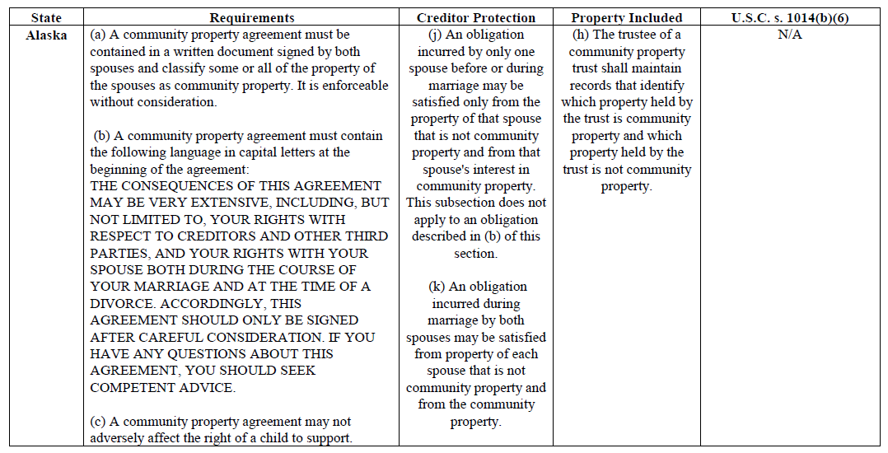
Community Property Trust Features- Alaska

Slide 217
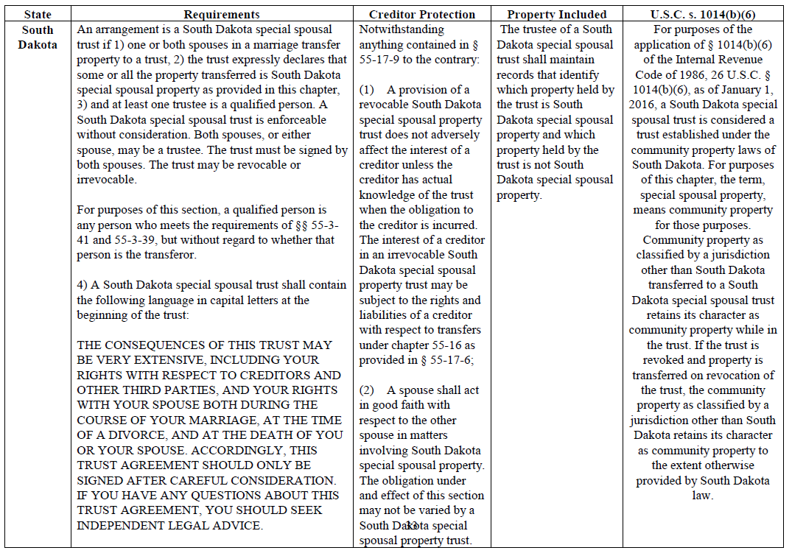
Community Property Trust Features- South Dakota

Slide 218
Community Property Trust Features- Tennessee

Slide 219
Community Property Trust Features- Kentucky

Slide 220
Will a Community Property Trust Work?
The question still stands as to whether an elective community property arrangement like the Florida Community Property Trust will be recognized by the IRS as a legitimate community property arrangement to qualify all trust assets for a fair market value date of death basis step-up under IRC Section 1014(b)(6).
Commentators who urge caution point to the 1944 U.S. Supreme Court decision of Commissioner v. Harmon, which involved a married couple who opted into community property treatment under an Oklahoma law that was passed to allow married couples living there to elect whether to have community property characterization apply to their assets.

Slide 221
Will a Community Property Trust Work?
The U.S. Supreme Court held in Harmon that the act of electing into the community property regime constituted an “assignment of income” and quoted the 1930 United States Supreme Court case of Lucas v. Earl.
Nevertheless, the 1958 United States District Court decision of McCollum v. United States seems to support the proposition that the 1014(b)(6) step-up in basis will apply to community property created as a result of an election made by the spouses.
In McCollum, a married couple elected under the then applicable Oklahoma law to treat their assets as community property under Oklahoma law in 1943, and in 1945 Oklahoma changed its law to require that all of a married couple's assets had to be considered to be community property. Mr. McCollum died after the community property status became mandatory and Mrs. McCollum took a full step-up in basis for the full value of the community property that existed on Mr. McCollum's date of death. The court allowed the full step-up in basis
  Although Oklahoma had a mandatory community property system by the time the decision was reached because the property at issue was acquired before the change of law in 1945, the property would not have been community property under the 1945 Oklahoma community property law, except by reason of the fact that the McCollum's had previously designated it as community property under the elective system.

Slide 222
Will a Community Property Trust Work?
IRC Section 1014 was enacted in 1948, only four years after the Supreme Court decision in Harmon, and it is therefore possible that Congress recognized the issue by enacting Section 1014(b)(6).
  This is evidenced by the fact that Congress made no mention in the statutory language and provided no legislative history that would distinguish between elective and mandatory versions of community property law.
Further, Section 1014(b)(6) is clear that the step-up in basis applies to the surviving spouse’s share of community property “held by the decedent and the surviving spouse under the community property laws of any State, or possession of the United States or any foreign country…” (emphasis added), without distinction for elective community property laws or without regard to unique characteristics that a State might have with respect to its community property laws (such as creditor protection features).
There are no known cases or audits of elective Community Property Trusts, so the risk of this being an issue as a practical matter may be quite small.

Slide 223
Creditor Rights in Community Property
Creditor rights vary based on the state where the community property is located. Most of the community property states allow a creditor of one spouse to reach all community property.
“Creditors Can Take It All” States
  All states, except Texas, allow collection of some post-marital obligations from 100% of community property. Some states (California, Idaho, and Louisiana) allow creditors to collect all debts of either spouse from 100% of community property. Other states (New Mexico and Nevada) only allow this with respect to post-marital obligations.
  In California, Idaho, and Louisiana, creditors of the debtor spouse can reach all community property if the debt is incurred during the marriage. Idaho and Louisiana courts have held similarly that community property can be reached to satisfy separate debts.
  New Mexico law requires the creditor to first seek payment from the separate property of the debtor spouse before being able to attempt to attach the debtor spouse's one-half ownership in the community property.

Slide 224
Creditor Rights in Community Property
“Community Debt” States
  Some states (Arizona, Washington, and Wisconsin) characterize post-marital debts as either community debt or separate debt. Community debt is debt that has been incurred to benefit the marriage or family. Community debts may be satisfied from all community property. Separate (“non-community”) debt may only be satisfied from the debtor spouse’s half of community property or from the debtor spouse’s contribution to community property. In these states, the presumption is that debts are community debts
  In Arizona, all debts incurred during the marriage are presumed to be community debt unless clear evidence is presented to show that the debt is separate. Thus, Arizona law allows creditors to reach the debtor spouse's interest in community property for payment for debt incurred prior to the marriage
  Washington statutes permit community debt to be satisfied from the community property of both spouses, and the separate property of the debtor spouse.
  Wisconsin courts divide the debts incurred after the marriage into (1) family purpose obligations; or (2) non-family purpose obligations. Debt incurred for family purpose obligations can be satisfied through the debtor spouse's separate property and all marital property, including community property. Non-family purpose obligations can be repaid by the debtor spouse's separate property and the debtor spouse's one-half interest in the couple's community property

Slide 225
Creditor Rights in Community Property
“Community Debt” States (continued)
  Texas law provides for different rules as to a creditor’s ability to access community property, depending on whether the debt results from a contract or tort claim, and whether the debt was incurred before or during the marriage.
  Under the Tennessee Community Property Act, the obligation of one spouse incurred before or during the marriage can be satisfied only from that spouse's one-half of the trust. On a spouse's death, half of the value of the trust reflects the deceased spouse's share and the other half reflects the surviving spouse's share.
  Similarly, Florida's Community Property Trust Act provides that the debts and obligations of one spouse may be satisfied from that spouse's one-half share of the trust, regardless of whether the debt or obligation is incurred before or during the marriage. As such, the Florida Community Property Trust may not be attractive to spouses who prioritize creditor protection planning due to assets owned as tenants by the entireties generally being protected from the debts and obligations of only one spouse. A joint debt or obligation of both spouses may be satisfied from the assets of the trust, which is similar to the treatment of joint debts and obligations vis-à-vis tenants by the entireties assets.

Slide 226
#13
Domestic Asset Protection Trusts

Slide 227
Discussion of Rensin and Campbell

Slide 228
Nevis, Tennessee, or Delaware
TBE APT Jurisdiction Trust
SPOUSE 1
SPOUSE 2
TBE
(Assets)
Any distributions must be made to Spouse 1 and Spouse 2 as TBE.
Tennessee, Delaware, and Nevis law provide for retention of TBE status to the extent of assets under Trust which have originated from TBE assets.
TRUST

Slide 229
Dynasty Wealth Protection Trust
Trustee
Grantor can replace the Trustee at any time and for any reason.
Protected from creditors of Grantor and family members.
Can benefit spouse and descendants as needed for health, education and maintenance.
Per Private Letter Ruling 200944002 the Grantor may be a discretionary beneficiary of the trust and not have it subject to estate tax in his or her estate. But be very careful on this! The Trust would need to be formed in an asset protection jurisdiction and there is no Revenue Procedure on this.
Should be grandfathered from future legislative restrictions.
May loan money to Grantor.
May own limited partnership or LLC interests that are managed at arm’s-length by the Grantor.
May be subject to income tax at its own bracket, or the Grantor may be subject to income tax on the income of the trust, allowing it to grow income-tax free unless or until desired otherwise. If the Grantor is a beneficiary it must remain a disregarded Grantor Trust.
DYNASTY WEALTH PROTECTION TRUST
Assets gifted to trust and growth thereon.
Note: Nevada gets a gold star for having a law that says there cannot be an assumed or an oral agreement between the Grantor and the Trustee of a dynasty trust; because of this, the IRS cannot say that the grantor retains certain control.

Slide 230
Florida and APT Jurisdiction Trust Varieties
Reciprocal Asset Protection Trusts
INCOMPLETE GIFT TRUST
FLORIDA COMPLETE GIFT TRUST
APT
COMPLETE GIFT TRUST
TRUST 1
TRUST 2
To preserve assets for marriage, management , or otherwise.
Grantor retains power to prevent distributions and testamentary power to appoint how assets pass on death - may be limited to not being exercisable in favor of creditors or creditors of estate, and exercisable only with approval of a non-adverse party not acting as a fiduciary.
Use Crummey Power for annual exclusions, or part of Grantor's exemption amount.
Held for health, education, and maintenance of individuals other than the Grantor.
Complete gift to fund - will not be included in Grantor's estate.
Grantor/Contributor cannot be a beneficiary.
Use Crummey Power for annual exclusions, or part of Grantor's exemption amount.
Held for health, education, and maintenance of individuals other than the Grantor.
Complete gift to fund - will not be included in Grantor's estate.
Under PLR 200944002, Grantor may be a discretionary beneficiary.
Beware the reciprocal trust doctrine, both under estate tax law and creditor protection law - see Gideon Rothschild's article entitled Creditor Protection - - The Reciprocal Issue for Reciprocal Trusts (It's Not Just About Estate Taxes ).
http://www.mosessinger.com/site/files/creditorprotectionreciprocaltrusts.pdf

Slide 231
Irrevocable Funded Domestic and International Wealth Accumulation Trust Categories:
Where Will Your Client Best Fit?
 | A |  | B |  | C
 | Irrevocable, Complete Gift Trust Settlor Not a Beneficiary | Shielded from future estate tax of settlor | Irrevocable, Complete Gift Trust Settlor is a Beneficiary | Shielded from future estate tax of settlor – but in case PLR 200944002 is not correct – empower a third party to deprive the settlor of distribution rights more than 3 years before the settlor dies – IRC §§ 2035 & 2036 | Irrevocable Incomplete Gift Trust Treated as if no gift occurred for federal estate and gift tax purposes – business purpose is wealth preservation for family members.
1. Most Domestic States – Including Florida | A1 Protected from creditors of the settlor, and some but not all of the creditors of the beneficiary. Exception Creditors: Support obligations: beneficiary’s child, spouse or former spouse (i.e., FL, CA, NY, NJ) Person who has provided services for the protection of the beneficiary’s interest in the trust (i.e., FL) State or U.S. claim empowered by state or federal law (i.e., public support obligations in CA) Some states have more exceptions, (i.e., criminal restitution in CA, or punitive damages arising from manslaughter or murder in NJ) Future legislation – What can they get you on next? NOTE – May benefit spouse but be careful under IRC 2036. If spouse is beneficiary cannot toggle off tax defective status unless an adverse party can approve all distributions to spouse. |  | B1 Will be subject to estate tax under IRC § 2036 because the settlor may be seen as retaining benefit by having the trust pay his/her creditors – Revenue Ruling 2004-64 |  | C1 If grantor is beneficiary there will be no creditor protection – if grantor is not beneficiary then see A1 for exceptions Any creditor may be able to reach into the trust (unless the trust flees to another jurisdiction – don’t forget the flee clause)
2. Nevada | A2 Protected from all creditors – subject to 2 year Statute of Limitations (Much safer – assuming Nevada law applies) |  | B2 IRC § 2036 should not be an issue if PLR 200944002 |  | C2 Same as A2: All creditors, 2 yr statute
3. Alaska, Delaware, and Wyoming (WY recently passed amendments to Uniform Trust Code | A3 Delaware has a 4 year Statute of Limitations and exceptions for divorcing spouse, alimony and child support, as well as for preexisting torts. Alaska has a 4 year Statute of Limitations and an exception only for a divorcing spouse. Wyoming has a 4 year Statute of Limitations and exceptions for child support, property listed on an application to obtain creditor, or for fraudulent transfers. |  | B3 PLR 200944002 indicates that Alaska is fine – but ex-spouse creditors can get into a trust and may upset the apple cart under present Alaska law. Only single clients should use Alaska? Delaware and Wyoming have more exception creditors and may be more susceptible under PLR 200944002. |  | C3 Same as A3: Delaware, Alaska, Wyoming have 4 year statutes. Delaware has exceptions for support obligations and preexisting torts. Alaska has an exception only for a divorcing spouse. Wyoming has exceptions for child support, property on an application for creditor, or fraudulent transfer.
4. Offshore – Nevis, Belize, Cook Islands | A4 Completely protected depending on jurisdiction NOTE: Must remain defective for income tax purposes – cannot toggle off except by moving the trust to the United States. |  | B4 Should be as good as Nevada – Belize has a 1 day statute |  | C4 Should work fine as in A4 – no full faith and credit clause or state law jurisdiction concerns.

Slide 232
Do Domestic Asset
Protection Trusts Work?
Nevada, Alaska and Delaware have asset protection trust statutes. But the Full Faith and Credit Clause of the U.S. Constitution provides that a judgment issued by the court in one state will be respected by the court in other states.
There are many questions regarding the effectiveness of domestic APTs. The case law is not yet fully developed on the question of whether the law of a foreign jurisdiction will apply for the determination of whether a creditor protection trust will shield trust assets from creditors of the grantor who is also a beneficiary.
  Hanson v. Denckla, 357 U.S. 235 1958 – the law of the state where the trust administration occurs will be determinative.
  In re Portnoy, 201 B.R. 685 (Bankr. S.D.N.Y. 1996) and In re Brooks, 217 B.R. 98 (Bankr. D. Conn. 1998) – assets placed in offshore APTs were not excluded from the debtor’s Bankruptcy estates.

Slide 233
#14
Foreign Asset Protection Trusts and
Foundations

Slide 234
The Anatomy of a Typical Offshore or APT State Trust Arrangement
Trust Company or professional Trust Company (located in the APT jurisdiction)
Possible U.S. – based family Co-Trustee
TRUST SETTLEMENT (AGREEMENT)
Trust Protectors – (Individuals or Trust Companies with the power to add the Settlor as a beneficiary and to change beneficiaries)
GRANTOR/SETTLOR
(Contributes to Trust)
(Possible minority interest in LLC)
Managed by Settlor or Family Member
100% or less ownership
Directly held account or accounts
Unrelated partners
LLC
LLC?

Slide 235
The Anatomy of an Asset Protection Trust
Trustee – The Trustee holds the trust assets for the benefit of the beneficiaries pursuant to the terms of the Trust Agreement.
Trust Settlement – This is the Trust Agreement, and should be drafted by competent legal counsel with an understanding of:
  The law of the jurisdiction
  United States tax law
  Trust and creditor protection law in general
Scheduled Beneficiaries – These are the initial named beneficiaries that the trust is established for. Reputable offshore trust companies will require passports, utility bills, professional letters of reference, and sometimes affidavits from each beneficiary when the trust is established.
Trust Protectors – These are individuals and/or trust companies who have certain powers over the trust:
  To change the Trustee or Trustees – commonly any replacement Trustee must be a reputable trust company or a lawyer practicing in an asset protection trust (“APT”) jurisdiction.
  The power to add beneficiaries who are not “excluded persons.”
Flee Clause a/k/a Cuba Clause – A provision that requires the Trustee to move the trust and trust assets to another jurisdiction in the event of a governmental change, or if a judicial challenge to the trust makes it possible that the trust assets would be invaded within a short period of time.
United States Judgment – A judgment from a United States Court, which means nothing whatsoever in the jurisdiction where the trust is sitused (located). In most reputable APT jurisdictions, the creditor will have to file a brand new lawsuit in the jurisdiction and obtain a new judgment against the debtor before then attempting to set aside the trust by proving that the trust is an alter ego of the settlor or a beneficiary, or that the transfer to the trust was for the primary purpose of avoiding creditors.

Slide 236
The Anatomy of an Asset Protection Trust
APT Legislation – Special laws passed in a number of offshore jurisdictions which make it extremely difficult, if not impossible, for a creditor to pierce an APT:
Contingency Fees Not Permitted – In most asset protection jurisdictions, lawyers must charge their clients by the hour, and not on a contingency fee basis.
  Belize has no statute of limitations – unless there is a judgment against the settlor in Belize on the day the trust is formed, Belize law will protect the trust.
  Court Registry deposit requirement – Nevis requires a 100,000 Nevis dollars deposit into the Court Registry before a trust can be challenged. A 100,000 Nevis dollars deposit is also required to challenge an LLC. A Nevis trust and LLC challenge will therefore require a 200,000 Nevis dollars deposit.
Conflict of Interest Considerations – Typically, there are between two to six dozen practicing lawyers in a popular asset protection trust jurisdiction. Most or all of these lawyers have done work for the more popular trust companies, and would therefore have a conflict of interest in pursuing a trust for a creditor – lawyers from outside of the country must therefore come in as “foreigners before the court” to be admitted to practice law there to challenge the trust.
Judicial Bias - The asset protection trust jurisdictions derive significant income and lawyer work, not too mention governmental fees that support the local economy. The last thing an asset protection trust jurisdiction economy needs would be a judicial decision that lets creditors into a well intended asset protection trust that was structured in advance.
Having Your Cake and Protecting it, Too - The Trustee of the APT can own a 99% limited partnership interest or the ownership of an LLC, with the entity being managed responsibly and transparently by the general partner or manager, which may be the settlor. If and when a challenge might occur, the settlor may transfer control of the subsidiary entity to the Trustee of the trust.

Slide 237
Consider the Offshore Foundation
A foundation is a special entity found in a handful of countries that include Nevis, the Bahamas, Panama, Lichtenstein, and Switzerland.
A foundation is similar to a trust, because it is held for the benefit of one or more individuals and/or charities. It can own assets and can return those assets to any beneficiary who may have contributed them.
A foundation has a manager, a secretary, and a registered agent. Typically, the secretary and registered agent will be a lawyer or trust company in the foreign jurisdiction. A trusted U.S. individual will typically be the manager.
Trust reporting requirements may be eased considerably.
Normally, a foundation will be taxed as a regular C corporation, which can be catastrophic, but it is possible for a foundation to be taxed as a trust or as a partnership, depending upon drafting and operation.
Tax filings with a foundation will be the same as applies to an offshore trust, but red tape normally required by reputable trust companies under trust arrangements will often not apply with a foundation.
In civil law jurisdictions, such as Lichtenstein, a judge does not have the power or authority to do anything but follow the exact written law. If the law says that creditors cannot reach a foundation, that is the judge’s order, and the case is otherwise dismissed.

Slide 238
Foreign Foundations
Simpler than Offshore Trusts But Equally Effective According to Offshore Statues
Available in the Bahamas, Switzerland, Panama, and More
SPOUSE 1
SPOUSE 2
TRUST FOR CHILDREN
FAMILY LIMITED PARTNERSHIP
Partners sign agreement to provide that Foundation distributions will be considered to be partnership distributions for income tax and contractual right purposes.
FOREIGN FOUNDATION
Foundation manager offshore has the power to make distributions to or for one or more of the partners, and will not be subject to charging order rules.
Trust company may act as Foundation manager, but not treated as a partnership or as an association for income tax purposes, if properly drafted.
Protected
Assets

Slide 239
Considering Offshore or Domestic Creditor Protection Trusts
Should I Stay or Should I Go?
FACTOR | NEVADA | ALASKA | ISLE OF MAN/JERSEY (Channel Island) | NEVIS | BELIZE
Asset protection law – Statute of Limitations | See Page 46 Strong/2 years – BUT full faith and credit issue | Strong/4 years – BUT full faith and credit issue | No statutory limitation on fraudulent transfer – unless import law of jurisdiction of a Co-Trustee | Strong/2 years | Strong/1 day statute!
Approximate minimal cost to open trust and annual fees. | $250 to open $1,500 per year thereafter | $750 to open $3,000 per year thereafter | $1,600 to open $1,600 - $3,300 per year thereafter | $1,750 min to open $2,500-$5,000 per year thereafter depending on value of trust | $700 fee to register; $1,100 - $2,300 per year thereafter
Risk of theft. | Very low. | Very low. | Should be very low. | Low, if you use a safe trust company. | Not sure.
Use of subsidiary entities permitted- settlor can be Manager of entity. | YES | YES | YES | YES | YES
Reputation with US courts. | Does the judge gamble? | Does the judge like cruises? | Does the judge know European history? | Does the judge like Four Seasons Hotels or Alexander Hamilton (born there). | Has the judge read SEC v. Banner Fund International, or like barrier reefs?
Commonality of use of Swiss or Bermuda depositories. | New concept | Not common | Common in these islands for centuries | Common | Common

Slide 240
Considering Offshore or Domestic Creditor Protection Trusts
Should I Stay or Should I Go?
FACTOR | NEVADA | ALASKA | ISLE OF MAN/JERSEY (Channel Island) | NEVIS | BELIZE
Use of Trust Protectors. | New concept | New concept | Since the 1700s | Normal | Normal
Quality of service. | High | High- time zone difference | British-style/time zone difference | Small town- usually good. | Mayberry RFD
Allows importation with statute of limitations tolling from inception of trust at where it was imported from? | YES if original situs has substantially similar spendthrift laws | YES | The Statute of Elizabeth provides that fraudulent transfers should be void, not subject to any limitation period | YES | YES
Toggling off is possible? | YES | YES | NOT unless there is one or more U.S. beneficiaries | NOT unless there is one or more U.S. beneficiaries | NOT unless there is one or more U.S. beneficiaries
Provides for contingency fee payments? - Number of lawyers | YES About 10,000 attorneys | YES About 4,000 attorneys | NO, about 170 attorneys in Isle of Man, and 150 in Jersey Most lawyers are conflicted | NO, about 100 attorneys Most lawyers are conflicted | NO, about 150 attorneys Most lawyers are conflicted
Rule Against Perpetuities | 365 years | 1,000 years | 150 years | Does not apply | Abolished

Slide 241
A Matter of Opinion – Reasonable Minds Will Differ
House of Bricks/House of Sticks/Soap on a Rope
HOUSE OF BRICKS | HOUSE OF STICKS | HOUSE OF STRAW | FORGET IT | SOAP ON A ROPE (PRISON)
Offshore trust in a top offshore jurisdiction? | Domestic in a top domestic jurisdiction?
Trustee controlled | Most assets under an LLC or partnership controlled by client. | Client as co-trustee and/or loosely managed LLC or partnership
Small percentage of personal assets | 50% of personal assets | The majority of assets
Business purpose besides creditor protection | Creditor protection is the sole purpose | Creditor protection is the primary purpose and last minute/domestic
No benefits paid or derived by settlor | Occasional benefits in unexpected situations or expected future retirement benefits | Significant continuing benefits | Debit card
Fully reported for all tax and disclosure purposes | Reasonable attempts to comply with reporting purposes | Haphazard reporting | Intentional non-reporting | Intentional failure to report income Intentional non-reporting
Disclosure on financial statements and otherwise | No one is misled over the arrangement | No one is intentionally misled over the arrangement | Has intentionally misled creditors (may be a crime) | Has intentionally misled a court or the Internal Revenue Service

Slide 242

Common Offshore Trust Mistakes
  Not reporting the trust and trust activities on a Form 3520, upon inception, Form 3520A each year thereafter, TD F 90-22.1 (FBAR) forms annually, and compliance with FATCA (Foreign Account Tax Compliance Act) reporting requirements.
  Not reporting trust income or not reporting income that goes into the trust.
  Being dishonest with any potential creditor, the IRS or any taxing authority with respect to the trust or its underlying operations.
  Not reporting the funding of the trust as a completed gift for gift tax purposes if the grantor has not retained a power with respect to the trust that would cause its funding to be an incomplete gift (such as the testamentary power to appoint trust assets) even if the trust will be subject to estate tax by reason of such power.
  Failure to provide that upon death, any marital deduction devise must override any discretionary power of the trustee or trust protectors to deprive the grantor’s spouse of sole lifetime beneficiary/QTIP trust or outright payment rights.
  Getting the trust assets stolen by the trustee.
  Being dishonest with any court with respect to the trust or its operations.

Slide 243
Avoid Theft
It is vital that clients utilize reputable trust companies and structures that assure that the assets they place under an APT will not be stolen.
Sometimes two trust companies from different jurisdictions will serve as Co-Trustees under the trust agreement, or a lawyer or other fiduciary may serve so that two signatures and collusion would be required before monies held in an offshore account could ever be stolen.
Some jurisdictions, like the Isle of Man and Jersey in the Channel Islands allow for the law of a co-trustee’s jurisdiction to apply.
  There are many well-funded and reputable trust companies in the Isle of Man and Jersey willing to serve as managing Co-Trustee of APT formed under the laws of a more recognized APT jurisdiction.

Slide 244
#15
Charity

Slide 245
The Very Best Creditor Protection Technique
(Give Significant Assets to a Private Foundation)
1. Tax deduction for contribution, which is controlled by the
donors, and earmarked for eventual use for charity.
2. Creditors cannot reach it.
3. Family members can receive reasonable compensation for
charitable services rendered on behalf of the Foundation.
4. Organization provisions can require that only family members
will control the organization for up to 360 years.
5. The organization can be set up as a trust, with the donors as
Trustees, to avoid state filings and annual filing costs that
would apply for a charitable corporation.
6. The organization can be the beneficiary of a Charitable Lead
Annuity Trust, but there will have to be a Chinese wall on
management for a separate identical organization, so that the
Grantor cannot manage what ends up going to charity from
the CLAT.
CHARITY

Slide 246
#16
What To Do In The
Next 30 Days

Slide 247
What To Do In The Next 30 Days -
    1. Know your liability limits for personal coverage.
    Ask for proposals to increase these.
    2. Know your liability limits for business coverage.
    Ask for proposals to increase these.
    3. Know what it will cost you to replace assets that are lost to casualty.
    4. Understand your business interruption insurance if:
    A. You are disabled.
    B. A storm or other tragedy stops your business.
    C. What else might happen?

Slide 248
What To Do In The Next 30 Days -
5. Know the owner and beneficiary and terms of each term life insurance policy.
6. Know how much coverage you need and have.
7. Have agency start informal application for new policies.
8. If you have permanent insurance – know why.
9. Have an annual physical, and consider Mayo.
10. Know how your assets are titled.
This includes any pay-on-death or beneficiary designation.

Slide 249
What To Do In The Next 30 Days -
11. Have a Will and Trust language in place, or set up an appointment to have these prepared or updated.
Set up 3 appointments, one month apart, so that you can review drafts, etc.
12. Know if your assets are protected from creditors. Set up an appointment to find out.
Personal Creditor Protection.
Business Creditor Protection.
13. Put a succession plan for your business on the agenda.
Start with a short essay on what you know that your successors may not know.
Who has business sense and integrity and who doesn’t?
Agree now who the decision making Trustee team should be if you are not there to make decisions.

Slide 250
What To Do In The Next 30 Days -
14. Put an estate plan for your parents on the agenda.
15. Make your marriage great.
16. Make your children self-supporting.

Slide 252
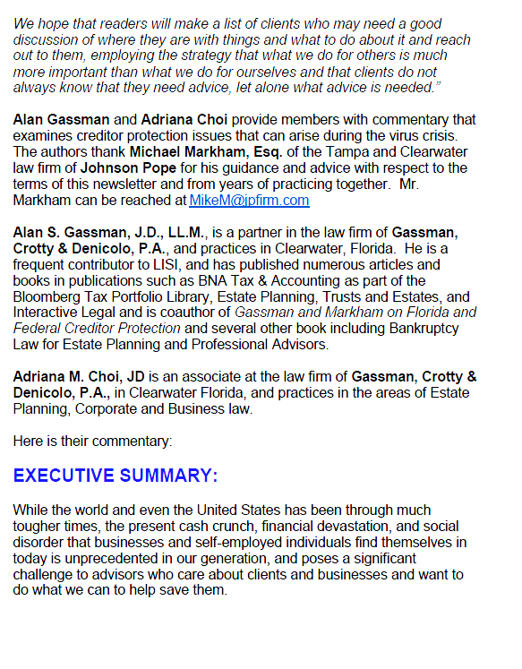

Slide 265
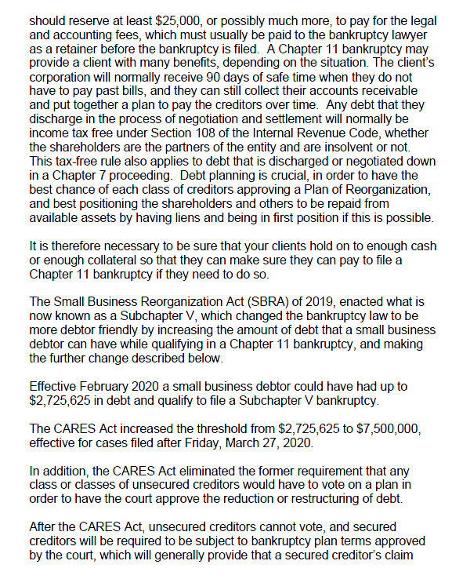

Slide 268


Slide 272
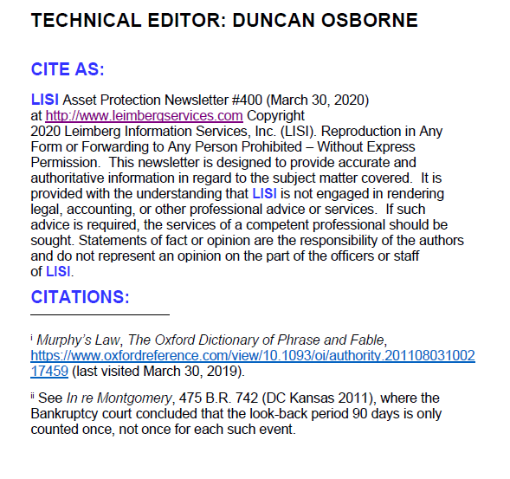

Slide 273
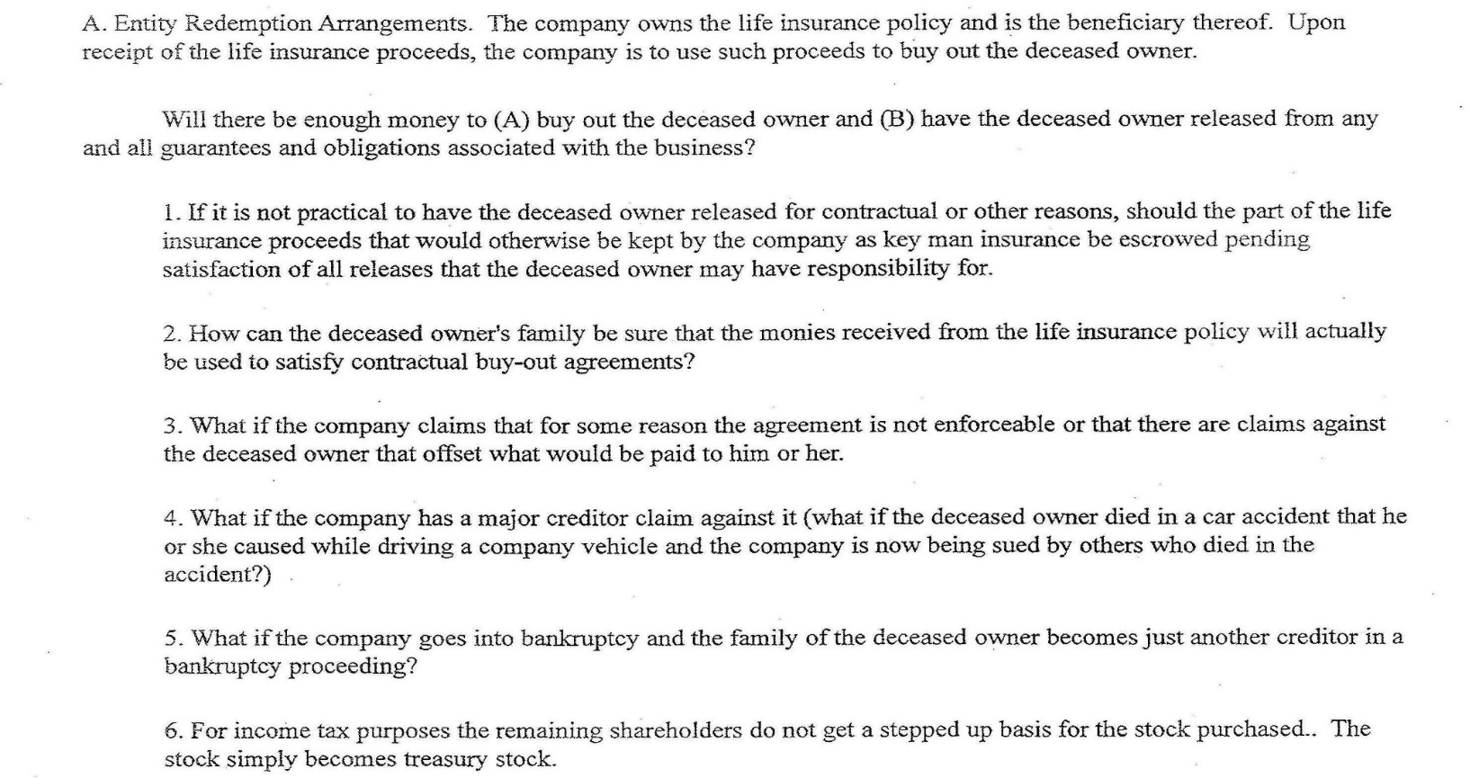
A Logical Guide to Selecting Buy/Sell Agreement Arrangements-Traditional Choices are Not Always the Best
By Alan S. Gassman, J.D., LL.M.

Slide 274
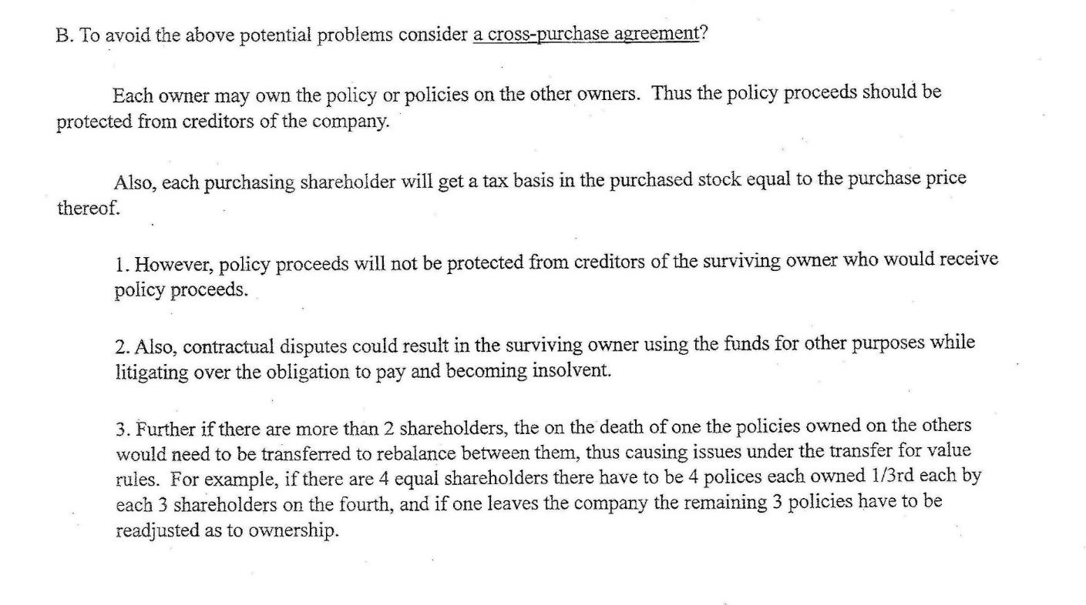
A Logical Guide to Selecting Buy/Sell Agreement Arrangements-Traditional Choices are Not Always the Best
By Alan S. Gassman, J.D., LL.M.

Slide 275
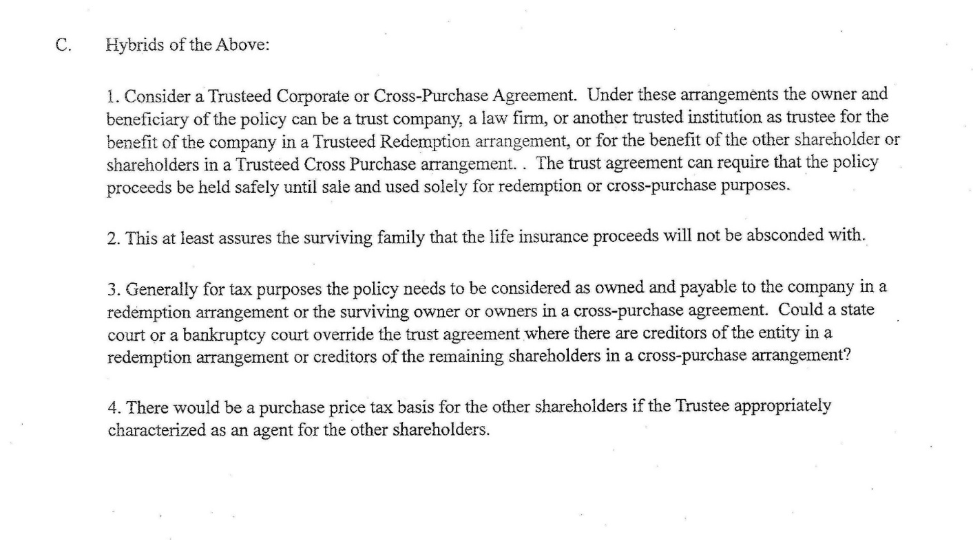
A Logical Guide to Selecting Buy/Sell Agreement Arrangements-Traditional Choices are Not Always the Best
By Alan S. Gassman, J.D., LL.M.

